Slide 1

Haystack EU 2019
Berlin, Germany
October 28th, 2019
Notes:
Hello everyone
Guten Morgen unt villkommen
Welcome to Haystack Europe 2019!
My name is Bertrand Rigaldies. I am a search consultant at OpenSource Connections – your conference host today -- and I live and work in lovely Charlottesville VA on the east coast of the US, which is also as you know the epicenter of Search Relevance R&D!

Slide 2

Quick Bio
Bertrand Rigaldies
Search Consultant
OpenSource Connections
Email: brigaldies@o19s.com
Linkedin: bertrandrigaldies
Tweeter: @brigaldies
Location: Île de Ré, France Circa: 80s
Notes:
Quick Bio -
Yes, this is me in my twenties! Any windsurfer in the audience?
I joined the fascinating field of search only three years ago after a life-long of windsurfing, I mean software development, using the other database stuff – you know, SQL (now, don’t get me wrong, I still love relational algebra, and I miss it sometimes) – But the unique challenges and issues that I have encountered thus far in my burgeoning search career have not ceased to challenge me, and so today, as a search practitioner still learning the ropes, I am honored to give the Key Note address of Haystack EU 2019. I’m also glad to be here, being a European myself, -- I was born, raised, and educated in France. And It is also my first time in Berlin.
That picture was taken at the French island Ile de Re on the Atlantic coast south of Bretagne.

Slide 3
Welcome to Haystack EU 2019
115+ attendees
50+ Companies
10+ Countries
8 Talks
2 Training Classes
Notes:
I am glad to report that Haystack EU 2019 is being attended by 115+ of you, from 50+ companies, across 10+ countries.
We will be treated to 8 exciting talks (including this Key Note) on a variety of topics that no doubt will keep us excited about our field.

Slide 4








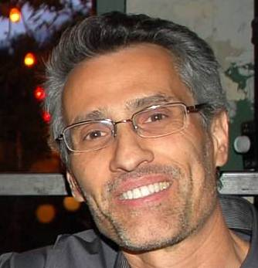
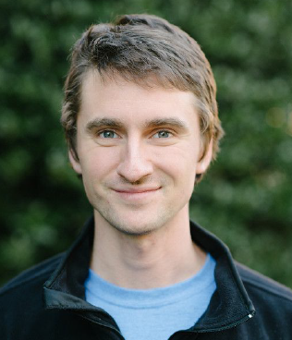



Notes:
OpenSource Connections is your host today, and these are the friendly faces behind OSC.
I would like to thank my OSC colleagues for welcoming me to their family a few years ago, and for sending me to Berlin for this conference.
And now, without any further ado let’s jump right into the Key Note.

Slide 5

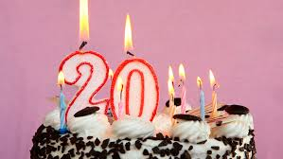

Lucene is 20 years old!
Let’s celebrate!
Mature, field-proven, reliable, and lean-and-mean search engine
Vibrant open source Lucene, Solr, and Elasticsearch communities
Wide ranges of domains and applications
Extendable platform for innovations
We’ve indexed just about everything
Scalable
We’ve battled Relevancy until money ran out!
The platform keeps getting better, and the community keeps growing
Notes:
Lucene is 20 years old! Happy Birthday Lucene!
Now, I’m not trying to show Lucene’s advanced age here. First of all, it’s not that advanced. Successful technologies can last for a long long time. Just look at Unix/Linux for example.
No, it’s a very good thing. Lucene has aged well.
So, let’s celebrate for a minute.
Lucene is mature, field-proven, reliable, and lean-and-mean search engine that embodies decades of Information Retrieval research & development.
The Lucene’s renowned inverted index might be unrivaled in terms of disk space efficiency and search and scoring performance at the moment.
Vibrant open source community
We have built a wide variety of systems in ecommerce, education, library, medical, news, legal, etc., both in the private and public sectors
We have built not only search systems of course, but also auto-suggestions, spell checking, and recommendations systems of impressive sophistication
The amount of ingenuity has been phenomenal. Every time I have attended a conference on search, I have been amazed at the new production-grade capabilities that people have been able to implement with the platform.
We have indexed not only text, but also images, sound, concepts, and various vectors models. More on vectors later.
We have scaled to very large distributed topologies with hundreds of nodes and billions of documents
We’ve battled Relevancy Until one is blue in the face
The interests in, and usages of Lucene and its eco-systems, keep increasing
By the way, the author of Lucene In Action, Erik Hatcher, who also lives in Charlottesville, I think said it would be great for someone to write the 3rd edition!

Slide 6


The Tooling Is Awesome!
Let’s appreciate our toolbox!
Notes:
I think the Tooling is awesome.
So, as a new search practitioner, allow me to show my appreciation of our toolbox for a minute.

Slide 7

Tooling - Lucene Java SDK
Op: BOOST (value: 10.0)
Parse Tree
Op: OR
new BoostQuery(
new BooleanQuery.Builder()
.add(new SpanNearQuery(
new SpanQuery[]{
new SpanTermQuery(new Term(“title”, term1),
new SpanTermQuery(new Term(“title”, term2)
}, distance, order), BooleanClause.Occur.SHOULD)
.add(…, SHOULD)
.build(),
10.0);
title:term1
title:term2
…
Notes:
Starting with the Lucene Java SDK, which I have had the pleasure to work with recently, as I have been working on a custom query parser for a client.
I was a Java Enterprise developer in a past life, and I have been impressed with Lucene’s query composition model in Java, where you can basically nest queries at any depth.
This nesting capability lends itself nicely to the generation of a query from a query parse tree; as you visit the tree depth-first, you build and nest the Lucene query components recursively. Quite neat!
The Java objects model for token filter implementation is equally well designed and pleasant to work with.
Generally, I find the Lucene JDK very approachable, which I imagine has been a factor in its success.
Low barrier to entry.

Slide 8

Tooling - A Wealth of Text Processing Widgets
Linguistic-Oriented Normalizations
Char Filters
Tokenizers
NLP
Letters N-grams
Remove/Add/Map Terms
Term N-Grams (Shingles)
Payload-based custom meta-data
Write your own!
Notes:
Then, we have the remarkable variety of text processing widgets to help us with both Recall and Precision.
We have:
Character filters
Tokenizers of various forms and specialties;
Ways to remove, add, or map terms with other terms
Perform various linguistic-oriented processing such as stemming, lemmatization, and other ways to distill a term to some kind of root;
NLP capabilities for part-of-speech and entities recognition;
N-graming techniques at the letter or term level;
A very nice term payload feature to associate custom meta-data/attributed to you term.
And this is just a sample.
And then of course, write your own text analyzer, which is a surprisingly easy thing to do thanks to the pluggability of our tooling.

Slide 9
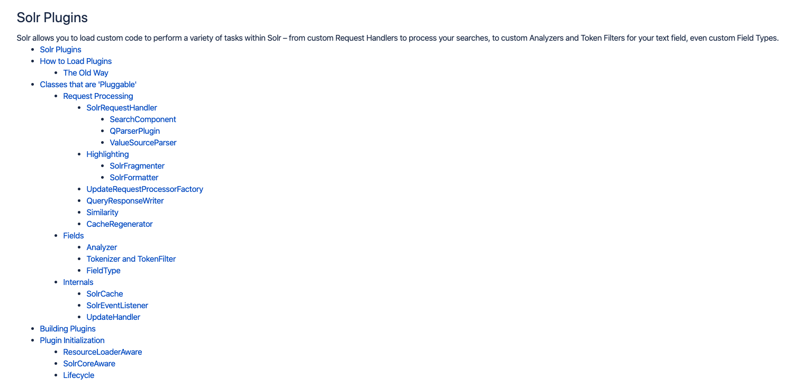
Tooling - Rich Plugins Eco-System
Token Filters
Similarity Algorithms
Query Parsers
Scorers
Highlighters
Multiple-Independent Searches
Solr Request Handler(*)
*: Activate 2019, “Elevation Query Extension: Introducing “Subselects” into Lucene Queries”, R. Kirchgessner, N. Seniuk
Notes:
And talking about pluggability, let’s also recognize that our tooling has been designed for plugins.
Maybe such plugin architecture has been a primary factor of the success of Lucene, Solr, and ES.
What sorts of plugins can we build. Many!
NEXT, NEXT, etc.
Max has good stories about custom query parser and highlighter development
And this is just a sample.

Slide 10
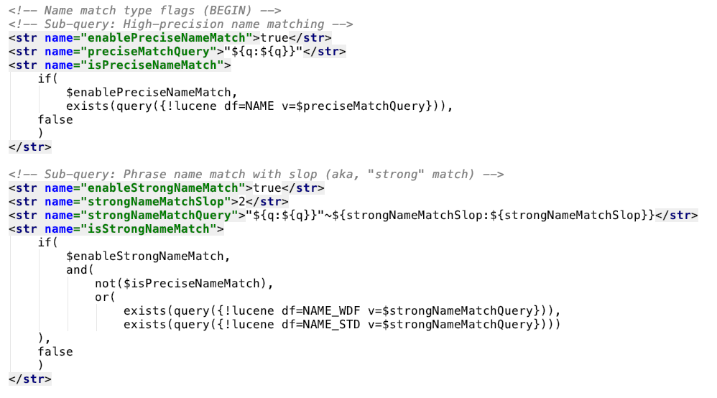
Tooling - The Joy (Or Not) Of Scripting
Notes:
And then there is scripting!
If you’re not a Java programmer, then this is your programming environment, isn’t it?
Taking Solr as an example, here is an example of either beauty or the horror of the Solr scripting.
I won’t decipher the XML for you; instead let your eyes absorb the overall structure. It looks like code, doesn’t it?
Maybe this is actually a problem. When I started working with Solr, I drove my mentor crazy with this kind of configuration. He told me once: Stop programming in solrconfig.xml; it’s configuration, not code.
Well, it’s code-through-configuration, and with I was successful in implementing complex ranking rules around tiering based on subtle notions of strong, medium-strong, and weak matching.

Slide 11

Tooling - We’re also doing A.I.
Machine Learning-based learning-to-Rank (LTR)
Deep Learning (Neural Network)-based automatic(*):
Classification
Synonyms generation
Query expansion
Auto-suggestions
Recommendations.
*: Source: Tommaso Teofili (2019), “Deep Learning for Search”, Manning.
Notes:
TITLE
And we are also increasingly taking advantage of the ready-to-use technologies that the AI, Machine Learning, and Deep Learning fields have been delivering for the past decade ago.
We seem to have come out of the last “AI Winter” with an explosion of open source libraries, toolkits, on-line classes, examples, of this stuff, and search has been an avid consumer.
[NEXT]
We teach Learning to rank at OSC. Our CTO Doug Turnbull in collaboration with others have developed the Learning to Rank plugin for ES.
What I find interesting in LTR is that after spending a year tweaking the Solr configuration I showed you in the previous slide, I came to his Ah Ha moment where I felt that a machine would be much better than a human to explore many many combinations of signals. Hence, the idea behind letting a machine find the optimum combination.
Now, of course, training an effective LTR model requires a significant amount of training data, here judgments, across the while spectrum from very relevant to irrelevant
[NEXT]
We are also starting to see the use of Deep Learning techniques combined with various methods of vectorized text (NN wants vectors as input) to build features such as:
Advanced similarity algorithms
Automatic synonyms generation
Query suggestions
Query expansion
Recommendations

Slide 12
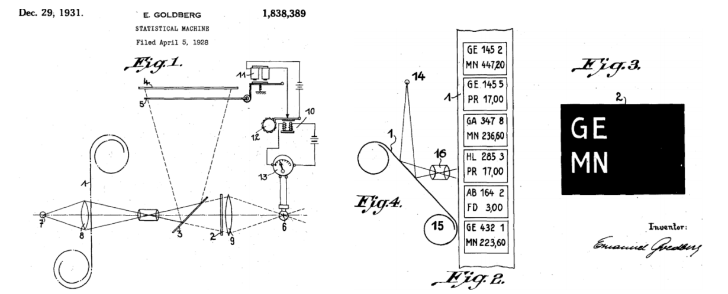
How Did All This Start?
Source: M. Sanderson, W. B. Croft (2012) “The History of Information Retrieval Research”, Proceedings of the IEEE ( Volume: 100 , Issue: Special Centennial Issue , May 13 2012 )
Notes:
As in any scientific or engineering field, we are enjoying great search technologies because we are resting on the shoulders of giants, who before us created the foundation for Information Retrieval.
So let’s also recognize their work too, and just for fun, let’s go down memory lane for a few minutes.
Background: Picture of a German 1928 patent on a mechanical device to search for information based on microfilms.

Slide 13
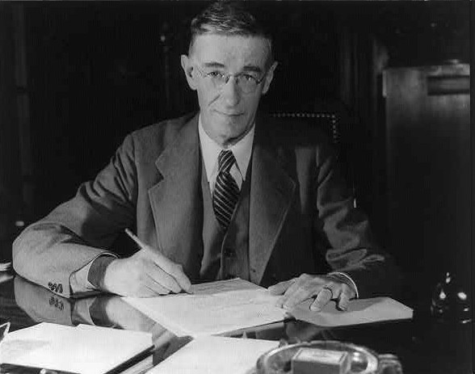
Vannevar Bush’s “Memex” Vision
“A memex(*) is a device in which an individual stores all his books, records, and communications, and which is mechanized so that it may be consulted with exceeding speed and flexibility.”
*: Portmanteau of "memory" and "index"
Notes:
Perhaps a good starting point if the vision laid out by Vannevar Bush, whose portrait you see in the background, with his Memex machine in 1945. Read quote…
I would argue that we are still working on fulfilling Vannevar Bush’s vision, and although Mr Bush did not use the IR terms ”search” or “retrieve”, he did use the verb "consult", which is interestingly richer, should I say more relevant, then “search & retrieve” in terms of the assumed man-machine dialogue.
Note also the name “Memex” as a portmanteau of the words “memory” and “index”. So, memex definitely had an index component.
Let’s fast forward from this seminal moment in computer science, and let's go through 6 decades of Information Retrieval R&D. So, stay with me!
[NEXT SLIDE]

Slide 14
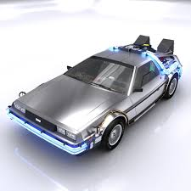
Six decades of IR in one slide!
Pre-60s
60s
70s
80s
90s
Present
”Library Problem”
Classification
Index Cards
Explosion of Knowledge
Mechanized Indexing & Searching
Seeds for Vector Space Model, Term Frequency Weighting
Foundation
Corpus-based Terms Indexing
Probabilistic Term Weight
IDF intuition
Precision vs Recall Metrics
Synonyms
Stemming
Stop Words
Build Up
Word-Word, Doc-Doc Associations
Natural Distribution of Corpus Terms
Formal IDF (1972, Jones)
Term Weighting with TF * IDF
“Probability Ranking” Hypothesis
User Focus
Text Books (Jones, Salton)
Probabilistic Models
Natural Language Queries
User Studies (Saracevic)
First Okapi Best Matching (BM) Test
IR Triumph
Internet
Web Search Engines
First TREC (Text REtrieval
Conference)
Language Modeling
BM25
Lucene (1999)
Open Source Search Engines Blossom
Lucene, Solr, ES
Scaling Up
Personalization
Recommendations
Increasing influence of AI / Machine Learning / Deep Learning
What are you working on today?
Notes:
Pre-60s: “Library Problem”
Classification Cards
Still indexing by crafting Subject Headings
Mechanize index and search
Early seeds
60s: The Foundation
- Shift from classic library science to “let’s index the corpus terms themselves”
70s: Build Up
80s: User Focus
90s: IR Triumph
Today: Open Source search engines

Slide 15

A Typical Day as a Search Engineer in 2019
Notes:
Okay, so we fast-forwarded to the present. So, let’s take a look at what a Search Relevancy engineer, someone like me, does on a typical day in2019.

Slide 16
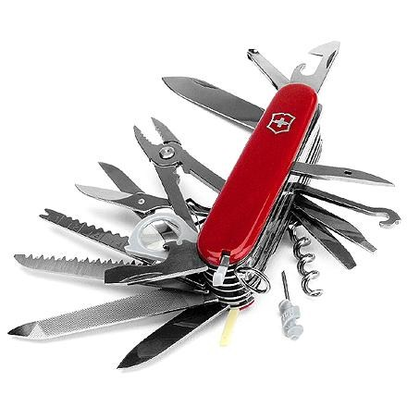
Recall Devices
Solrconfig.xml:
<str name=“defType”>edismax</str>
<str name=“qf”>title abstract body</str>
<str name=“mm”>2<75%</str>
Schema.xml:
Field types and fields for text normalization
Notes:
First we start with a high-recall query to make sure you’ve got good Recall.
This is assuming that we’ve dealt with the all the classic text processing issues of tokenization, lower casing, various forms of linguistics, etc.

Slide 17
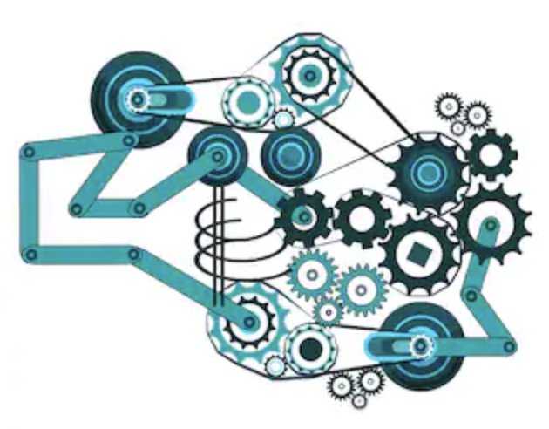
Precision Devices
qf=title^5 abstract^2 body
tie=0.5
pf2=title^2 abstract^1.5 body^0.8
ps2=2
bq={!field f=title v=$q}
boost=add(1, recip(ms(NOW,date), $m1, $a1, $b1))
boost=add(1, recip(geodist(), $m2, $a2, $b2))
Notes:
And then we do this… We try to find Relevancy “signals” that we can work with.
We act on a bunch of dials and knobs.
And as we said, the tooling is mostly great.
BUT..
[NEXT SLIDE]

Slide 18

”Whack-a-mole!”
Fix something here
Break something there
Repeat
Notes:
This methodology remains that of a whack-a-mole game: We fix something here (we wacked it), and then another mole (issue) pops up elsewhere.
We can spend months doing this!
Now, that can work; After a while, you decide that you’ve reached a local optimum that’s good enough.
So, we need a test methodology to remain sane!
We’re engineers; We like rigor, processes, and repeatability.
A significant amount of the IR literature over the past few decades has been about how to test: What Corpa, queries, and metrics to test with?
Every search project I have been on, these questions remain around test methodology, practices, and operational aspects absolutely remain.
[NEXT

Slide 19

Hypothesis-Driven Experimentation
Run an Experiment:
State a Hypothesis
Implement Changes
Deploy Changes
Run Test Queries
Evaluate the Changes
Repeat!
“Virtuous Cycle”
Many small time-boxed experiments
Accountable to Management
Fail fast!
Notes:
At OSC we’ve been honing in on a methodology akin to scientific research where we:
Make a Hypothesis (e.g., a strong match on TITLE is highly correlated with relevance);
Implement the corresponding changes (i.e., boost on title match with a high edismax mm);
Test the results (e.g., run sample queries with experts’ judgments)
Drive the chosen Recall & Precision metrics
Assert whether the relevancy metric change is statistically significant (Think rigorous Statistical Inferencing with this bullet)
And we’re reasonably successful, and we feel like we’re going through iterations of relevancy changes with some discipline we can explain to our stakeholders.
We call our virtuous cycles of experimentation.

Slide 20



“Evaluate Changes” How?
Recall Evaluation
→ Are we matching what we’re supposed to?
Traditional Functional tests-oriented
Less clear-cut as Recall Tests
“Judgments” (Subjective!)-based
Various (confusing) metrics
Moving sand
At the end, the end-users are the judges!
Relevancy Evaluation
→ Are we ranking properly?
Notes:
[TITLE]
But one step in this virtuous cycle deserves some scrutiny, and that is the Evaluation of the Changes
How do you evaluate and ultimately assert that a given set of changes actually improved Relevancy? Core to the Haystack conference series. I make a living at helping companies tune, measure, and test relevancy!
[CLICK]
Easy Part: Recall Testing
[CLICK]
Not so Easy Part: Relevancy Testing

Slide 21

Where Do We Go From Here?
We’re enjoying the fruits of 6 decades of R&D.
And, we’re basically doing term matching with a probabilistic term weight (e.g., BM25).
But, “Search is not a solved problem” - Pandu Nayak
So, have we reached some kind of plateau of tricks?
What about this “aboutness” that IR researcher Maron talked about in the 60s?
“there should be degrees of aboutness”
Are we matching more on meaning, and less on character sequences!
So, let’s go back to the Space Vector Model…
Notes:
Okay, so where do we go from here?
Read the bullets!

Slide 22


Vector/Term Space Model
Advantages over the Boolean Model:
Geometric Angle-based Relevance
Visually Intuitive;
Continuous value of similarity
Better “aboutness” than probabilistic term weights?
Term k
W_{k,d}
Doc d
Query Term n
$$θ$$
Term j
Query q
Issues with the Term Space Model:
High-Dimensionality curse ~ O(n²);
Sparse (Low density);
No sense of terms ordering
No sense of CONTEXT!
W_{j,d}
Query Term 1
Term i
W_{i,d}
Similarity(q, d) ~ Angle $θ$ ; cos($θ$) = $\frac{d . q}{\left|\left|d\right|\right| |\left|q\right||}$
Notes:
On density: The work in the 70s by Salton and his colleagues have developed the belief and somewhat proved it in various experiments the search performance, defined for example by the classic Precision vs. Recall ratios), is inversely proportional with the space density.
In other words, the closer the relevant documents are to each other for a query, the better.
See also: Generalized Vector Space Model (GVSM)

Slide 23
From Terms to “Context” Vectors
CONTEXT in languages is critical
"a word is characterized by the company it keeps”, Firth (1957)
Say Hello to ”Embeddings”
Idea: (Unsupervised) Train a Neural Network to:
Learn the context-based similarity between words (or paragraphs, docs);
Using the context provided by the corpus as training data;
Provide a function to associate each term (or paragraph, doc) to a “dense” vector.
Use the vectors to calculate similarities (e.g., cosine, Euclidian) between terms and/or docs for various use cases (query matching, synonyms generation, query suggestion, auto-clustering, classification boost, etc.)
Notes:
Fast forward to today, and we have this thing called Embeddings, that is also trying to cluster similar terms, paragraphs, and documents.
Reaching out to linguistics, we’ve known for quite some time that the semantic of words is in relation with its context.
Therefore, if we want to cluster similar docs according to their terms, we have to take into account the context the terms are used in.
This is the idea behind Embeddings:
The dense vector space created by embeddings is in accord with the early IR researchers’ intuition that the denser the better.

Slide 24


From Term to Embeddings Space Vectors
Term k
Embedding k
W_{k,d}
Doc d
W2v-Learned
Weights
Doc d
Query Term n
$$θ$$
$$θ$$
Term j
Embedding j
Query q
Query q
W_{j,d}
Query Term 1
Term i
W_{i,d}
W2v-Learned Weights
Embedding i
Sparse 100,000 dimensions
Dense 100 dimensions
Notes:
So, are vectors the thing? Are they going to take Search to the next level, hence unshackling us from terms matching and Best Match No. 25?
To make vectors more concrete, let’s whiteboard together how Embeddings could be operationalized.

Slide 25


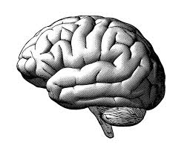

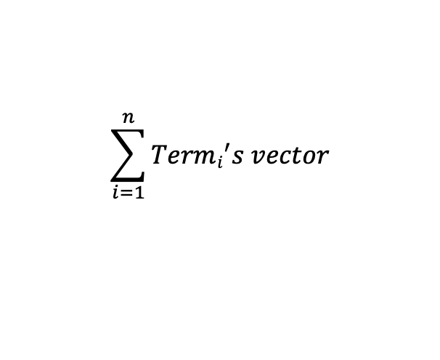
Embeddings Classification Example – Index Time
Just
Brainstorming here!
Word2vec “window”
Domain Items
c
(Classic) Text Analysis
Word2vec training
…
climate
…
change
…
Tokens Stream
Word2vec model
$$\sum_{i=1}^{n}{Termi^{′}s vector}$$
A
1
3
Payload=Doc Vector [.25, .41, …, .98]
5
$$\sim Doc vector$$
7
B
2
B
A | 1 | 3 | 5 | 7
B | 2 | 4 | 8
C | 0 | 6 | 9
Doc:
title:…
Body:…
cluster: A
4
C
8
6
K-Means Clustering
9
0
Lucene Inverted Index
Document Clusters
Notes:
At index time:
Analyze your domain’s documents as you normally would, with text tokenization and normalization;
Train a word2vec model
Produce the terms’ vectors
For each document, aggregate in some form the document’s term vectors (This is very primitive and meant to be illustrative only)
Feed the documents’ vectors into a K-Means clustering algorithm,
And voila, we have clustered our documents as Salton and his colleagues had envirioned!
Then, index each cluster’s mean vector into Lucene

Slide 26
Embeddings Classification Example – Query Time
Just
Brainstorming here!
(Classic) Text Analysis
K-Means Clustering
Query
Normalized Text
Query Vector
Word2vec model
public class MyVectorSimilarity extends Similarity {
…
private class MyVectorDocScorer extends SimScorer {
…
public float score(int doc, float[] qVector) throws IOException {
cosine(doc, qVector);
}
}
}
A
1
3
7
5
Q
B
2
B
bq={!lucene f=vector v=A}
4
C
8
Lost of implementation and operational challenges:
O(n²) computation with n=dimensions count
False positives (e.g., antonyms instead of synonyms)
My document’s vector was very primitive as an aggregate of its terms’ vectors
6
9
0
Document Clusters
Notes:
At query time:
Analyze the query’s text as you would normally do;
Generate the query’s terms’ vectors
Aggregate the query’s terms’ vectors to produce a query vector (Same process as during indexing)
Determine the closest cluster via the K-Means model
Generate a boost query for those matching documents that reside in the query’s closest cluster.
And/or, write a custom scorer to calculate the cosine distance between a document and a query and rank accordingly.
BUT, there are significant implementation issues. Max was recently educating me on this topic.
See also the ES “vector” scorer plugin.

Slide 27


We’ve got a great Haystack Conference Starting!
Improving Precision in eCommerce Searches
User’s Intent Understanding
Markov Chain-based Recommendations
Relevant Facets
Reinforcement Learning-based Ranking
Learning-to-Rank with LambdaMART
Notes:
Okay, this will be my parting thought with you today.
We’ve got a great conference today.
We will be hearing from our speakers today about:
Improving Precision in eCommerce Searches
User’s Intent Understanding
Markov Chain-based Recommendations
Relevant Facets
Reinforcement Learning-based Ranking
Learning-to-Rank with LambdaMART

Slide 28

Thank you
Notes:
Thank you for attending the conference.
Learn something new.
Meet some new people.
Share ideas.
And most importantly, have fun!

Slide 29
Some References
D. Harman (2019), “Information Retrieval: The Early Years”, Foundations and Trends in Information Retrieval: Vol. 13, No. 5, pp 425–577. DOI: 10.1561/1500000065.
C. Manning, P. Raghavan, H. Schütze (2009), ”An Introduction to Information Retrieval”, Cambridge University Press, Cambridge, England.
S. Robertson, H. Zaragoza (2009), “The Probabilistic Relevance Framework: BM25 and Beyond”, Foundations and Trends in Information Retrieval, Vol. 3, No. 4 (2009) 333–389
G. Salton, A. Wong, and C.S. Yang (1974), “A Vector Space Model for Automatic Indexing”, Information Storage and Retrieval Scientific Report No. ISR-22, Cornell University, Ithaca, N.Y., Dept. of Computer Science.
T. Saracevic (2007), “Relevance: A Review of the Literature and a Framework for Thinking on the Notion in Information Science. Part II: Nature and Manifestations of Relevance”. School of Communication, Information and Library Studies, Rutgers University, New Brunswick, NJ 08901.
T. Teofili (2019), “Deep Learning for Search”, Manning Publications Co.
D. Turnbull, J. Berryman (2016), “Relevant Search”, Manning Publications Co.

