Slide 1

Please write title, subtitle and speaker name in all capital letters
HOW TO KILL TWO BIRDS WITH ONE STONE: LEARNING TO RANK WITH MULTIPLE OBJECTIVES
HAYSTACK EU 2019
ALEXEY KURENNOY
28-10-2019
Notes:
Hi, I’m Alexey, a Data Scientist from Zalando. My talk is about multi-objective Learning to Rank.

Slide 2
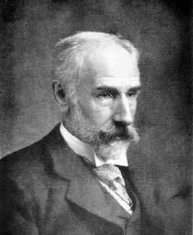
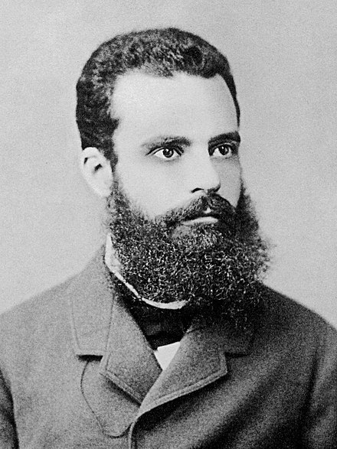
Notes:
To start with, I want to introduce these persons. They are Francis Edgeworth and Vilfredo Pareto and they are believed to (independently) come up with the notion of optimality in problems with multiple objectives. We will get back to it later but for now let’s discuss what a multi-objective optimisation problem is and why do we have to deal with such problems at Zalando.

Slide 3
MULTI-OBJECTIVE OPTIMISATION IN EVERYDAY LIFE
Product quality vs price
Hotel location vs facilities
Job satisfaction vs compensation
...
Notes:
One may think of multi-objective optimisation problems as something exotic but I can argue that it is, on the contrary, the most common situation to be in. Having multiple objectives means having several goals to achieve. Whenever you want to buy something, you usually try to find a product of the best quality but at the same time find the “best” deal or, at least, to stay on the budget. Whenever you choose a hotel, you consider the distance to the city center and the quality of the rooms. Whenever you look for a job, you care how interesting it is but also how big the compensation is and, may be, in addition, - how distant the office is from your home. You got the idea.
Not surprisingly, while working on the catalog ranking at Zalando, we also faced a multi-objective problem. But before I go into the details of that let me show you this slide that we often show.

Slide 4
ZALANDO AT A GLANCE
~ 5.4billion EUR
revenue 2018
> 300
million
visits
per
month
> 400,000
product choices
> 27
million
active customers
> 15,500
employees in
Europe
> 80%
of visits via mobile devices
~ 2,000
brands
17
countries
Notes:
On this slide, we only need the number in the orange frame. It demonstrates that the catalog of Zalando is huge and, therefore, the way we sort the fashion items when users are shopping on the website has a big impact both on the user experience and on the business KPIs.
When I joined the ranking team more than a year ago, our ultimate goal was to increase customer engagement. And we successfully achieved it by applying suitable ML techniques. However, our solution had a side effect: it was giving too much visibility to non-fashionable article. Although, many users are eventually buying them, we believe that giving too much visibility to non-fashionable items creates less of inspiration and hurts user experience and the image of Zalando in the long term. That naturally lead us to having another goal to pursue which is to keep the appearance of the catalog fashionable and inspiring. And I’m gonna tell you about our experience of applying multi-objective LTR methods to the problem of optimising user engagement and this second goal simultaneously.
[Long-sort]
[Anticipating some of your questions, I would like to add that this work is concerned with un-personalised ranking which is applied before the personalisation mechanism. I want to highlight it because you may say, wait a minute, different users are different - some of them need inspiration - others want to buy a suitable fashion item as quickly as possible. It’s absolutely true in this case we were developing an unpersonalised ranking algorithm and had to balance the different objectives.]

Slide 5
OUTLINE
Introduction
Learning to Rank recap
Multi-objective optimisation
LambdaMART recap
Multi-objective Learning to Rank with LambdaMART
Experiments
Conclusion and further steps
Notes:
So, here comes the outline of the talk. A bit late, but the good news is that we are done with the introduction. Next, we’ll have a short recap of LTR. Then I’ll present several multi-objective optimisation approaches. Then we will focus on Learning to Rank and, specifically, on the LambdaMART algorithm. Finally, I will describe our experiments and talk about conclusions and future steps.

Slide 6

LTR RECAP
MODEL TRAINING
MODEL
OBJECTIVE FUNCTION
HISTORICAL DATA
RANKING
Notes:
It is needless to say, that in modern search systems, it’s typical to have more search results the user can or is willing to explore. Therefore, after the items were retrieved they need to be sorted or ranked. The most common way of ranking items consists of ranking them by a numerical score assigned according to a scoring rule. By a scoring rule I mean a rule or a model that takes certain characteristics of an item and produces a number. The ranking consists of obtaining such numbers for all of the items in a result set and ordering the items by those numbers.
The process of generating a scoring rule by applying an ML method to historical data is called Learning to Rank. At the hart of any ML method lies an optimisation problem and a major component of an optimisation problem is its objective function. The choice of the objective function has a big impact on the resulting scoring rule and, consequently, on the ranking performance. And this is one of the levers one can use to target multiple objectives.

Slide 7
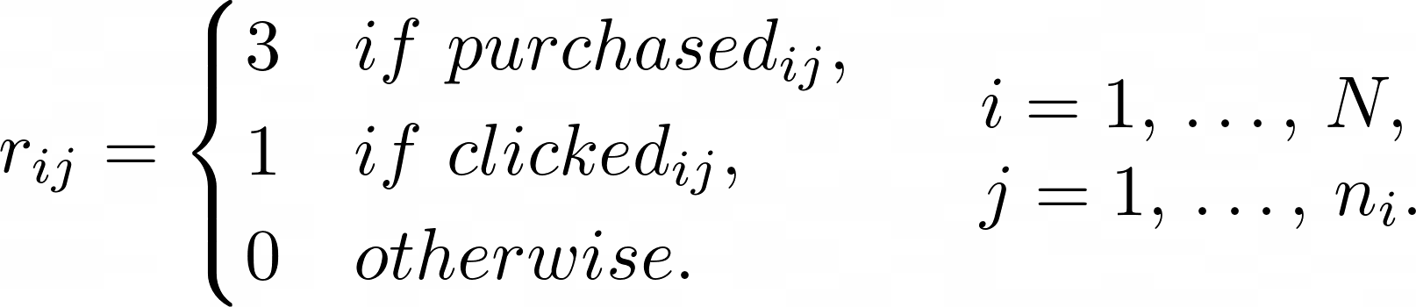

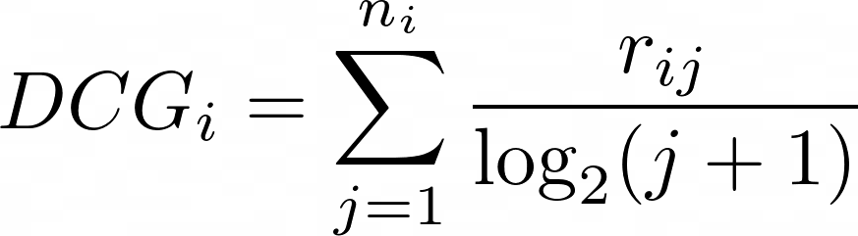
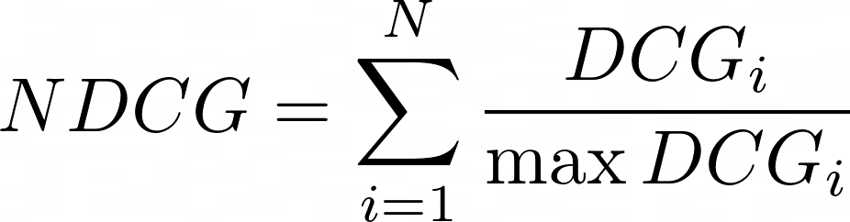
EXAMPLE: NDCG OBJECTIVE
Interaction
purchase | 3
click | 1
no interaction | 0
Notes:
To make things less abstract, let's consider an example. The objective presented on the slide is an instance of the so called Normalised Discounted Cumulative Gain. This is a popular objective in the context of Learning to Rank and most of you might be familiar with it. Here, the index i is used to enumerate result lists and the index j is used to enumerate the individual items in each result list. [Suppose, we have capital N result sets and the i-th result set has n_i items in it ranked in a certain way. In order to measure the quality of that ranking, we assign a label value to each item in each of the result sets. This label is also called relevance and is denoted by r here.] The essential part of the NDCG metric is the relevance assigned to individual items in the result lists. The relevance is a numerical label that measures how valuable the item is in the sense that, ideally, we would like to up-sort items with a large relevance. In this example, the relevance is set based on whether and how the user interacted with the item. If the user clicked on the item its relevance is set to 1, if the item was purchased the relevance is 3, and for items without any interaction it's 0. By optimising NDCG based on this definition of relevance, we are looking for a sorting rule that would up-rank those items in the data that users interacted with.
[Then, for each result set, we discount the relevances according to the positions that the respective items received in the ranking and sum them up. This gives us the so called discounted cumulative gain of the result set. Because of discounting, the DCG value is bigger when the relevant items appear higher in the ranking and hence, DCG measures how good the ranking is. Finally, we normalise the DCG of each result set by the best possible value and sum or average over the result sets in our dataset. The normalisation ensures that all of the result sets are treated equally and result sets with many interactions are not given a higher preference. The average Normalised DCG value can be used as an objective in an ML algorithm.]

Slide 8
WHY A SINGLE OBJECTIVE MAY BE NOT ENOUGH?
Different types of user feedback (implicit vs explicit)
Different sources of feedback (user vs annotator)
E-Commerce: engagement vs post-order experience
E-Commerce: engagement vs fashionability
Notes:
The NDCG based on the definition of relevance that I've just described is suitable when our goal is to improve user engagement. However, first, there can be other definitions of relevance leading to a better user engagement - for example, instead of user interactions one may use the explicit feedback (that is their likes or dislikes) or the evaluations made by human assessors such as fashion experts in Zalando’s case. And second, improving user engagement may not be the only goal. At Zalando, for example, we also care about the post order customer experience and thus we may want to reduce the number of returns or the delivery times. Finally, as I mentioned before, optimising for user engagement alone in the context of fashion can lead to up-ranking popular but non-fashionable articles.
Optimising the objective presented on the previous slide may not be enough for achieving such additional goals.

Slide 9
MULTI-OBJECTIVE OPTIMISATION
a dominated solution
objective # 2
objective # 1
Notes:
The difficulty in optimising several objectives is that there is usually a trade-off between them and there doesn’t exist a single best solution from the viewpoint of all the objectives. It doesn’t mean though that all possible solutions are equal. Some solutions can be dominated by others. Domination means that we can improve some of the objectives without hurting any of the others. For example, on the plot here, gray dots correspond to solutions that are dominated. Say, if we consider this gray dot, both objective 1 and 2 can be improved by moving to this dot or this one.
It makes sense to focus only on those solutions that can’t be dominated. Such solutions are called Pareto-efficient and that’s how optimality is understood in the context of multi-objective optimisation.

Slide 10
MULTI-OBJECTIVE OPTIMISATION
a Pareto-efficient solution
a dominated solution
objective # 2
objective # 1
Notes:
On the plot here, orange points represent Pareto efficient solutions. Gray dots correspond to solutions that are not Pareto efficient. The set of all pareto solutions is called the Pareto frontier. When we optimise, say, for objective_1 alone, it is natural to expect that we end up roughly in the rightmost orange dot. However, the value of objective_2 corresponding to that solution may be too low. Instead, we may want to be somewhere in the middle of the Pareto frontier. The question is, of course - how to get there?

Slide 11
MULTI-OBJECTIVE OPTIMISATION
a Pareto-efficient solution
a dominated solution
objective # 2
the Pareto frontier
objective # 1
Notes:
The set of all pareto solutions is called the Pareto frontier.
When we optimise, say, for objective_1 alone, it is natural to expect that we end up roughly in the rightmost orange dot. However, the value of objective_2 corresponding to that solution may be too low. Instead, we may want to be somewhere in the middle of the Pareto frontier. The question is, of course - how to get there?

Slide 12

HOW TO SEARCH FOR PARETO SOLUTIONS?
Notes:
We will now consider several approaches one can take. When we have a certain ranking metric to optimise there is typically an underlying item relevance definition that the metric is based on. [Just as in the example before we had a relevance defined in terms of customer interactions and formulated an instance of NDCG on top of that.]
So let's consider two definitions of relevance (r' and r'') and two ranking objectives based on those relevance definitions.

Slide 13
HOW TO SEARCH FOR PARETO SOLUTIONS?
Post-augmentation of the sorting rule
Notes:
The first approach to solving a multi-objective optimisation problem is to optimise one of the objectives and then modify the resulting solution. In the customer engagement and fashionability example, we may build a model by optimising the NDCG based on user interactions and then multiply the scores of the model by a fashionability score.

Slide 14
HOW TO SEARCH FOR PARETO SOLUTIONS?
Post-augmentation of the sorting rule
Redefining the relevance
Notes:
Another approach would consist of combining the two relevances into a single one and optimising an objective based on the resulting "combined" relevance.

Slide 15
HOW TO SEARCH FOR PARETO SOLUTIONS?
Post-augmentation of the sorting rule
Redefining the relevance
Interaction
purchase, fashionable | 7
purchase, non-fashionable | 3
click | 1
no interaction | 0
Notes:
For example, in the engagement-fashionability case, we may redefine the item relevance to account for both interactions and fashionability. Say, we may set the relevance of an item to 0 if the user didn’t interact with the item, to 1 if there was a click, to 3 if the item was purchased but it is not fashionable and 7 if the item was purchased and it is fashionable.

Slide 16

HOW TO SEARCH FOR PARETO SOLUTIONS?
Post-augmentation of the sorting rule
Redefining the relevance
Scalarization
Notes:
The third multiobjective optimisation approach is called scalarization. It consists of combining the multiple objectives into a single scalar function and optimising that "combined" objective. The most straightforward way is just to form a linear combination of the multiple objectives.

Slide 17


SCALARIZATION
combined objective
Notes:
Scalarization can be illustrated as follows. Let’s denote the values of the two objectives with gray dots. Then the value of the combined objective will lie on the segment connecting the two gray dots. And the position on the segment is determined by the value of alpha.

Slide 18
SCALARIZATION
Produces only Pareto optimal solutions
Allows finding any Pareto optimal solution (under certain assumptions)
Straightforward to apply when there are more than two objectives
Notes:
Scalarization has several properties. First, every solution it produces is necessarily Pareto-efficient. Second, under certain assumptions, every Pareto-efficient solution can be found using scalarization with a suitable value of alpha. Finally, in contrast to the previous approaches, it is more straightforward to apply scalarization when there are more than two objective metrics.

Slide 19
HOW TO CHOOSE AMONG PARETO SOLUTIONS?
selected solution
objective # 2
objective # 1
Notes:
Since there normally exist many Pareto-efficient solutions, we need to select among them. Let’s say, we applied scalarization with different alpha values and generated a set of Pareto efficient solutions. Which of them should we pick to bring to production? To make our choice, we can impose a constraint on one of the objectives and pick the Pareto-efficient solution that maximises objective 1 while satisfying the constraint. The constraint can be set based on the existing baseline. For example, let one of the gray dots be the current model used in production. We can decide that we want to maintain our objective 2 at least at the level of the current baseline and then select a solution with the best value of objective 1 among those that satisfy this constraint. In the picture on the slide, the rightmost solution above the line would be the selected in this case.

Slide 20
HOW TO SEARCH FOR PARETO SOLUTIONS?
Post-augmentation of the sorting rule
Redefining the relevance
Scalarization
Constrained optimisation
(Momma et. al. Multi-objective Relevance Ranking. SIGIR 2019)
Notes:
I should note that in such a setup one can also directly use a constrained learning to rank approach. Constrained learning to rank is an area of research at the moment. If you would like to use constrained learning to rank I’d recommend looking into a recent paper on the subject from the SIGIR conference that I link the slide to. We didn’t use the constrained learning to rank approach in our experiments.

Slide 21

LAMBDAMART RECAP
A boosting algorithm for optimising ranking metrics (such as NDCG)
Iteration:
  compute the lambda-gradient
  construct a tree that approximates the lambda-gradient and add it to the ensemble
Notes:
Now I will describe how one can implement the scalarization approach using the LambdaMART algorithm. As a short recap, LambdaMART is a boosting ML method for optimising ranking metrics such as NDCG. Its iteration consists of two steps. On the first step, we find the "lambda"-gradient. The "labmda"-gradient has as many values as there are items in the ranked lists used for training. For each item in each result set, the "lambda"-gradient value can be interpreted as the desired change in its current score that we would like to make.
On the second step, the computed lambda-gradient is fit by a decision tree and the newly grown tree is added to the ensemble.
the gif for the lambda-gradient

Slide 22
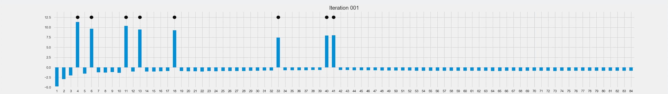
LAMBDAMART RECAP
A boosting algorithm for optimising ranking metrics (such as NDCG)
Iteration:
  compute the lambda-gradient
  construct a tree that approximates the lambda-gradient and add it to the ensemble
Notes:
Now I will describe how one can implement the scalarization approach using the LambdaMART algorithm. As a short recap, LambdaMART is a boosting ML method for optimising ranking metrics such as NDCG. Its iteration consists of two steps. On the first step, we find the "lambda"-gradient. The "labmda"-gradient has as many values as there are items in the ranked lists used for training. For each item in each result set, the "lambda"-gradient value can be interpreted as the desired change in its current score that we would like to make.
On the second step, the computed lambda-gradient is fit by a decision tree and the newly grown tree is added to the ensemble.
the gif for the lambda-gradient

Slide 23

MULTI-OBJECTIVE OPTIMISATION WITH LAMBDAMART
Notes:
Now, suppose we have two ranking metrics based on two different "relevances", and we want to optimise a linear combination of the two. In order to do that, we can compute the lambda-gradient for each of the two metrics, form a combination of the lambda-gradients with the respective coefficients, and use it during the tree construction.

Slide 24
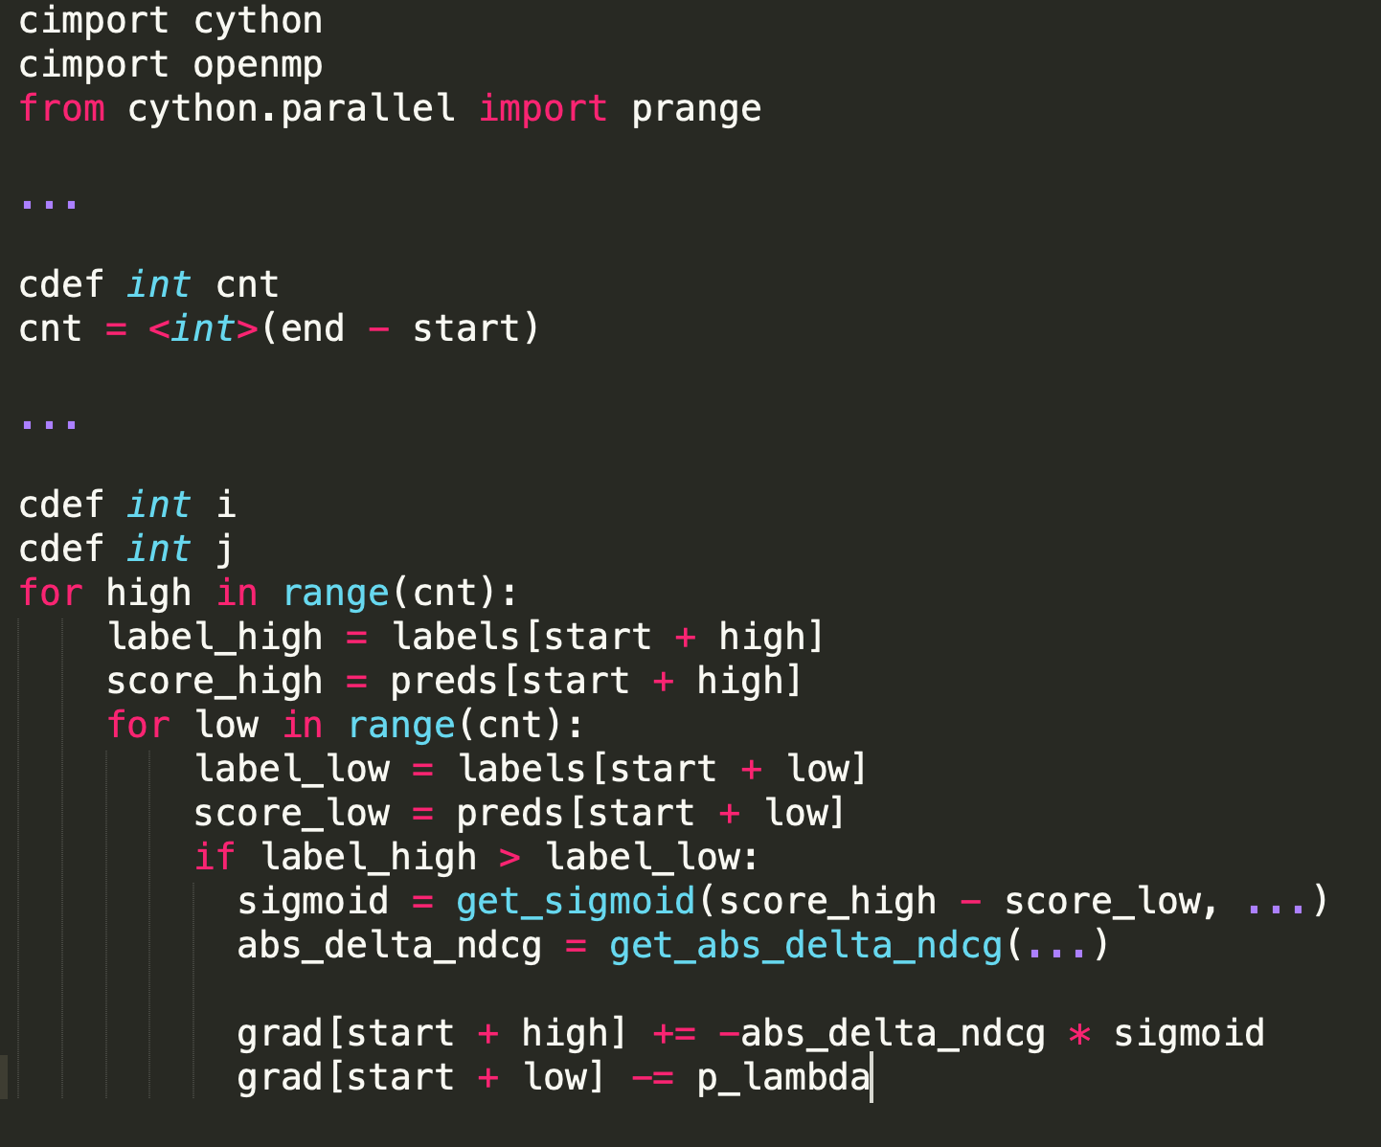
IMPLEMENTATION
Used Cython
Parallelisation by means of OpenMP
~5x speed-up (Dual-Core Intel Core i5)
The speed is on par with the original implementation
Notes:
We implemented scalarization using LightGBM. LightGBM allows passing a custom function for computing the lambda gradient to the train procedure. Our custom objective implementation is in Cython. Since lambda-gradient can be computed independently for each result list, the computation is straightforward to parallelise. We used OpenMP to parallelise the computation of the gradient. The parallelisation made computations approximately 5 times faster on a local machine with two cores but the effect may be different depending on the processor architecture. After parallelisation, the speed was roughly the same as that of the original LightGBM implementation.

Slide 25

OFFLINE EXPERIMENTS: SETUP
Result pages from Zalando catalog (~50K pages)
Two objectives:
  Interaction NDCG
  Fashionability NDCG (relevance = fashion score)
Goal: up-sort popular but fashionable articles
Notes:
For our experiments, we used the data from the fashion catalog of Zalando. The data consists of result pages generated while the users were browsing the catalog or searching for something in it. The data set consisted of roughly 50K ranked lists). For each result list, we know which fashion articles were displayed on it and which interactions they received from the user. We used two objectives. The first of them was NDCG with the relevance defined based on the user interactions. The second objective was an NDCG too but its relevance was set to a certain fashion score of the article. By optimising these two objectives jointly, we wanted, on one hand, to increase customer engagement and, on the other hand, to prevent non-fashionable articles from getting too much visibility.
(why subsampling)

Slide 26
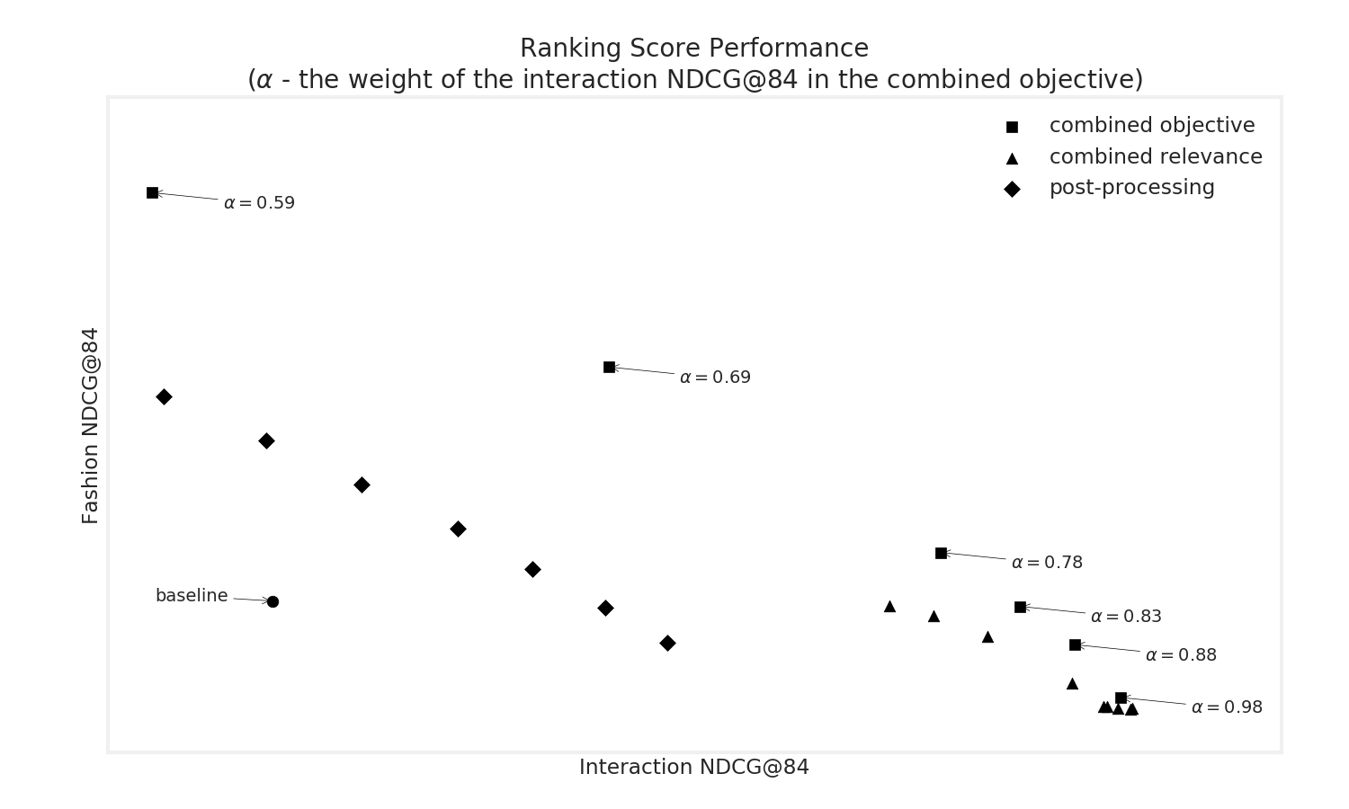
OFFLINE EXPERIMENTATION: RESULTS
Notes:
This plot shows the results of experimentation with different multi-objective optimisation methods. The circle is our existing baseline. The diamonds were obtained by means of optimising the interaction NDCG and subsequent post-processing. The triangles correspond to different instances of the approach that consists of using a "combined" relevance definition. The squares represent scalarization. As you can see, scalarization was dominating the other two approaches. And was a good candidate for subsequent online testing. However, some further investigation showed that the respective solution had some undesirable behaviour.

Slide 27
OFFLINE EXPERIMENTATION: RESULTS
Visibility of popular but non-fashionable articles went UP
Visibility of fashionable but unpopular articles went UP
Visibility of fairly popular and relatively fashionable articles went DOWN
Notes:
However, the online behaviour of the respective sorting rule was quite different from what we expected. Instead of giving more visibility to popular and fashionable items, the rule was giving more visibility to either popular OR fashionable articles.
example of a page with both gradients

Slide 28
CONCLUSIONS
A Pareto-efficient solution in ranking can lead to a “mixed” effect
Evaluation in the “multi-objective” space may not be reliable
Notes:
So, in the context of ranking, multi-objective optimisation can lead to a mixed effect. That is, if you optimise two objectives, you may end up with a model which up-ranks items that are very relevant from the viewpoint of the first objective and items that are very relevant from the viewpoint of the second objective but down-sorts items that are fairly relevant from the viewpoint of both objectives.
Because of this “mixed” effect, a dominating solution can be no better than a dominated one and the evaluation in the multi-objective space becomes unreliable. In our case, we had a model that was better than the baseline in terms of both our objectives but didn’t proceed with it because of the undesirable “mixed” effect.

Slide 29
FUTURE STEPS
Experimenting with the “combined” relevance
Experimenting with dataset augmentation
Notes:
In the future, we are planning to further explore the “combined” relevance approach. Moreover, we want to try out the dataset augmentation approach - for example, to build our model using data generated by users who buy fashionable articles.

Slide 30
P.S.
No birds were killed during the preparation of this talk.
Notes:
I would like to finish the talk with this short disclaimer. Thank you!

