Slide 1

Query Intelligence
Erica Lesyshyn | Principal Software Engineer

Slide 2



INSERT SCREENSHOT HERE
Source: Medscape EM Physician Compensation Report 2017

Slide 3
precision
recall

Slide 4
Agenda
KNOWLEDGE GRAPH
UNDERSTANDING
USER INTENT
MEDICAL SEARCH PLATFORM
QUERY INTELLIGENCE
PROBLEM
SOLUTION
NEXT STEPS
TUNING
PERSONALIZATION
GUIDED DISCOVERY
KNOWLEDGE GRAPH RELATIONSHIPS
GOLDEN SETS
WORKFLOW COMPARISON
SURVEYS

Slide 5

  KNOWLEDGE GRAPH
Source: Medscape EM Physician Compensation Report 2017

Slide 6
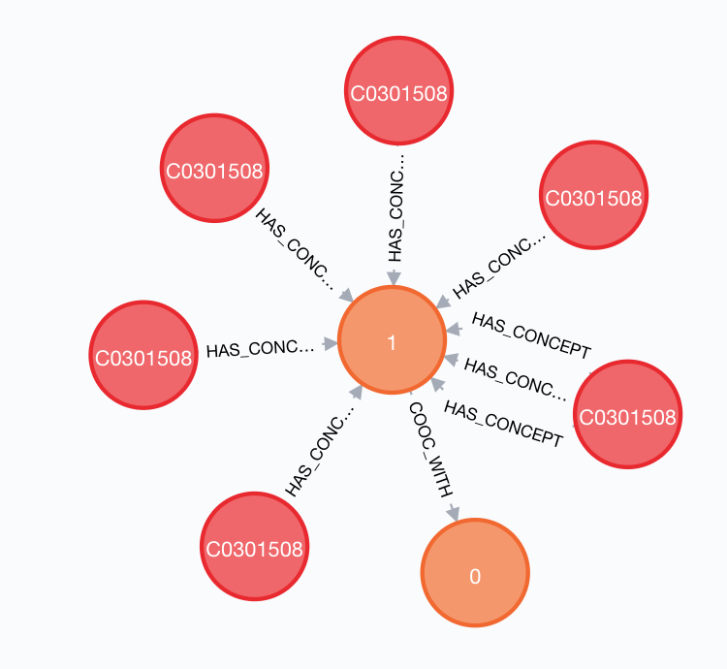
Medical Knowledge Graph
Full vocabulary
Concepts: 300,000
TERMS: 1,600,000
10+ DATA SOURCES
languages: 21
RELATIONSHIPS: 6,200,000

Slide 7
Medical Knowledge Graph
Runtime vocabulary
Concepts: 300,000
Synonyms: 670,000
Hypernyms: 430,000
Hyponyms: 450,000

Slide 8
Medical Knowledge Graph
CONTENT
ENRICHMENT
QUERY
SEGMENTATION

Slide 9
Keyword to Concept Mapping
NURSING
INFANT BREASTFED
BREAST FED (FINDING)
169741004
BREAST FED INFANTS
BREAST-FEEDING
BREAST FED
BREAST FEED

Slide 10
Query Segmentation
PARALYSIS FACIAL NERVE
QUERY | MAPPED CONCEPTS
PARALYSIS FACIAL NERVE | 44695005 60389000 56052001
PARALYSIS NERVE FACIAL | 44695005 60389000 256864008 89545001
NERVE PARALYSIS FACIAL | 256864008 44695005 60389000 89545001
NERVE FACIAL PARALYSIS | 280816001 256864008
FACIAL NERVE PARALYSIS | 280816001
FACIAL PARALYSIS NERVE | 280816001 256864008

Slide 11
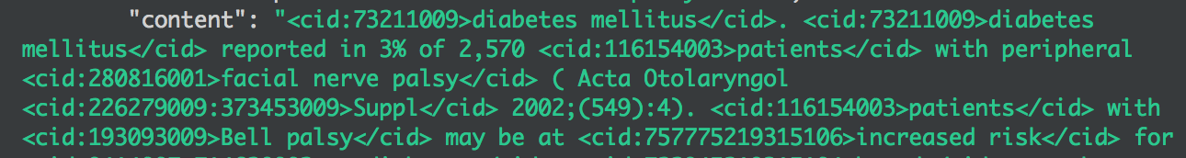
Query Segmentation
PARALYSIS FACIAL NERVE
QUERY | MAPPED CONCEPTS
FACIAL NERVE PARALYSIS | 280816001

Slide 12
Query Segmentation
Keyword to concept mapping
PARALYSIS FACIAL NERVE
PARALYSIS
FACIAL
NERVE

Slide 13
Query Segmentation
Keyword to concept mapping
PARALYSIS FACIAL NERVE
PARALYSIS
FACIAL NERVE

Slide 14
Query Segmentation
Keyword to concept mapping
PARALYSIS FACIAL NERVE
FACIAL NERVE PARALYSIS

Slide 15
Fuzzy Matching
NURSING
INFANT BREASTFED
BREAST FED (FINDING)
169741004
BREAST FED INFANTS
BREAST-FEEDING
BREAST FED
BREAST FEED
What about breastfed?

Slide 16
Fuzzy Matching
TERM | MEANING
SED SYNDROME | DISORDER OF BONE GROWTH THAT RESULTS IN DWARFISM
SEID SYNDROME | CHRONIC FATIGUE SYNDROME
NERVE VII | FACIAL NERVE STRUCTURE
NERVE VI | ABDUCENS NERVE STRUCTURE
NERVE V | TRIGEMINAL NERVE STRUCTURE

Slide 17
  UNDERSTANDING
  USER INTENT
Source: Medscape EM Physician Compensation Report 2017

Slide 18

Medical Knowledge Graph
Ambiguous acronyms
AMNIOTIC FLUID
ATRIAL FIBRILLATION
ASCITIC FLUID
ALDEHYDE FUCHSIN STAIN
ANTERIOR DISPLACEMENT
ANULUS FIBROSUS
AF
AURANOFIN
AFLATOXIN
ATRIAL FLUTTER
ASPERGILLUS FUMIGATUS

Slide 19
QUERY
BREAST CANCER
CHEMOPREVENTION OF BREAST CANCER
BREAST CANCER IN WOMEN
INFLAMMATORY BREAST CANCER
T
I
T
L
E
S
BREAST CANCER SCREENING
RISK FACTORS FOR BREAST CANCER
TUMOR MARKERS IN BREAST CANCER
MAMMOGRAPHY FOR BREAST CANCER

Slide 20
QUERY
BREAST CANCER
CHEMOPREVENTION OF BREAST CANCER
BREAST CANCER IN WOMEN
INFLAMMATORY BREAST CANCER
T
I
T
L
E
S
BREAST CANCER SCREENING
RISK FACTORS FOR BREAST CANCER
TUMOR MARKERS IN BREAST CANCER
MAMMOGRAPHY FOR BREAST CANCER

Slide 21
Medical Knowledge Graph
Doesn’t always represent the intent of the user
CLUSTER HEADACHES
MIGRAINOUS NEURALGIA
CRAINIAL PAIN
PAIN IN THE HEAD
HEADACHE

Slide 22
Medical Knowledge Graph
Doesn’t always represent the intent of the user
Headache
Side effect
symptom
Drug content
Condition content

Slide 23
Medical Knowledge Graph
Bridging a gap between precision and content
ZOLOFT PREGNANCY
ZOLOFT
PREGNANCY

Slide 24
Medical Knowledge Graph
Query expansion reduces precision
ANTIDEPRESSANT
UROGENITAL FUNCTION
SEROTONIN INHIBITOR
FEMALE function
SERTRALINE
SEXUAL FUNCTION
ZOLOFT
PREGNANCY
ZOLOFT PREGNANCY

Slide 25
Medical Knowledge Graph
Bridging the gap between precision and content
ANTIDEPRESSANT
SEROTONIN INHIBITOR
SERTRALINE
ZOLOFT
PREGNANCY
ZOLOFT PREGNANCY

Slide 26
Medical Knowledge Graph
Comparing two substances
ZOLOFT WELLBUTRIN
ZOLOFT
WELLBUTRIN

Slide 27
Medical Knowledge Graph
Comparing two substances
ANTIDEPRESSANT
SEROTONIN INHIBITOR
ANTIDEPRESSANT
SERTRALINE
ZOLOFT
WELLBUTRIN
ZOLOFT WELLBUTRIN

Slide 28
Medical Knowledge Graph
Comparing two substances
HUMIRA RUBBING ALCOHOL
HUMIRA
RUBBING ALCOHOL

Slide 29
Medical Knowledge Graph
Pharmaceutical biologic product
Pharmaceutical biologic product
Musculoskeletal drugs
Pharmaceutical fluid solution
Adalimumab
Isopropyl alcohol
Humira
Rubbing alcohol
Humira rubbing alcohol

Slide 30
Clinical Intent
Understanding the practitioner
MONITORING
TREATMENT
DIAGNOSIS
PREVENTION

Slide 31
Search Strategies
Strategy 2
Strategy 3
Strategy 1
Strategy 4
Strategy 6
Strategy 5
Strategy 7
prevention
diagnosis
treatment
monitoring

Slide 32
Query Intelligence
Medical Knowledge Graph
Clinical Intent
Search Recommendations
MEDICAL KNOWLEDGE GRAPH
intelligent
Plug-ins
intent recommendations

Slide 33
Query Intelligence
Intelligent plug-ins
semantic
Content type
Concept expansion
Content structure
Population
categories
gender
contextualization
personalization
Preferred acronyms
Guided discovery
Click-thru rate

Slide 34
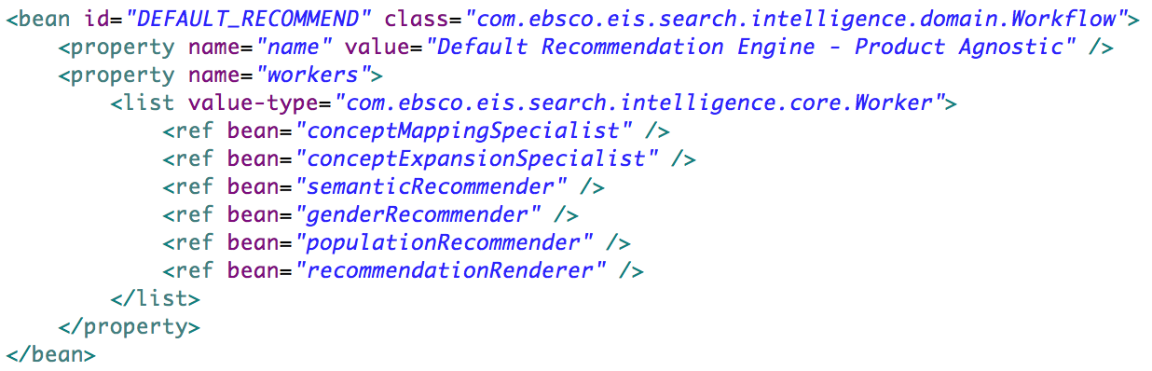
Query Intelligence

Slide 35
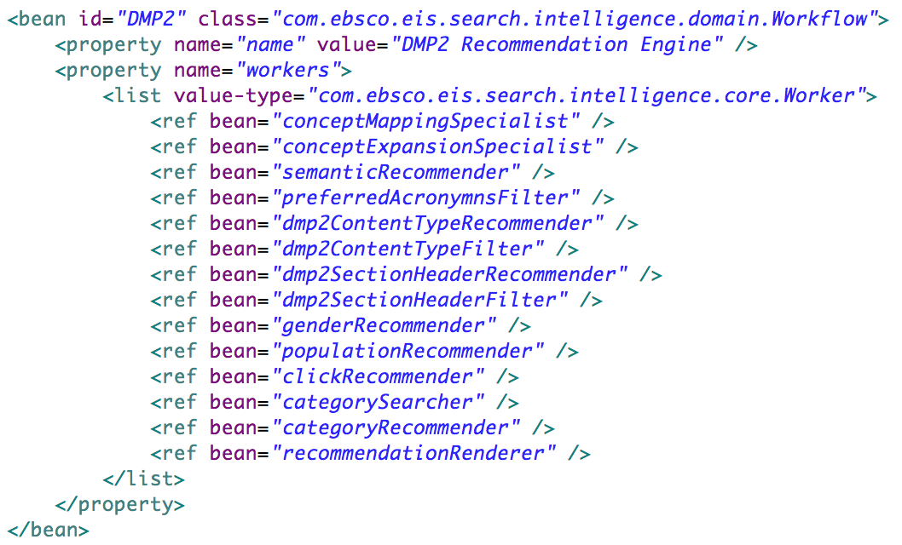
Query Intelligence

Slide 36
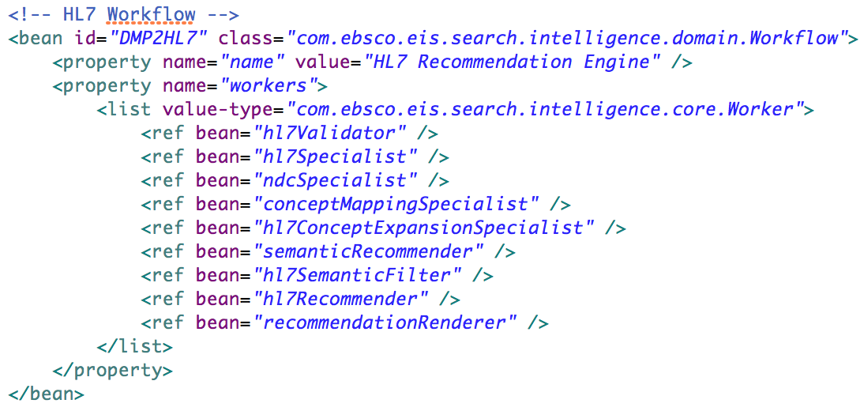
Query Intelligence

Slide 37
Search Runtime
MEDICAL SEARCH
PLATFORM
Query INTELLIGENCE
PREPROCESSORS
WHAT IS THE USER INTENT?
ELASTICSEARCH
SEARCHERS
RUNTIME SEARCH STRATEGIES

Slide 38
  QUERY INTELLIGENCE
  MEDICAL SEARCH PLATFORM
Source: Medscape EM Physician Compensation Report 2017

Slide 39
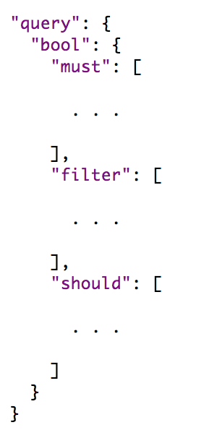
QUERY INTELLIGENCE
MEDICAL SEARCH PLATFORM
SEARCH
RECOMMENDATIONS
MATCHING CRITERIA
RANKING CRITERIA

Slide 40
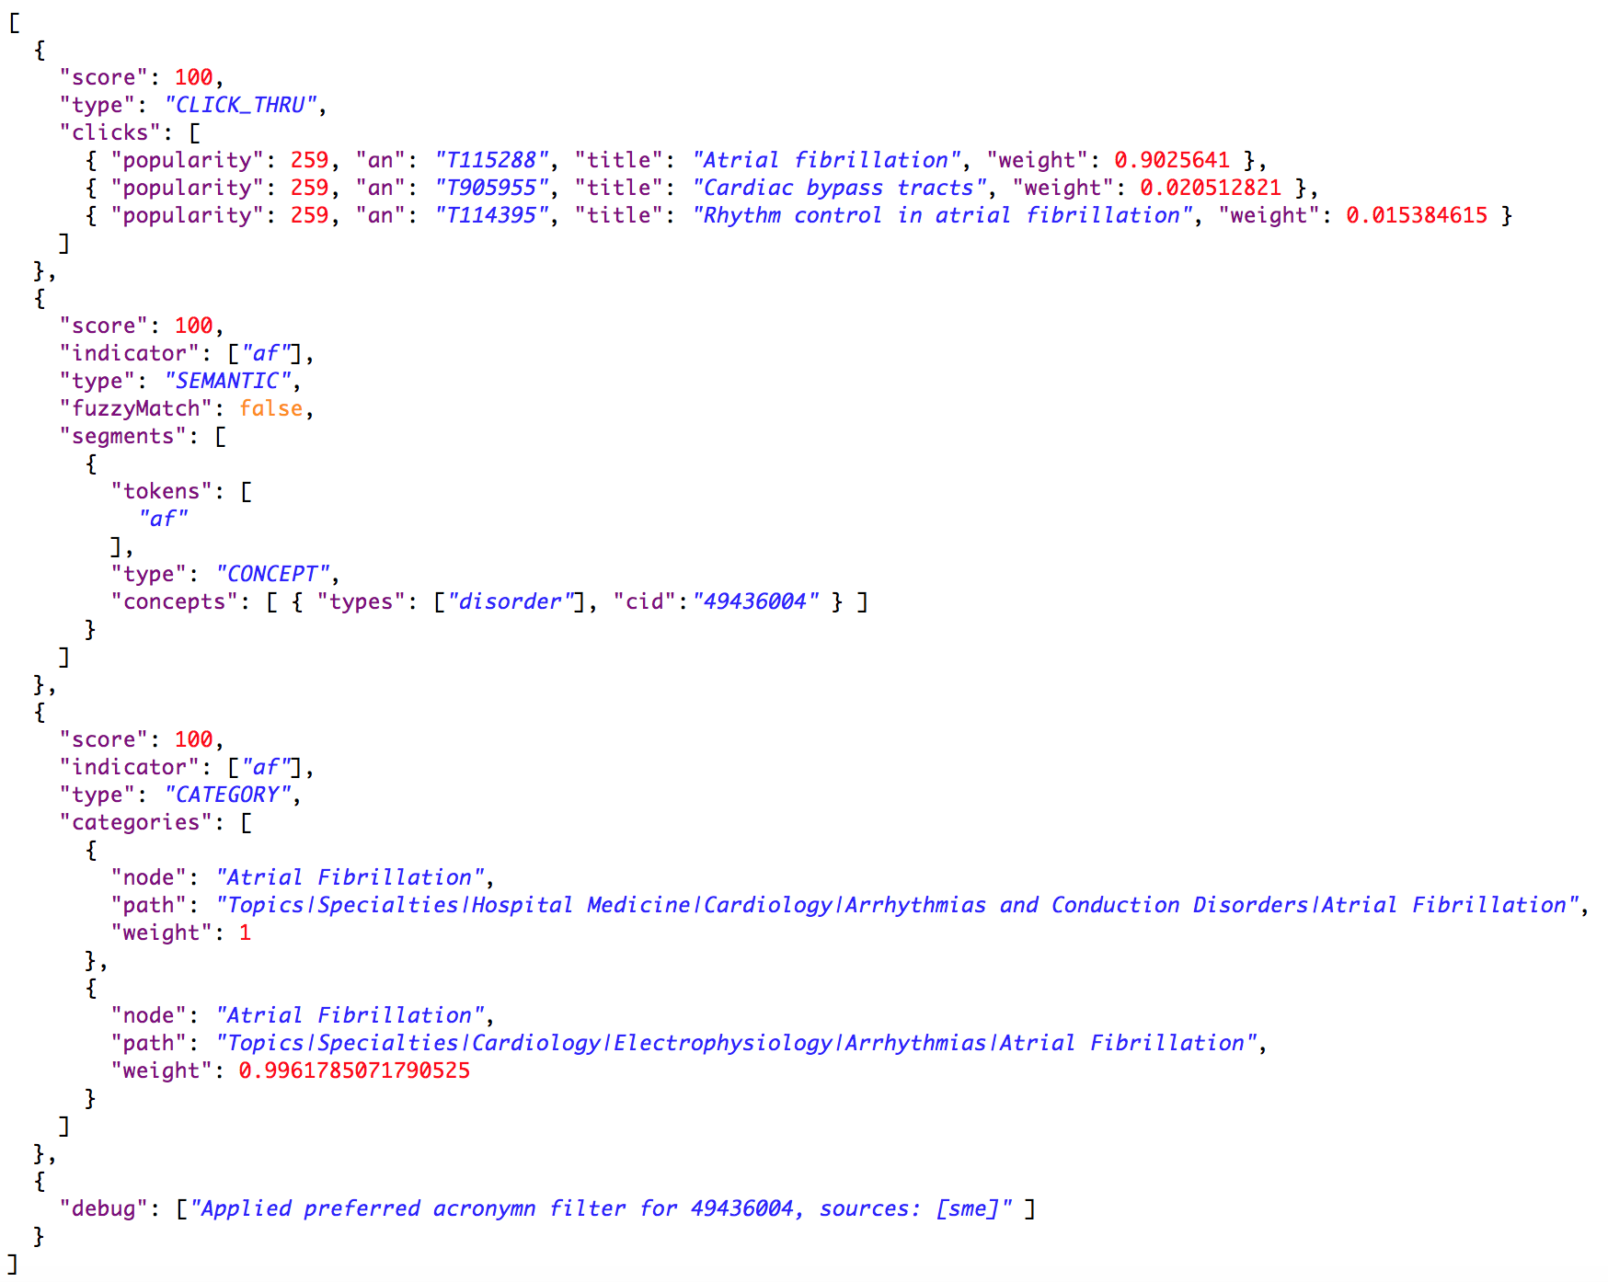
QUERY INTELLIGENCE
AF
Click-thru recommendation
Semantic recommendation
category recommendation
Acronym disambiguation

Slide 41
MEDICAL SEARCH PLATFORM
AF
MATCHING
CRITERIA
Semantic recommendation
Acronym disambiguation
ranking
CRITERIA
Click-thru recommendation
category recommendation

Slide 42
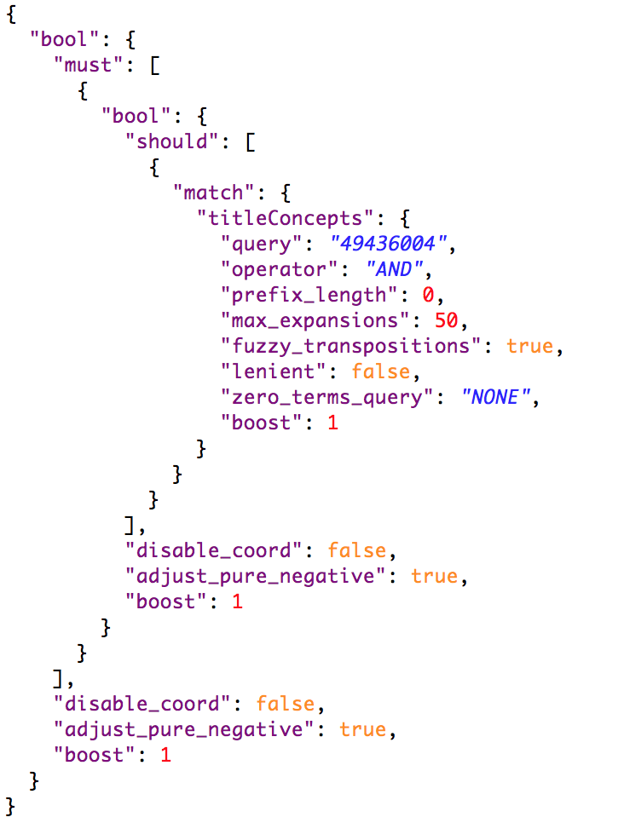
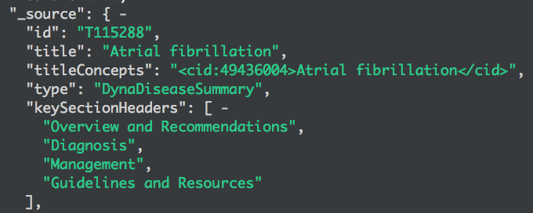
MEDICAL SEARCH PLATFORM
AF
Semantic recommendation
MATCHING
CRITERIA

Slide 43
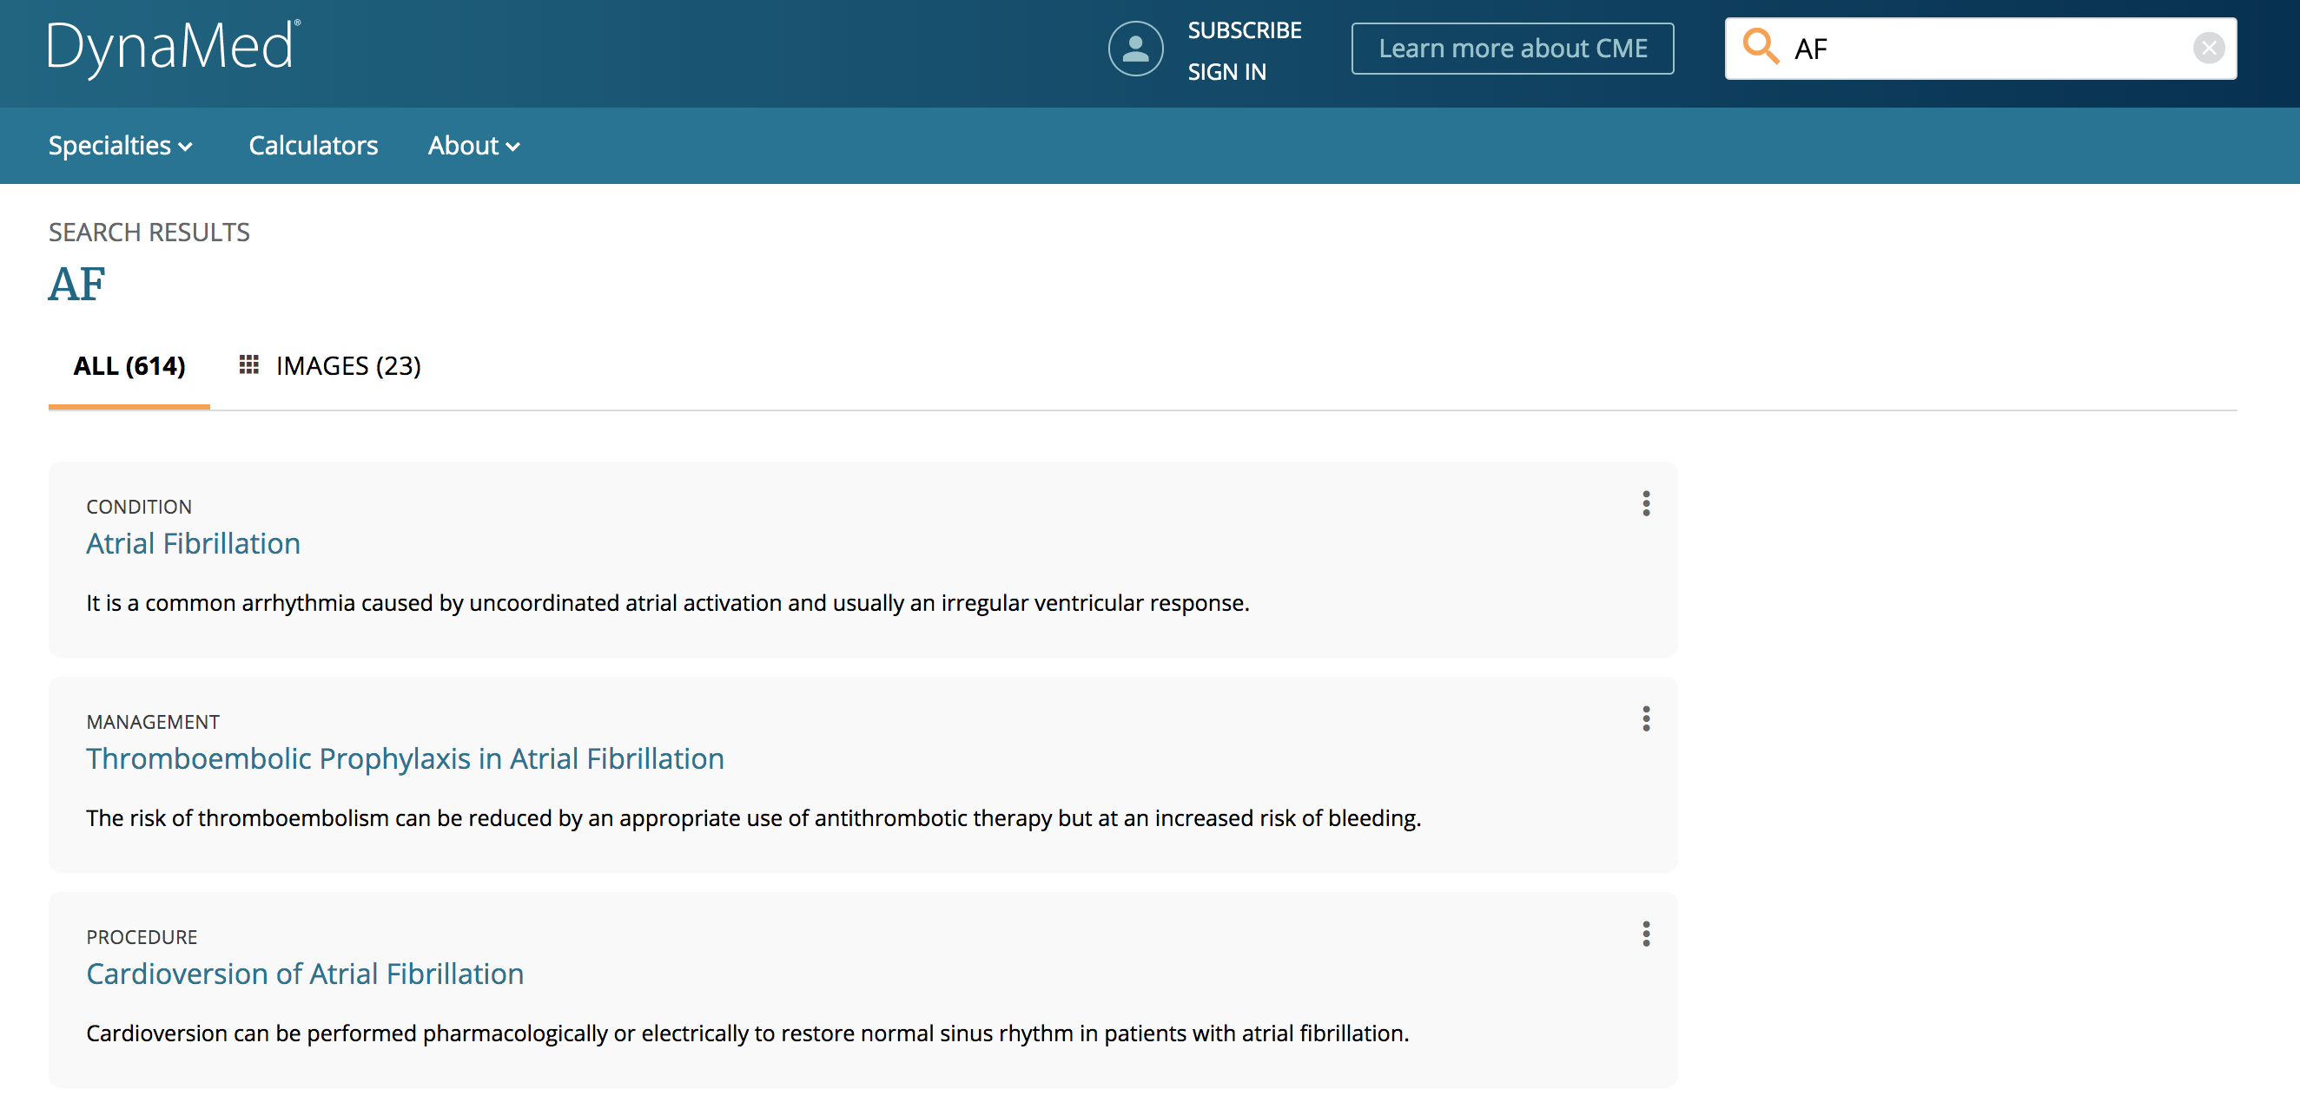
Acronym disambiguation

Slide 44
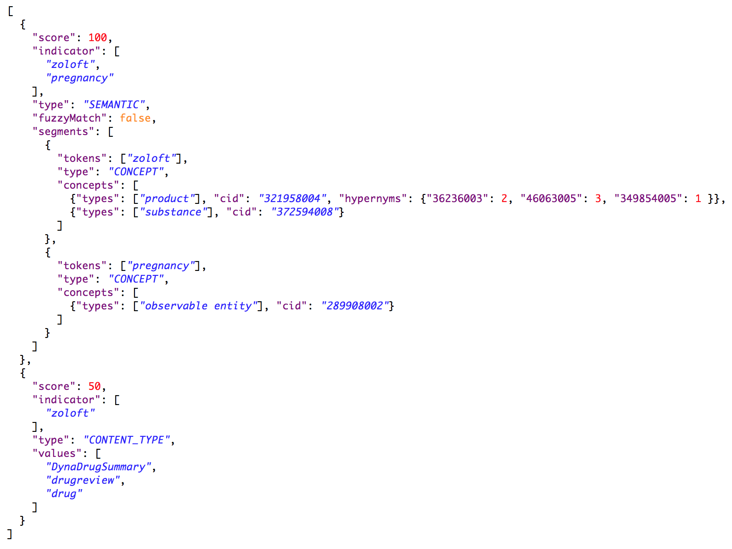
QUERY INTELLIGENCE
ZOLOFT PREGNANCY
Semantic recommendation
HYPERNYM EXPANSION
CONTENT TYPE recommendation

Slide 45
MEDICAL SEARCH PLATFORM
ZOLOFT PREGNANCY
MATCHING
CRITERIA
Semantic recommendation
HYPERNYM EXPANSION
ranking
CRITERIA
CONTENT TYPE recommendation

Slide 46
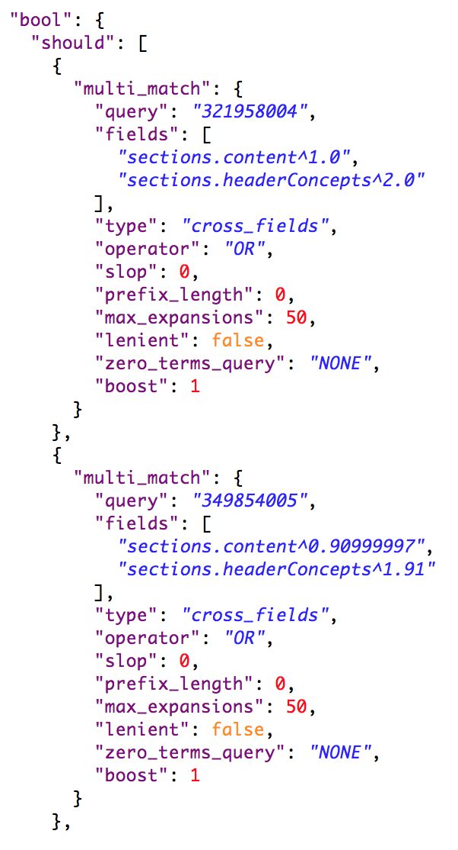
MEDICAL SEARCH PLATFORM
ZOLOFT PREGNANCY
Semantic recommendation
MATCHING
CRITERIA
ZOLOFT
ANTIDEPRESSANT
MATCHING
CRITERIA
SEROTONIN INHIBITOR
HYPERNYM EXPANSION
SERTRALINE
SERTRALINE
ZOLOFT

Slide 47
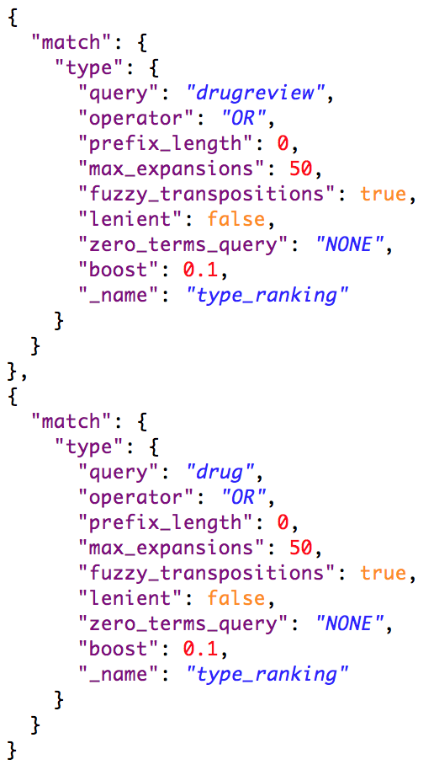
MEDICAL SEARCH PLATFORM
ZOLOFT PREGNANCY
CONTENT TYPE recommendation
RANKING
CRITERIA
CONTENT TYPE recommendation
RANKING
CRITERIA

Slide 48
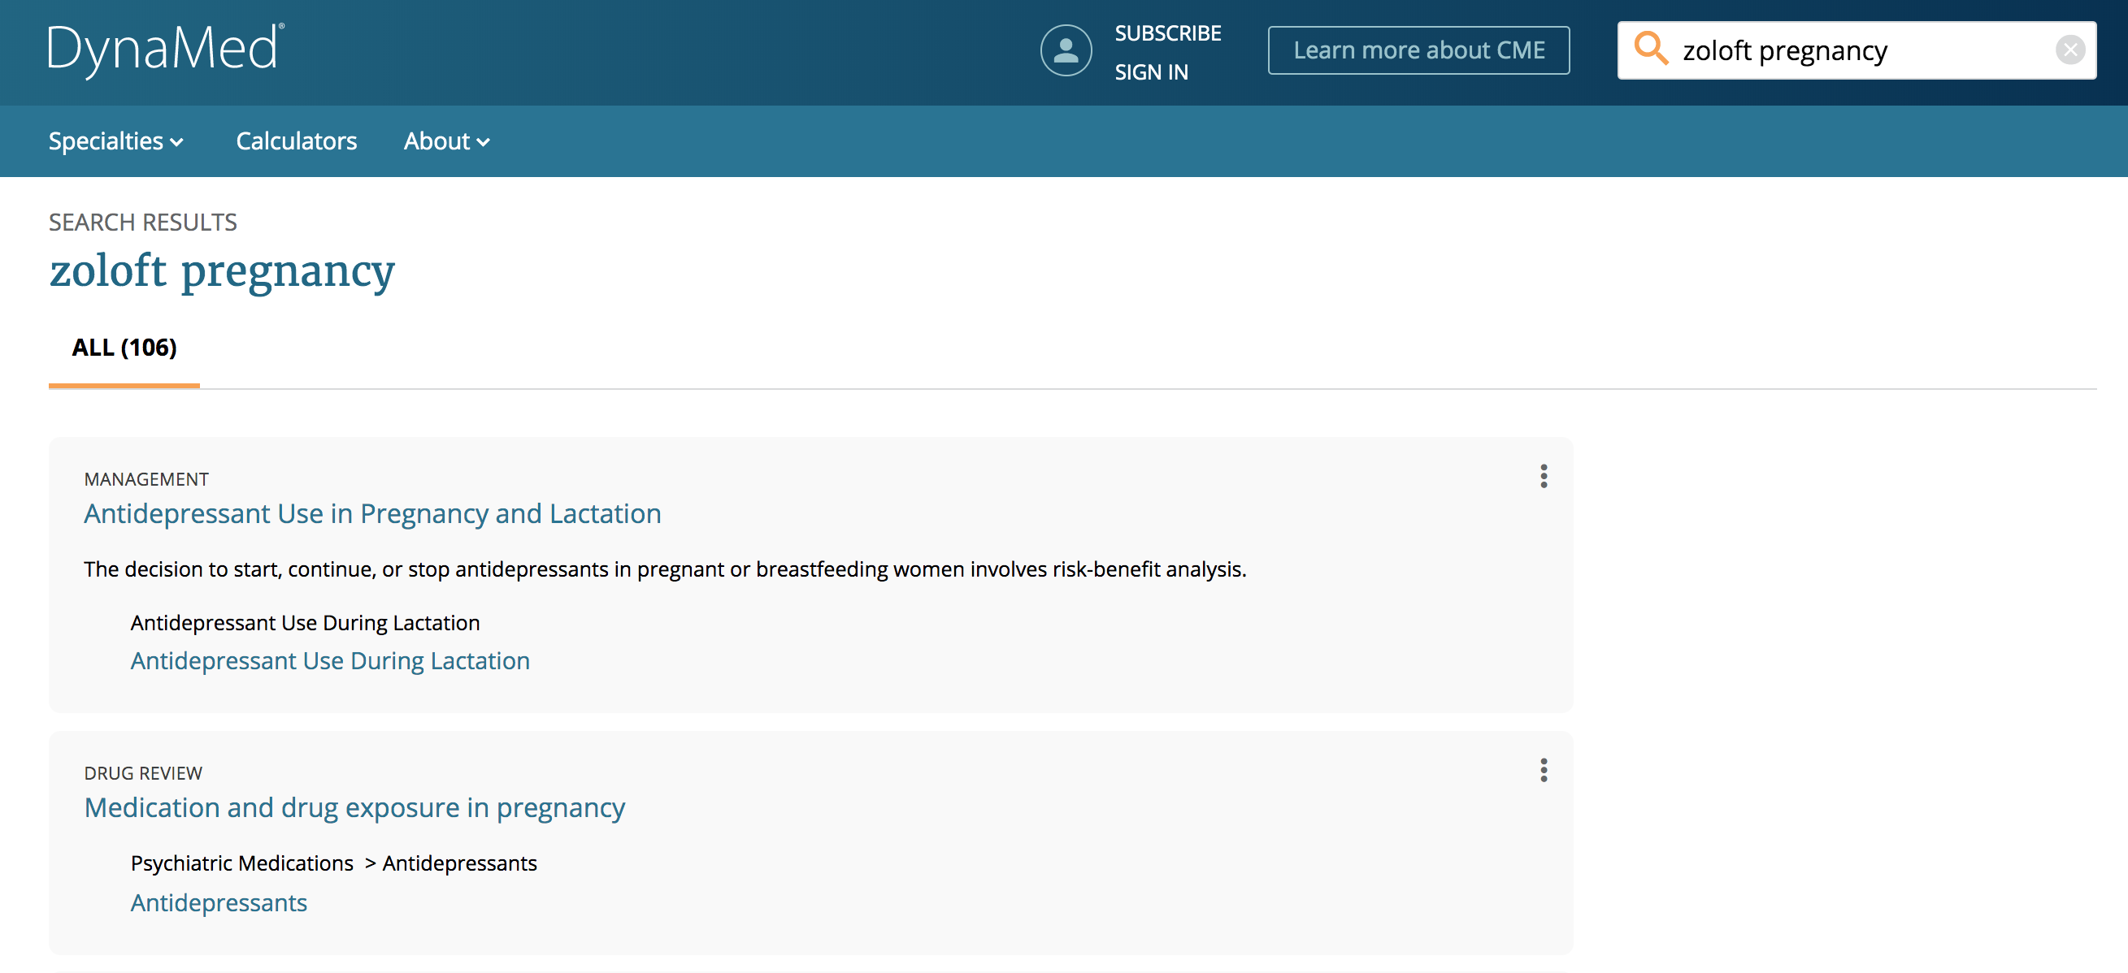
HYPERNYM EXPANSION
CONTENT TYPE RECOMMENDATION

Slide 49
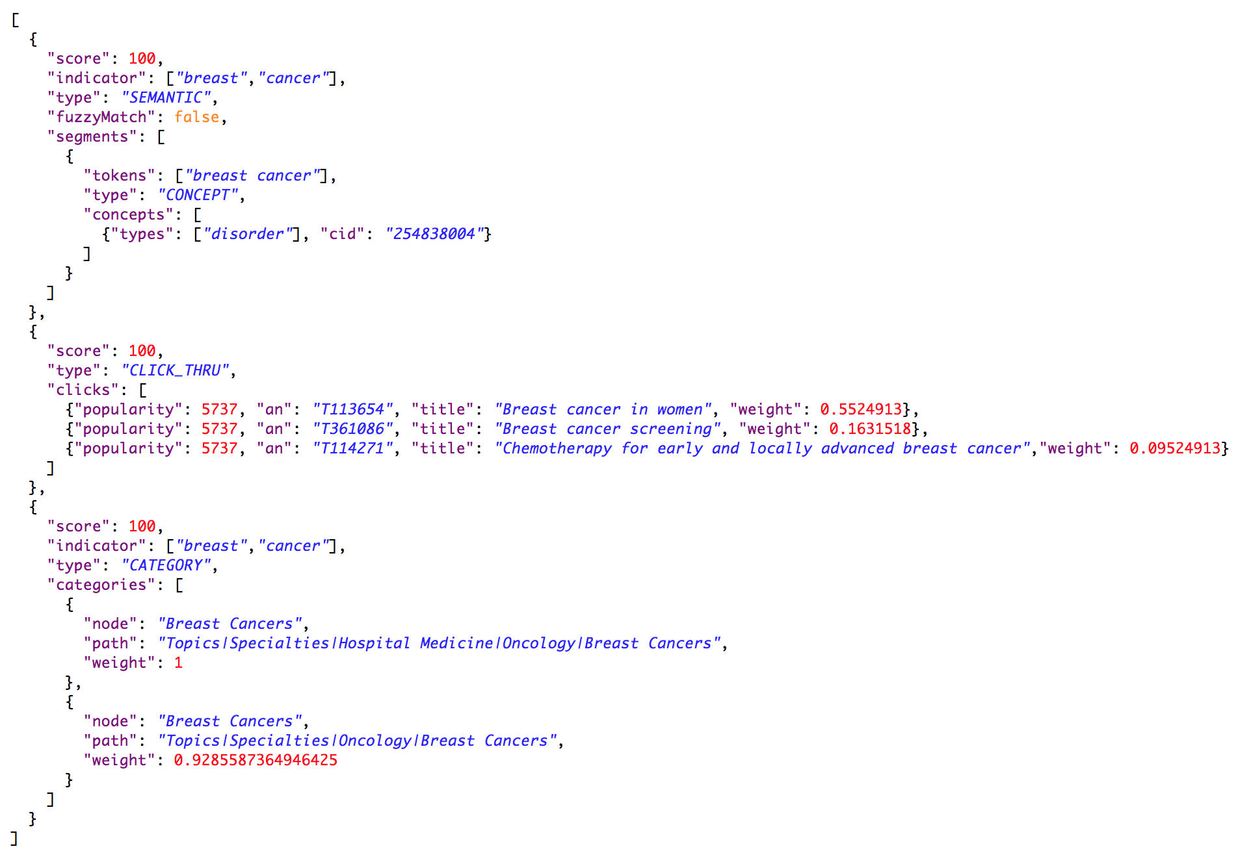
QUERY INTELLIGENCE
BREAST CANCER
Semantic recommendation
CLICK-THRU RECOMMENDATION
CATEGORY recommendation

Slide 50
MEDICAL SEARCH PLATFORM
BREAST CANCER
MATCHING
CRITERIA
Semantic recommendation
ranking
CRITERIA
CLICK-THRU RECOMMENDATION
CATEGORY recommendation

Slide 51
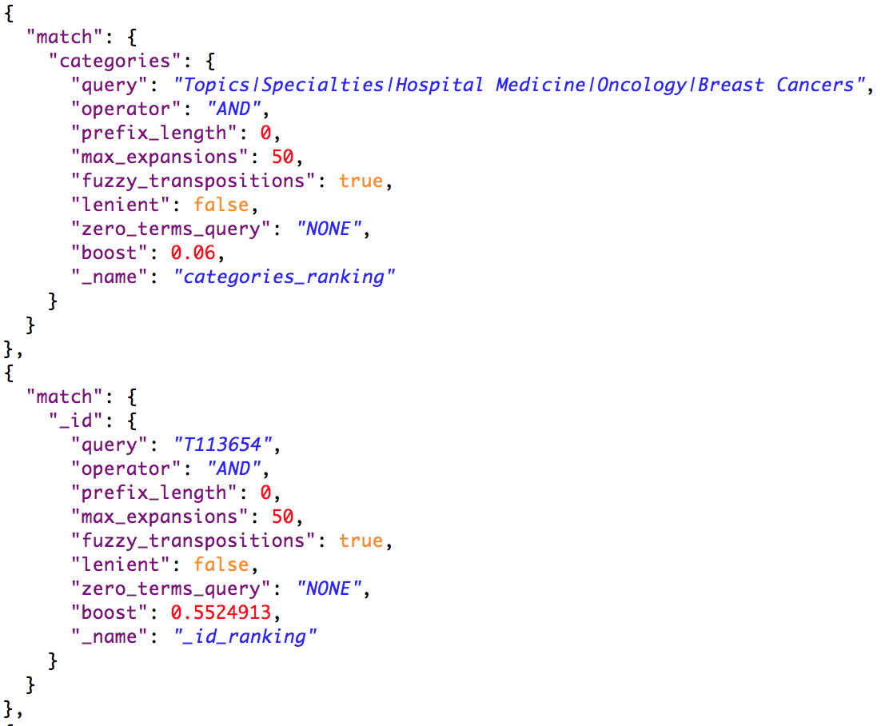
MEDICAL SEARCH PLATFORM
BREAST CANCER
CATEGORY recommendation
RANKING
CRITERIA
CLICK-THRU RECOMMENDATION
RANKING
CRITERIA
BREAST CANCER IN WOMEN

Slide 52
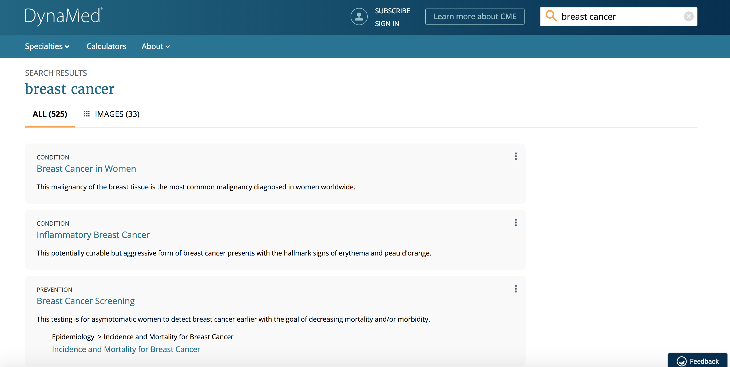
CLICK-THRU RECOMMENDATION

Slide 53
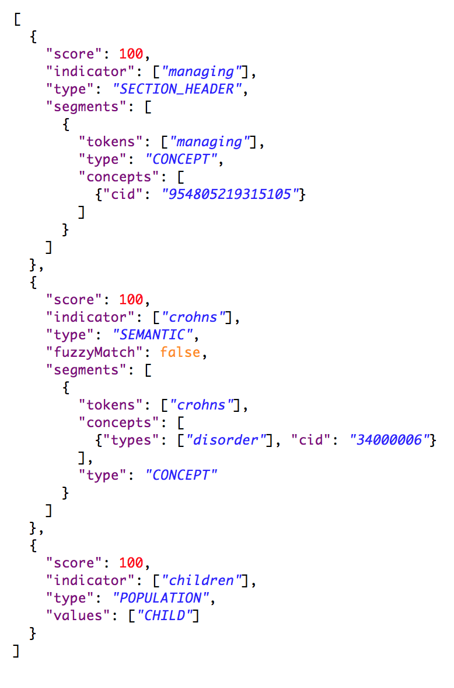
QUERY INTELLIGENCE
CROHNS CHILDREN MANAGING
CONTENT STRUCTURE recommendation
SEMANTIC RECOMMENDATION
POPULATION recommendation

Slide 54
MEDICAL SEARCH PLATFORM
ZOLOFT PREGNANCY
MATCHING
CRITERIA
Semantic recommendation
POPULATION RECOMMENDATION
CONTENT STRUCTURE recommendation

Slide 55
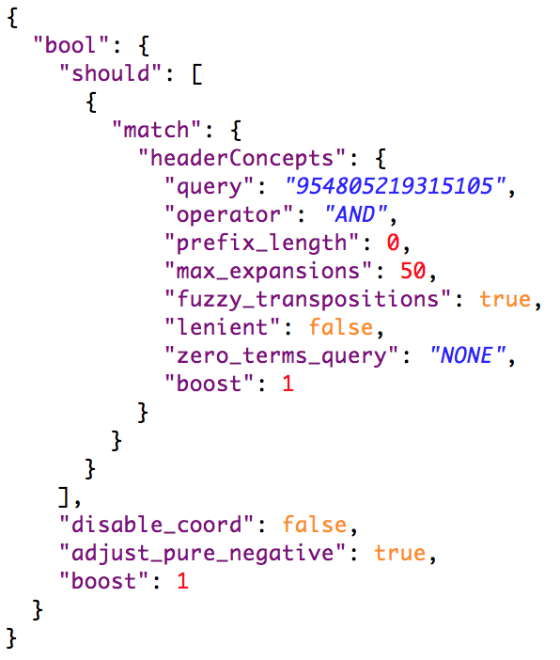
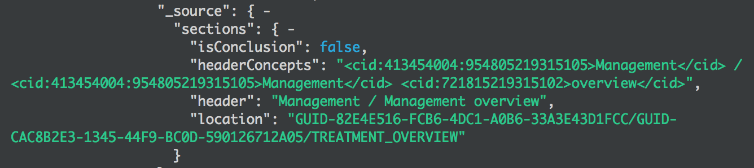
MEDICAL SEARCH PLATFORM
CROHNS CHILDREN MANAGING
CONTENT STRUCTURE recommendation
MATCHING
CRITERIA
MANAGING

Slide 56
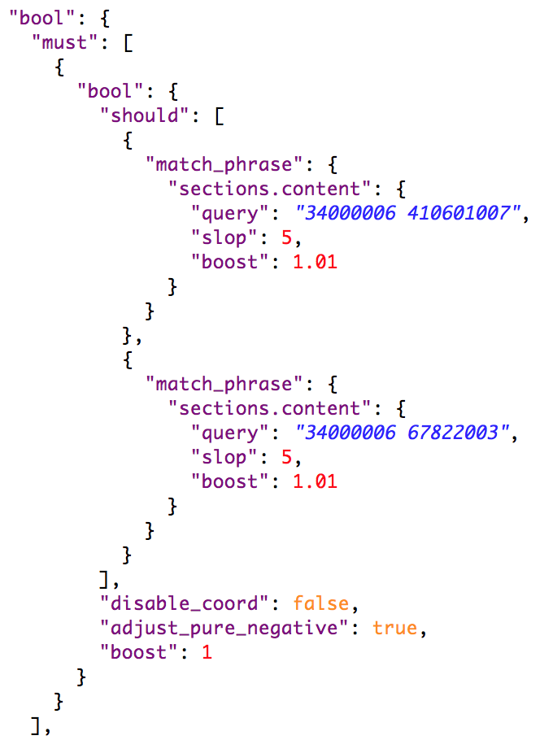
MEDICAL SEARCH PLATFORM
CROHNS CHILDREN MANAGING
SEMANTIC & POPULATION RECOMMENDATION
MATCHING
CRITERIA
CROHNS CHILDREN
SEMANTIC & POPULATION RECOMMENDATION
MATCHING
CRITERIA

Slide 57
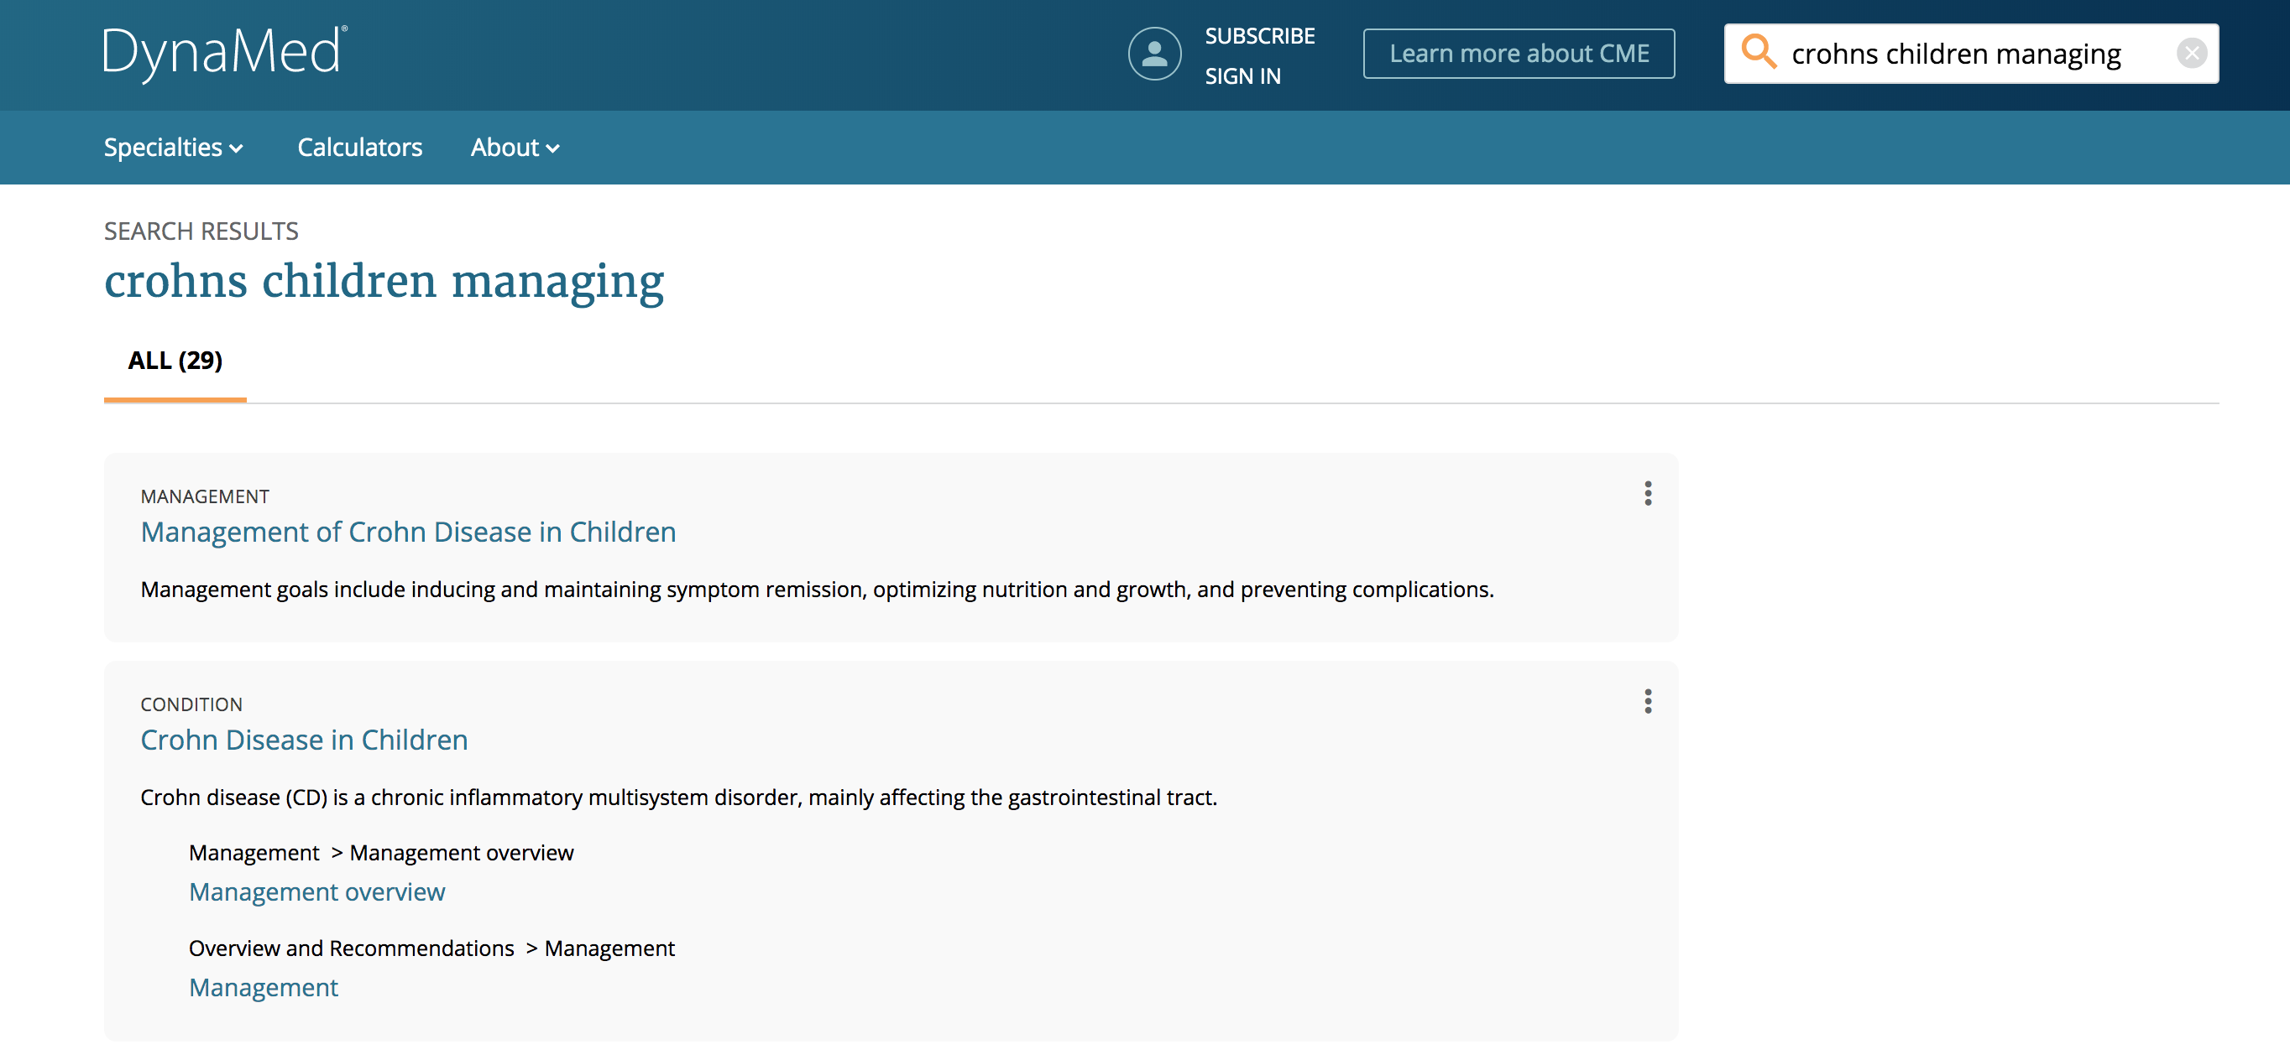
Combination of recommendations
Semantic recommendation
Content structure recommendation

Slide 58
  T U N I N G
Source: Medscape EM Physician Compensation Report 2017

Slide 59
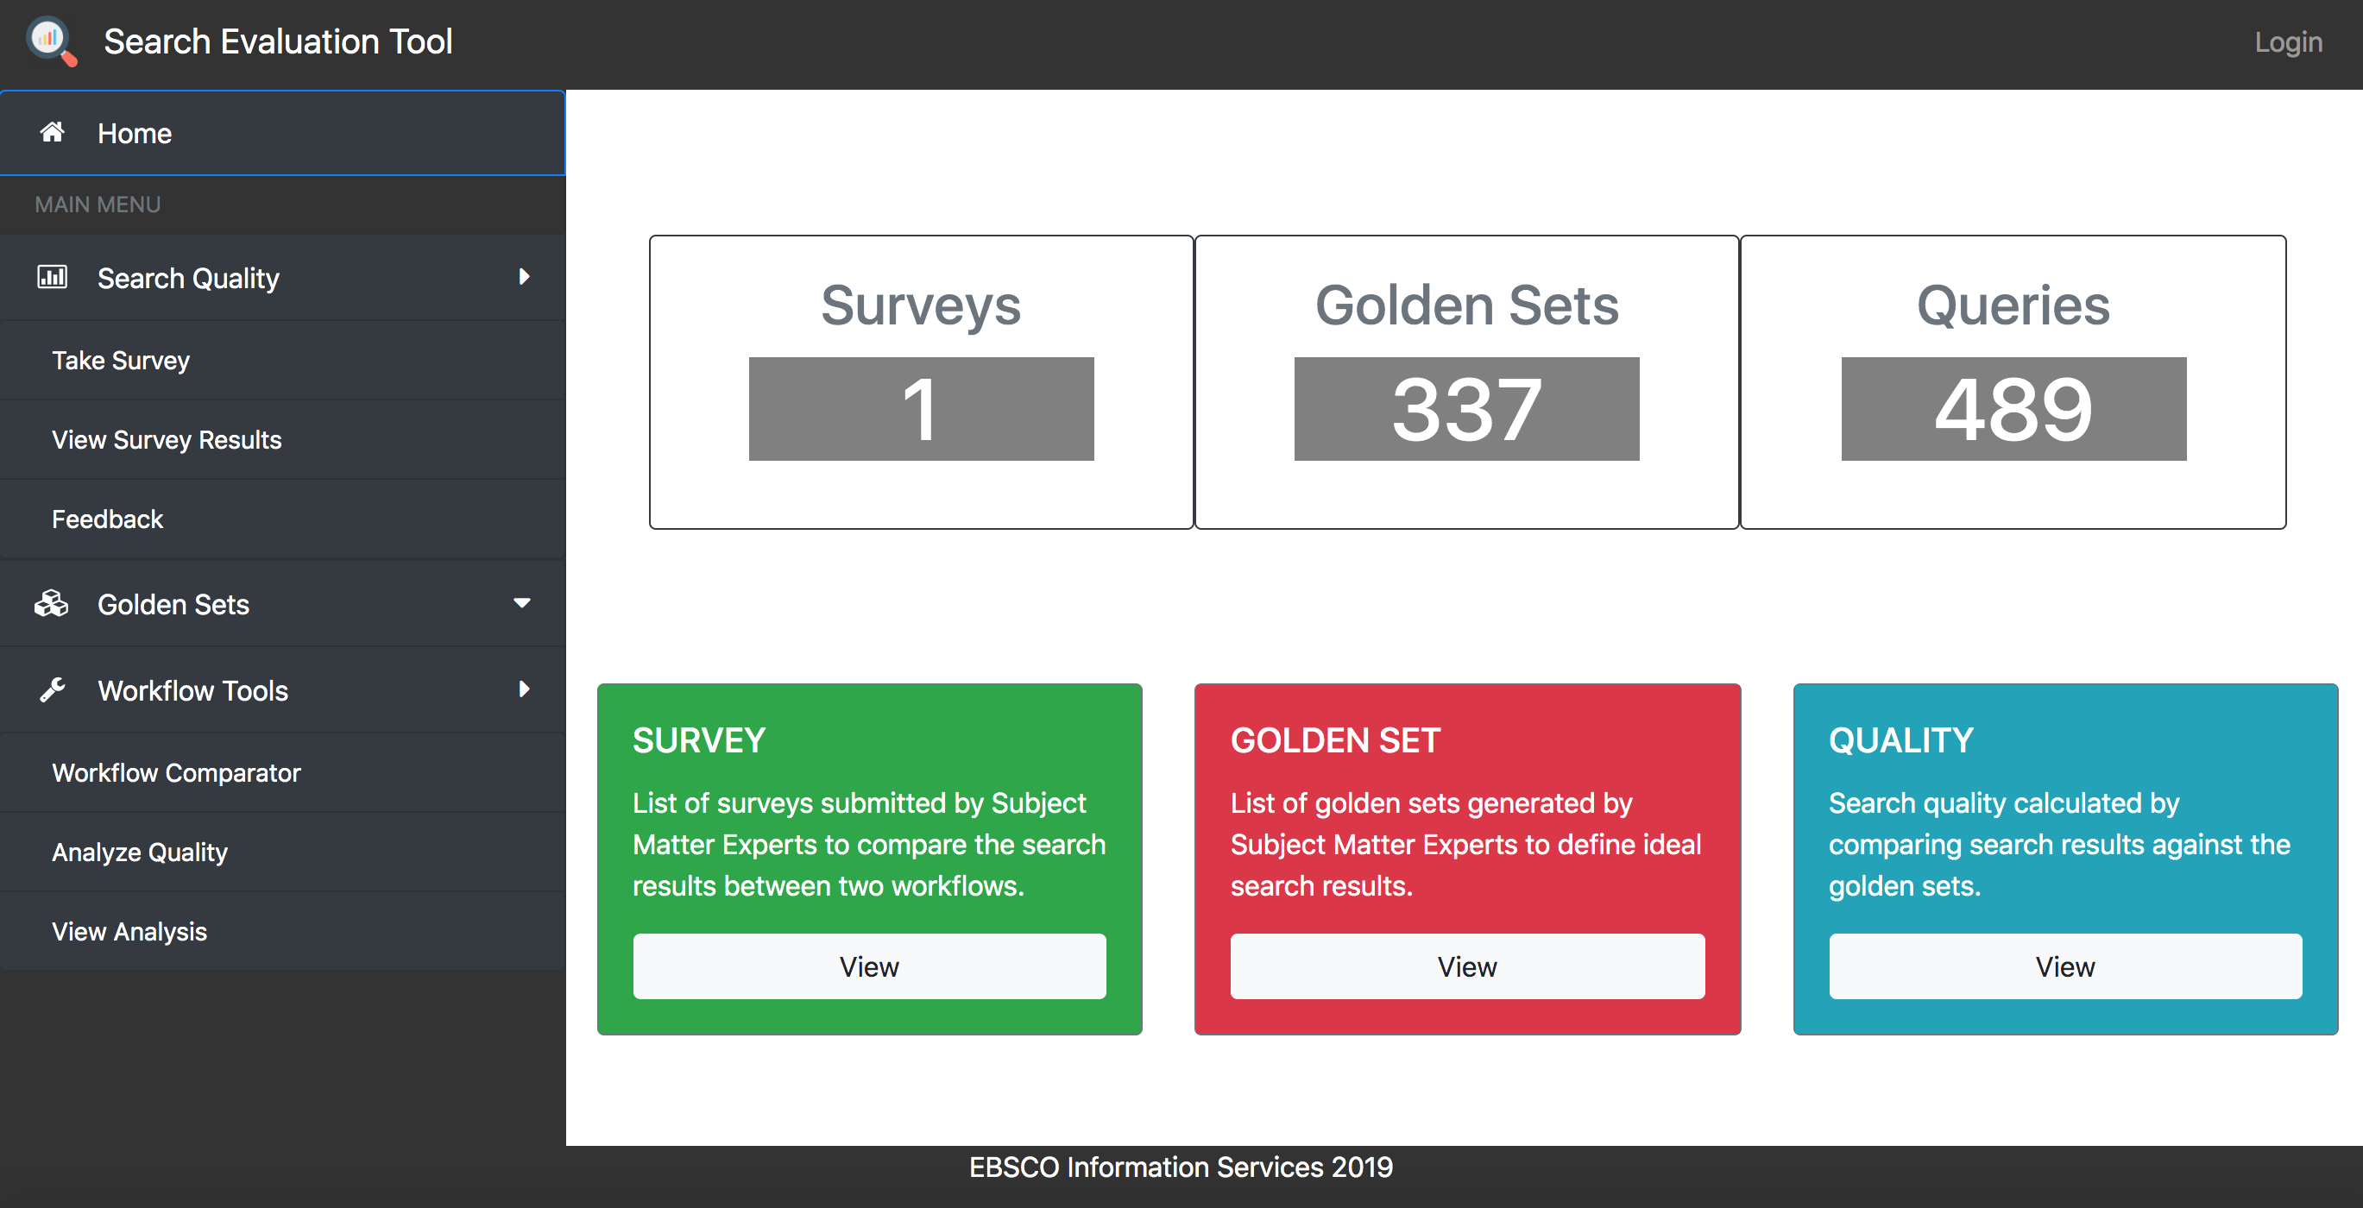

Slide 60
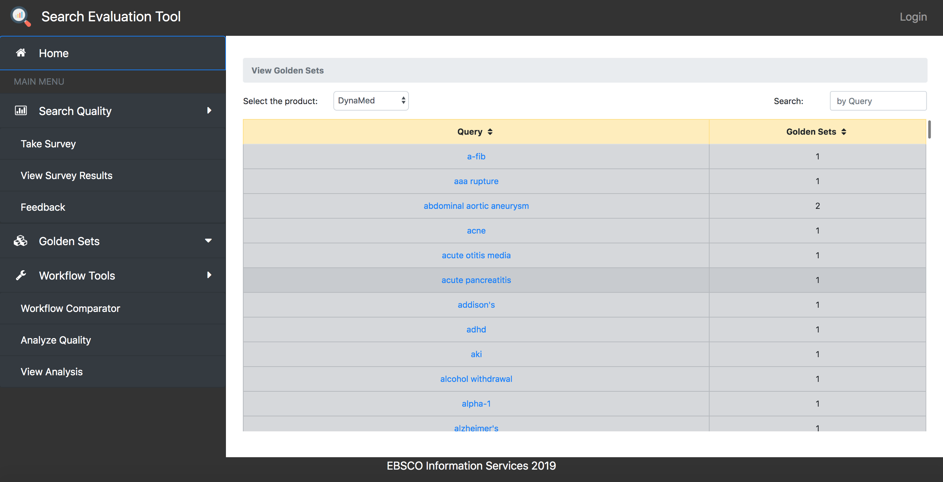

Slide 61
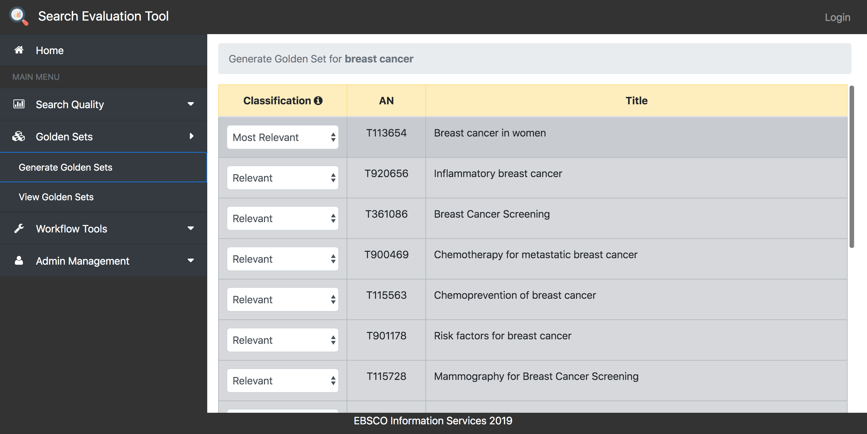
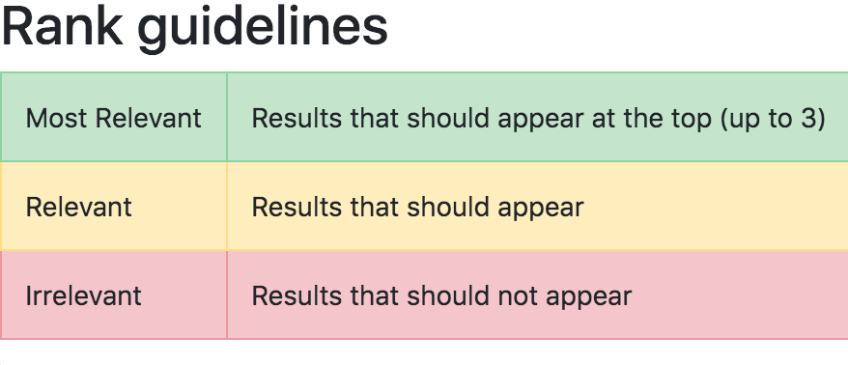

Slide 62
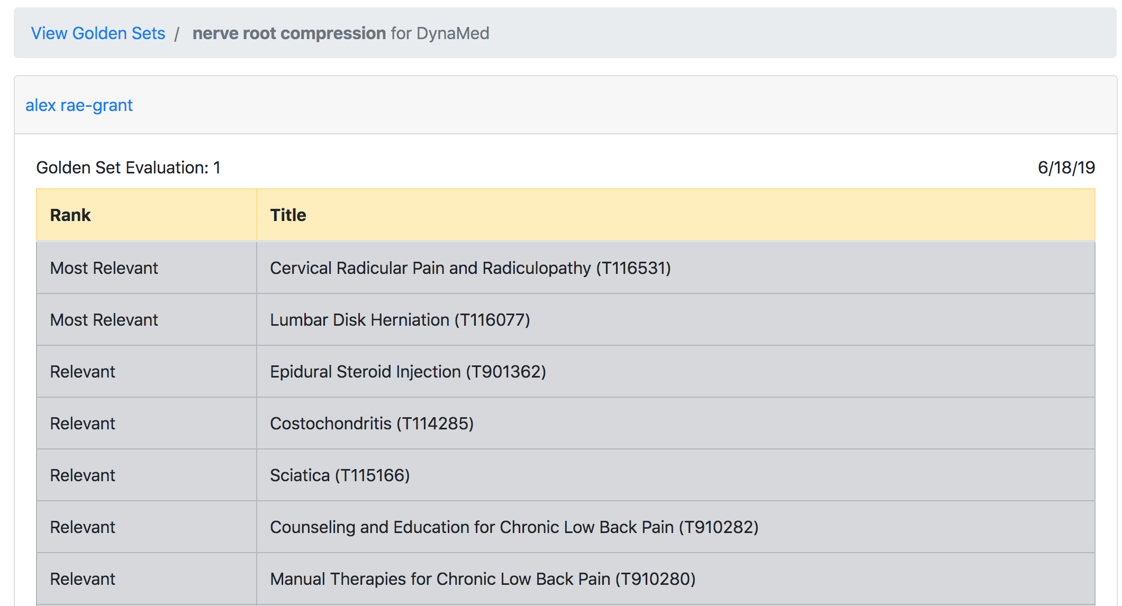
Golden Set
Actual Results

Slide 63
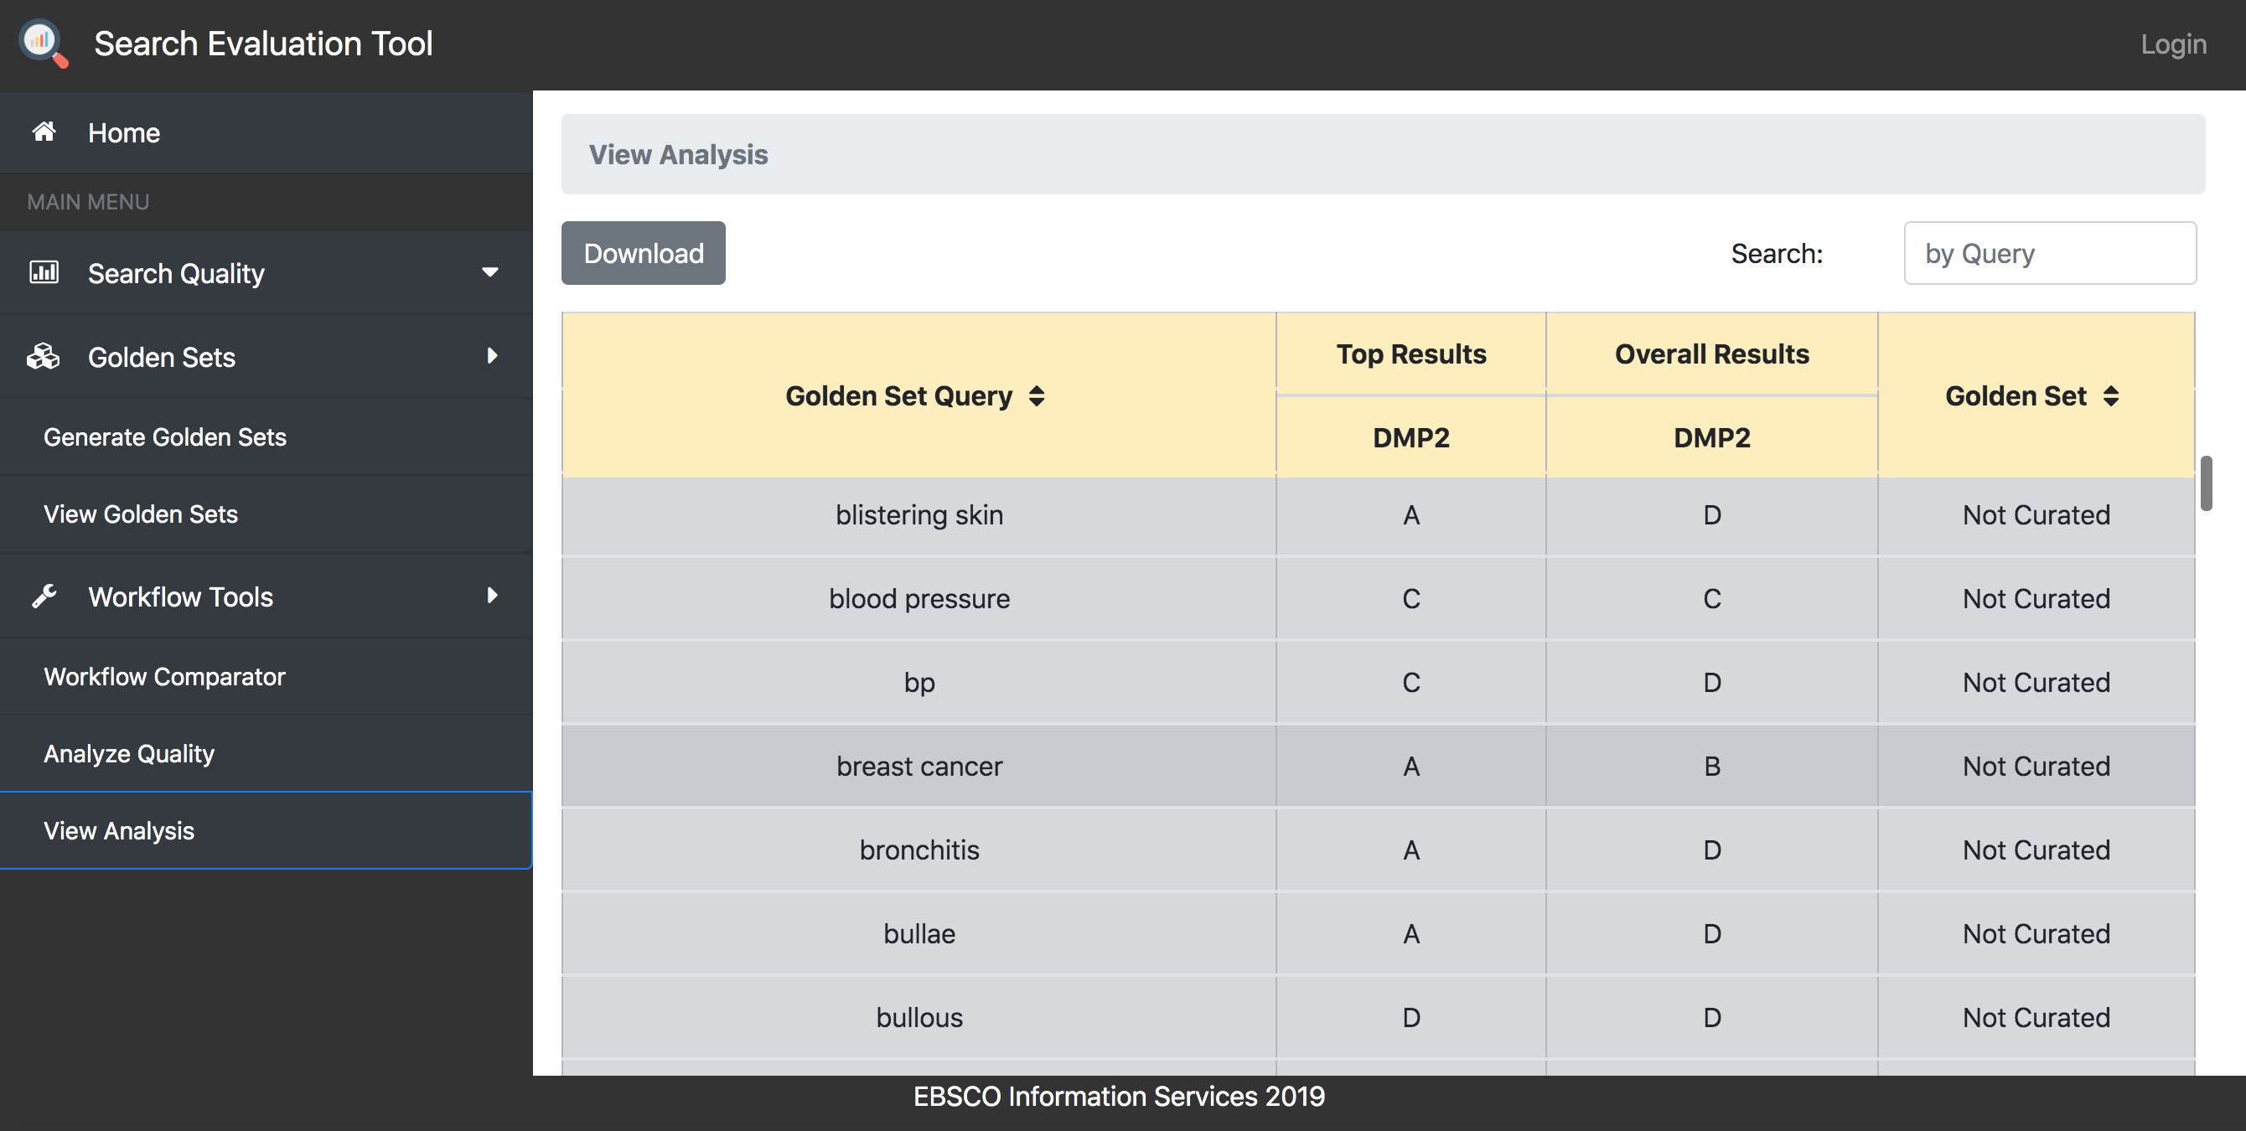

Slide 64
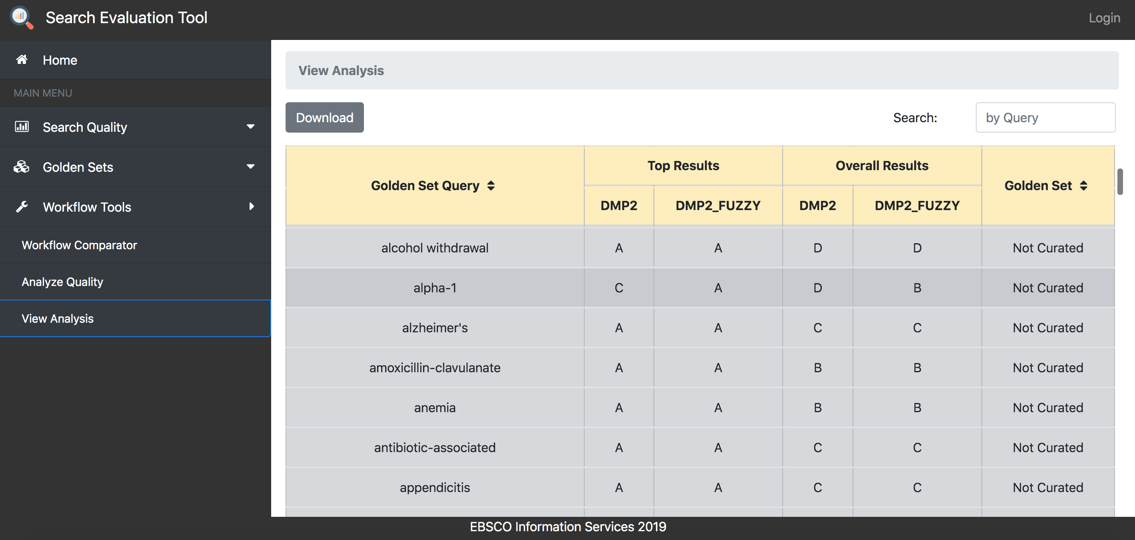

Slide 65
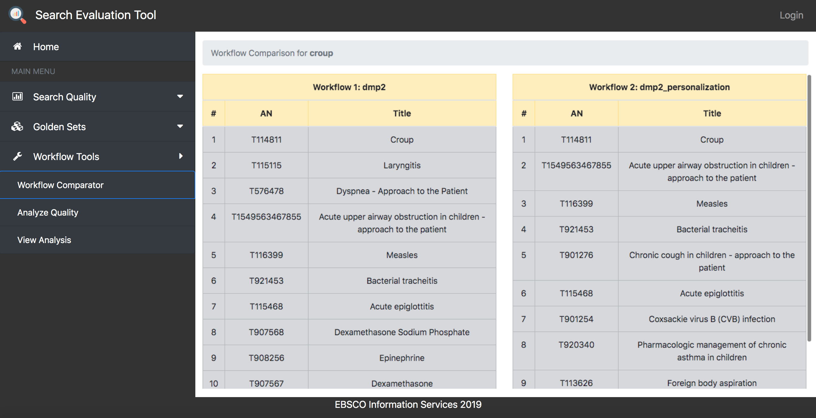
Hackathon Winners
Omkar Kulkarni & Achal Sancheti

Slide 66
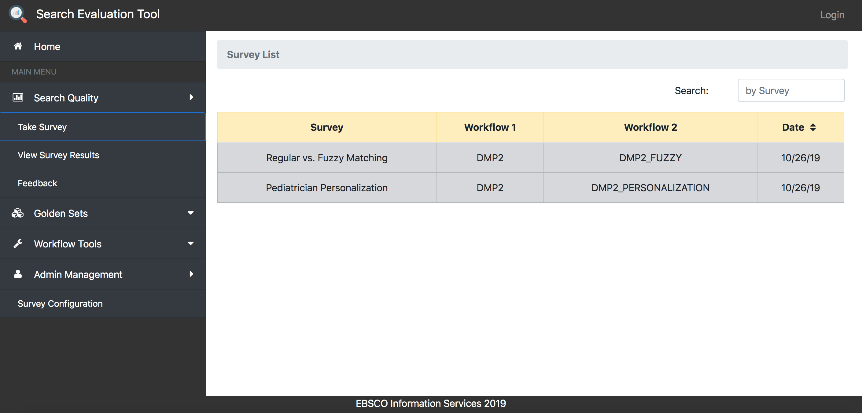

Slide 67
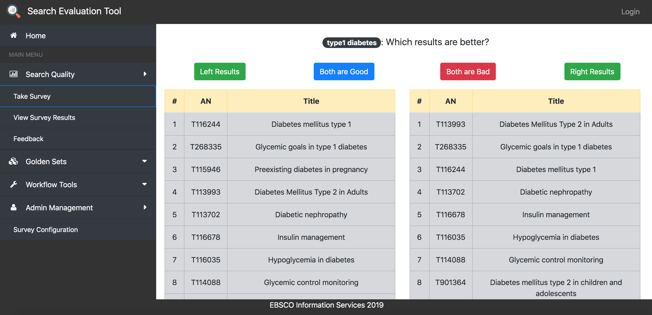

Slide 68
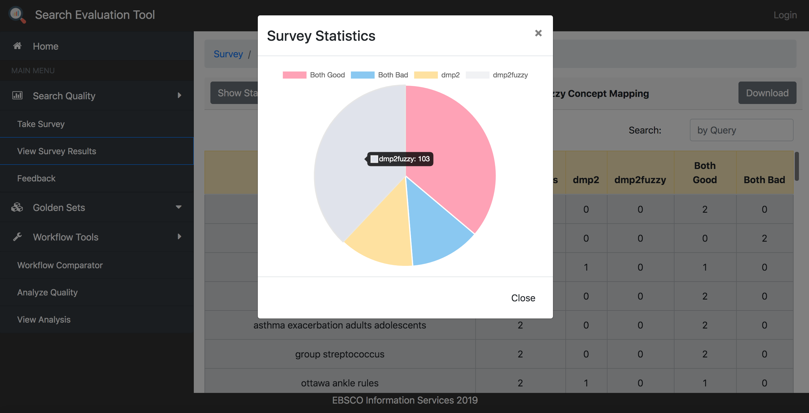

Slide 69
  N E X T S T E P S
Source: Medscape EM Physician Compensation Report 2017

Slide 70

Contextual Recommendations
Geographical Indicators
Treatment
Guidelines
Treatment
Guidelines
Nausea
Diarrhea
Treatment
Guidelines
Nausea
Diarrhea
Treatment
Guidelines

Slide 71

Personalization
Atrial Fibrillation
cardiologist
Amniotic Fluid
obstetrician
AF
Nausea
Diarrhea

Slide 72

Guided Discovery
What are the treatment options to lower the risk of stroke?
How is Wellbutrin different from Zoloft?
How does sugar lead to Type 2 diabetes?

Slide 73
Knowledge Graph Relationships
ZOLOFT
WELLBUTRIN
HAS TRADENAME
HAS TRADENAME
HAS INTERACTION
ALCOHOL
SERTALINE

Slide 74
Search Ecosystem
CONTENT TRANSFORMATION
ENRICHMENT
INDEXING
MEDICAL SEARCH PLATFORM
QUERY INTELLIGENCE
SEARCH PREP
SEARCH RUNTIME
USER FEEDBACK
EXPERT FEEDBACK
CLICK THRU RATES
CONVERSION RATES
A/B TESTING
GOLDEN SETS
WORKFLOW COMPARISON
KNOWLEDGE GRAPH

Slide 75
Erica Lesyshyn
  Principal Software Engineer
  EBSCO Information Services

