Slide 1
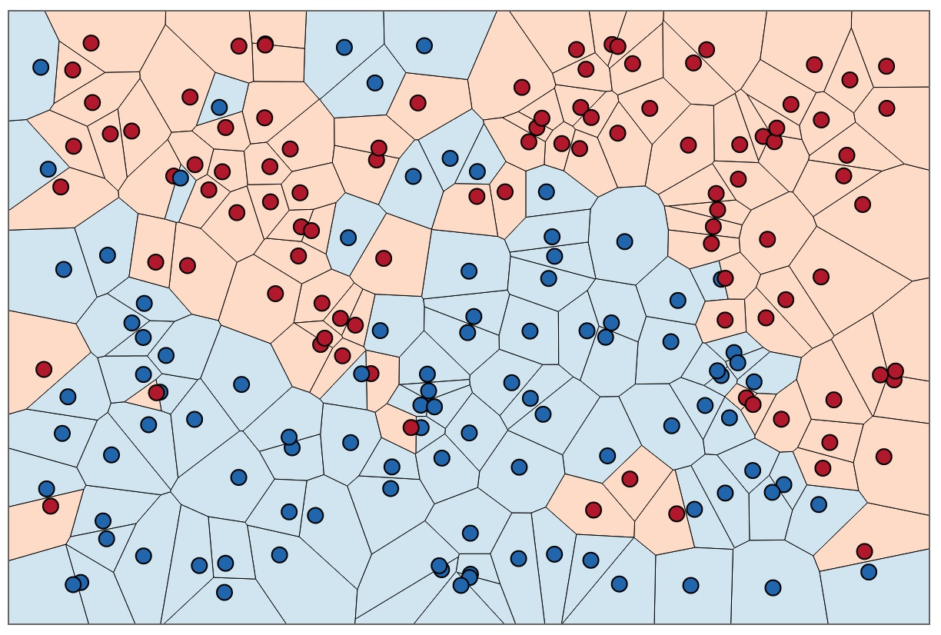

Big Vector Search
The NeurIPS 2021 Billion-Scale ANN Challenge

Slide 2
Agenda
Who Was Involved ?
Why It’s Important?
Competition Details
Winners
Future
Getting Involved!

Slide 3







Who Was Involved?

Slide 4
Motivation

Slide 5
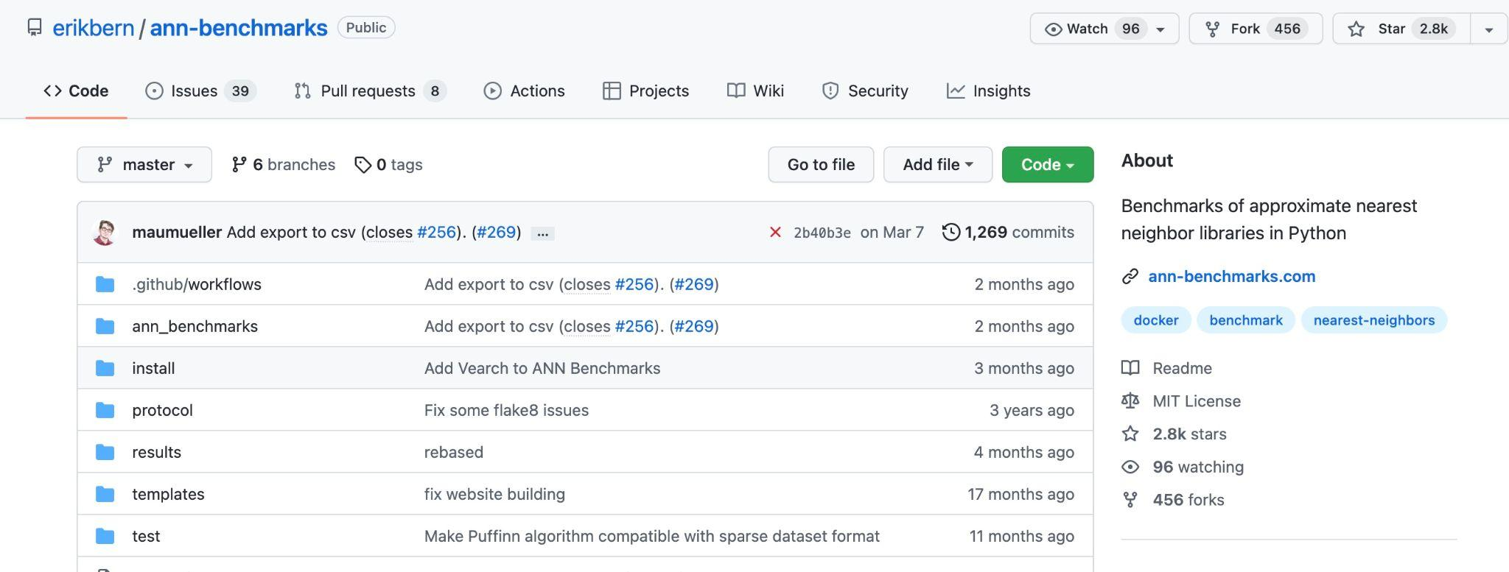
Why It’s Important?
http://github.com/erikbern/ann-benchmarks

Slide 6
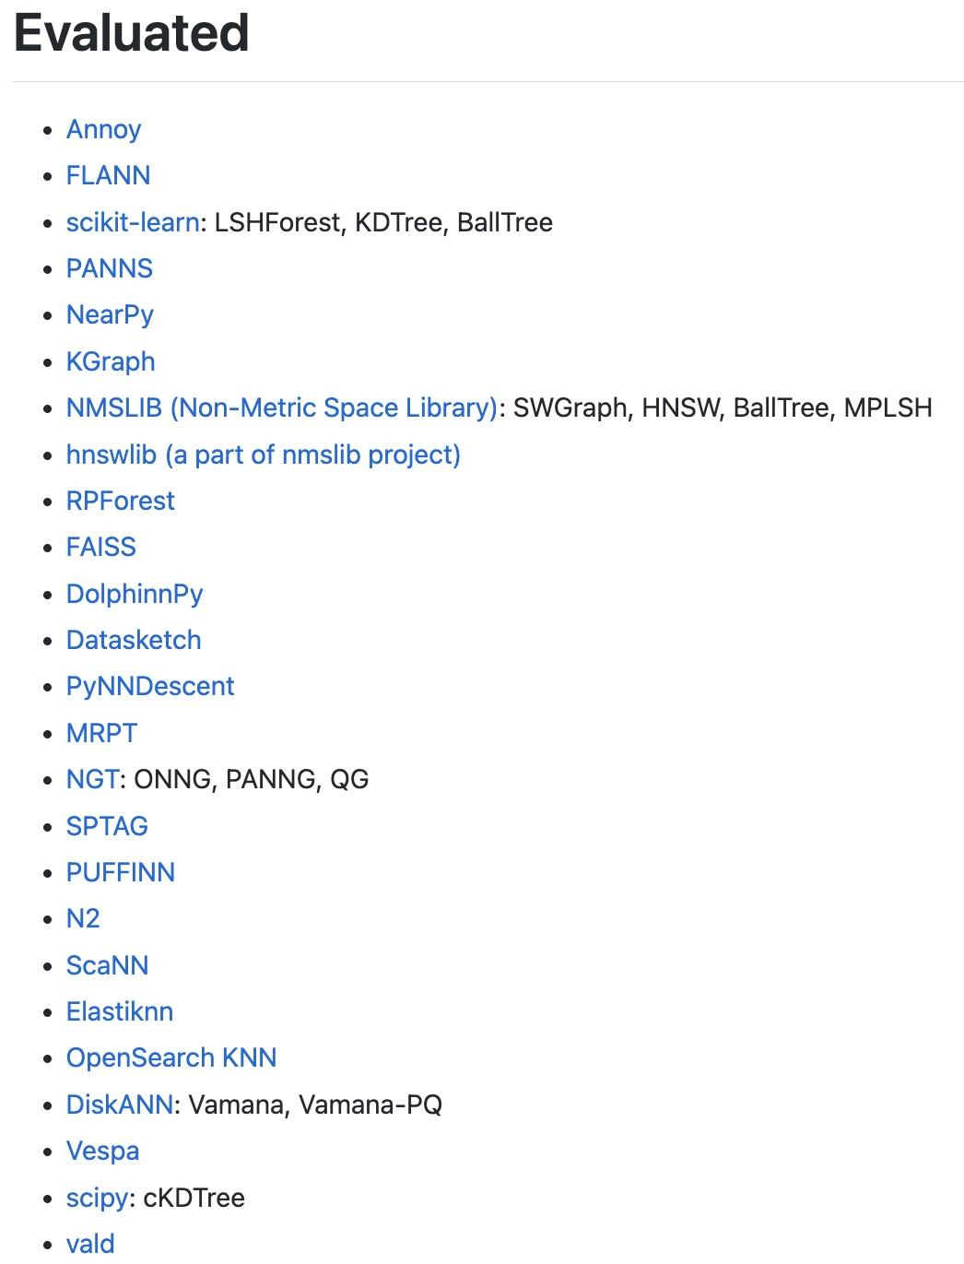
Why It’s Important?
http://github.com/erikbern/ann-benchmarks

Slide 7
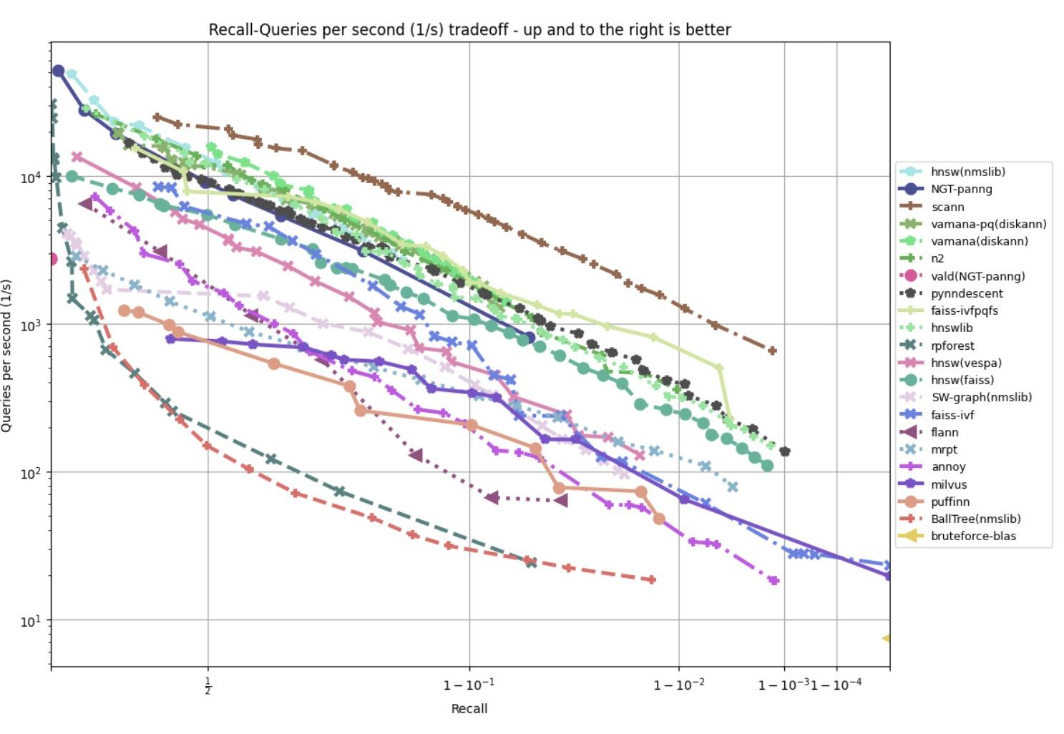
Why It’s Important?
http://github.com/erikbern/ann-benchmarks

Slide 8
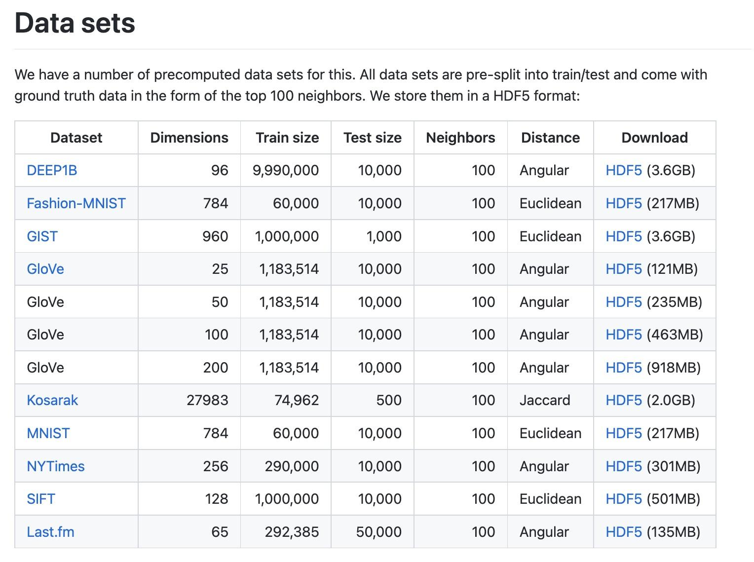
Why It’s Important?
http://github.com/erikbern/ann-benchmarks

Slide 9
Why It’s Important?
http://github.com/erikbern/ann-benchmarks

Slide 10
Motivation: Billion-Scale ANN
Open Evaluation
Big Vector Databases
Collaboration

Slide 11
Motivation: Billion-Scale ANN
Open Evaluation
Big Vector Databases
Collaborations
Bonus: Martin Amueller of ann-benchmarks is on the committee!

Slide 12
Competition Datasets

Slide 13
BigANN Competition Datasets
BigANN
2011
Deep1B
2016
Jegou, Tavenard,
Douze, Laurent (INRIA)
Babenko, Lempitsky (CVPR)

Slide 14
BigANN Competition Datasets
BigANN
2011
Deep1B
2016
SSNPP
2021
MSTuring
2021
MSSpaceV
2021
Text2Image
2021

Slide 15



BigANN Competition Datasets
BigANN
2011
Deep1B
2016
SSNPP
2021
MSTuring
2021
MSSpaceV
2021
Text2Image
2021

Slide 16
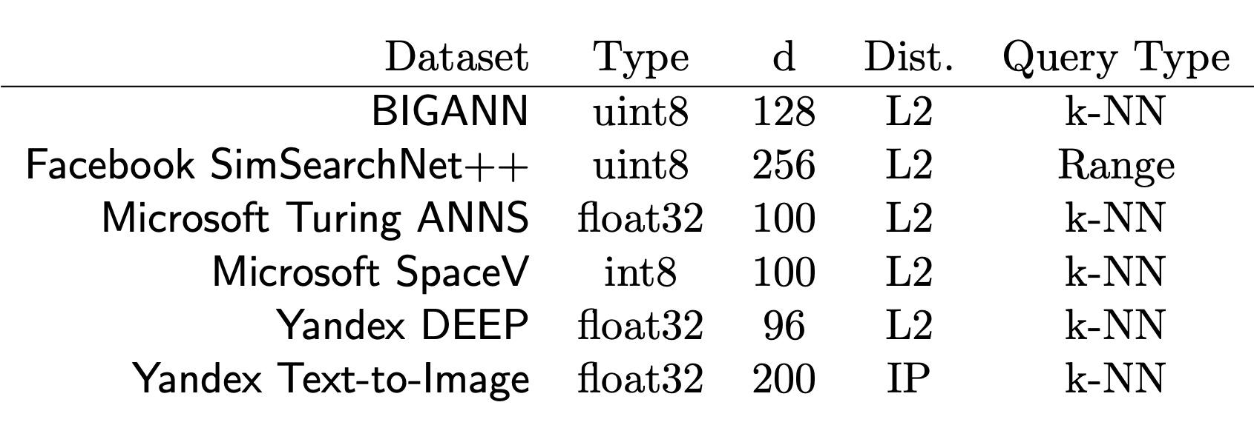
BigANN Competition Datasets

Slide 17
Competition Tracks

Slide 18
Competition Tracks
Track #1
Datacenter Server
64 GB RAM
Track #2
Track #3

Slide 19
Competition Tracks
Track #1
Datacenter Server
64 GB RAM
Track #2
Datacenter Server
64 GB RAM
2TB HTD SSD
Track #3

Slide 20
Competition Tracks
Track #1
Datacenter Server
64 GB RAM
Track #2
Datacenter Server
64 GB RAM
2TB HTD SSD
Track #3
Any Hardware
Evidence of Cost
Power Monitoring

Slide 21
Competition Tracks
Track #1
Datacenter Server
64 GB RAM
Track #2
Datacenter Server
64 GB RAM
2TB HTD SSD
Track #3
Any Hardware
Evidence of Cost
Power Monitoring
Limited Hardware Resource Budget
Ranked By Recall

Slide 22
Competition Tracks
Track #1
Datacenter Server
64 GB RAM
Track #2
Datacenter Server
64 GB RAM
2TB HTD SSD
Track #3
Any Hardware
Evidence of Cost
Power Monitoring
Limited Hardware Resource Budget
Ranked By Recall
Recall, QPS, Power, Cost

Slide 23
Evaluation Hardware

Slide 24
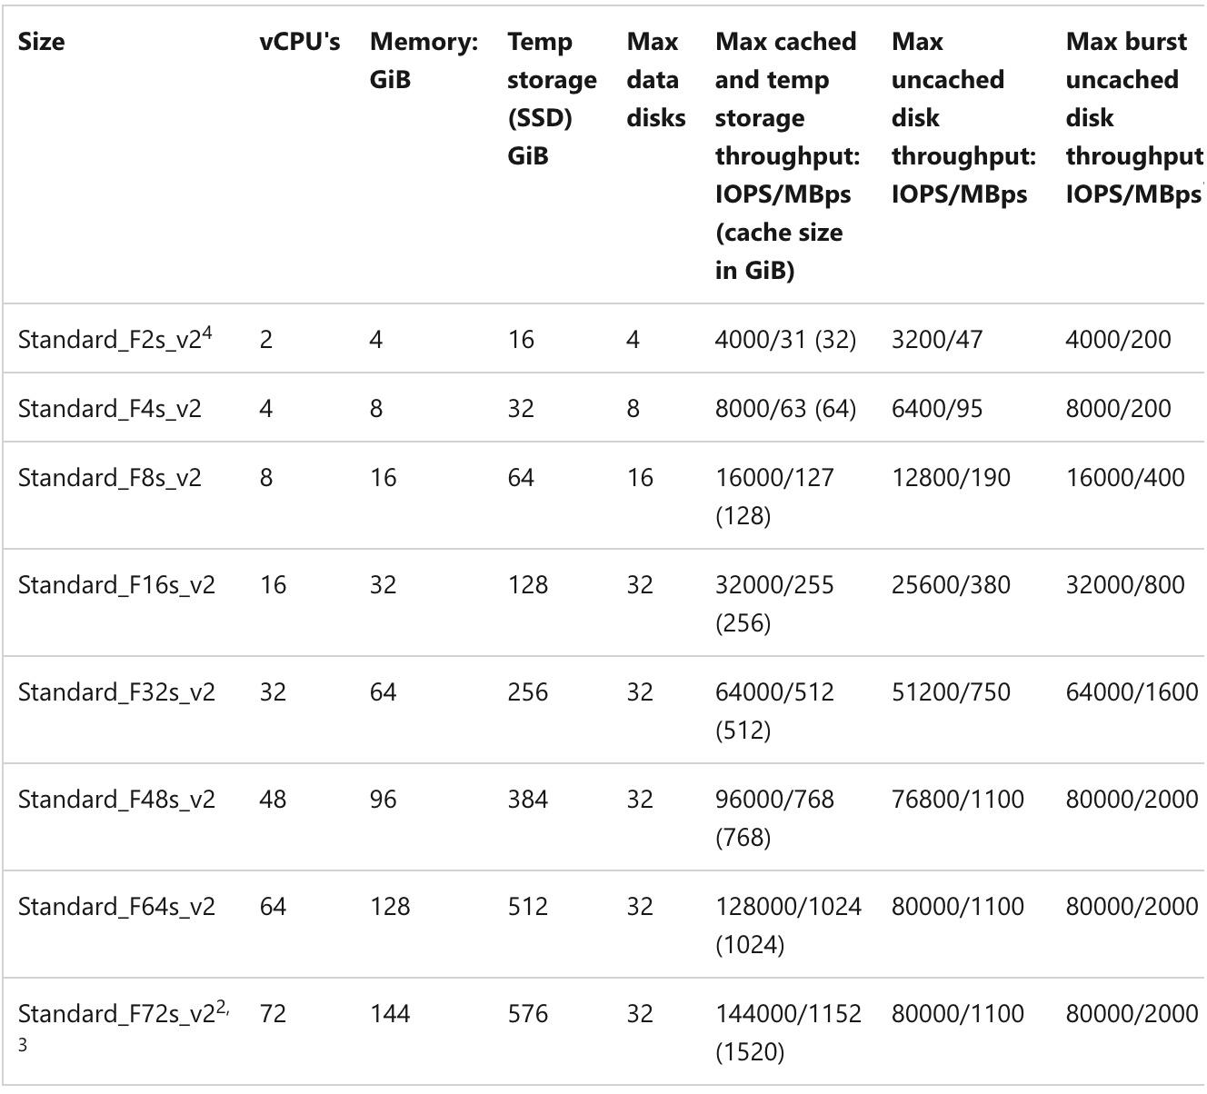

Competition Hardware: Track #1 Eval and Train
FSv2 Compute Optimized Series

Slide 25
Competition Hardware: Track #1 Eval and Train
FSv2 Compute Optimized Series

Slide 26
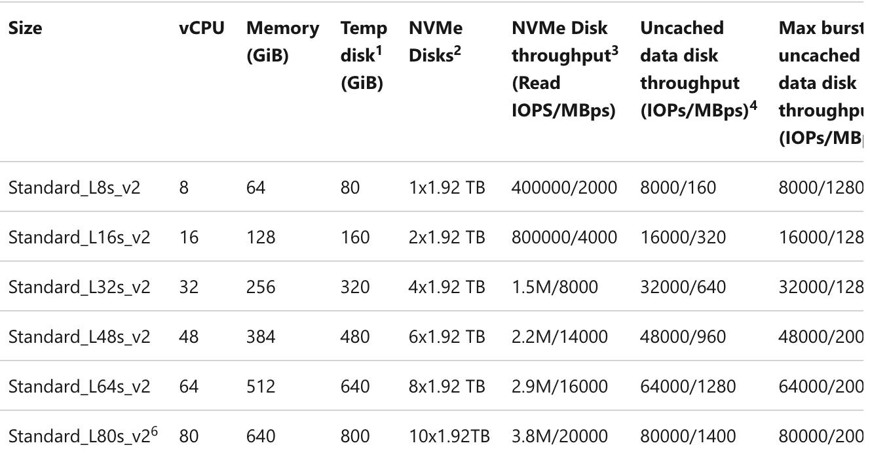
Competition Hardware: Track #2 Eval
LSv2 Storage Optimized w/High Throughput NVM SSD

Slide 27
Competition Hardware: Track #1 and #2
Track #1
32 vCPUs
Track #2
8 vCPUs
Build Machine
64 vCPUs

Slide 28
Competition Hardware: Track #1 and #2
Track #1
32 vCPUs
64GB
Track #2
8 vCPUs
64GB + 2TB HTD
Build Machine
64 vCPUs
128 GB + 4TB SSD

Slide 29
Competition Hardware: Track #1 and #2
Track #1
32 vCPUs
64GB
$1.696/hr
Track #2
8 vCPUs
64GB + 2TB HTD
$0.688/hr
Build Machine
64 vCPUs
128 GB + 4TB SSD
$3.392/hr

Slide 30
Competition Hardware: Track #1 and #2
Track #1
32 vCPUs
64GB
$1.696/hr
Track #2
8 vCPUs
64GB + 2TB HTD
$0.688/hr
Build Machine
64 vCPUs
128 GB + 4TB SSD
$3.392/hr
(4 days)

Slide 31

Competition Hardware: Track #3
Commercially Available
Evidence of Cost (MSRP)
Power Monitoring
Access
Otherwise, No Limits!!
“This Track Is Wild!”

Slide 32
Competition Ranking

Slide 33
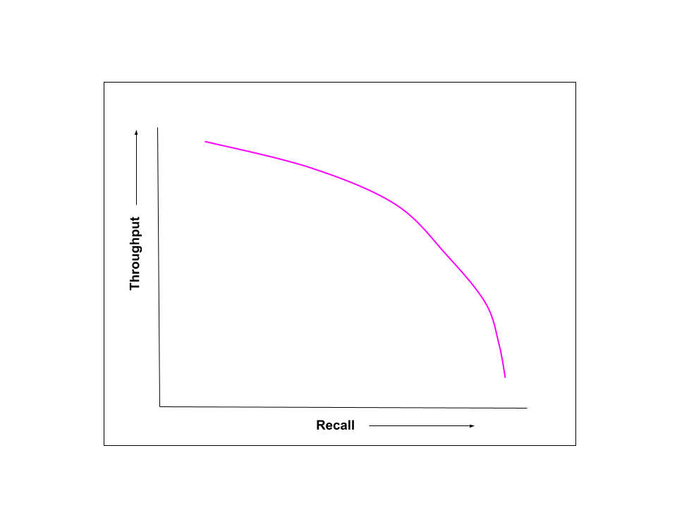
ANN Benchmarks

Slide 34
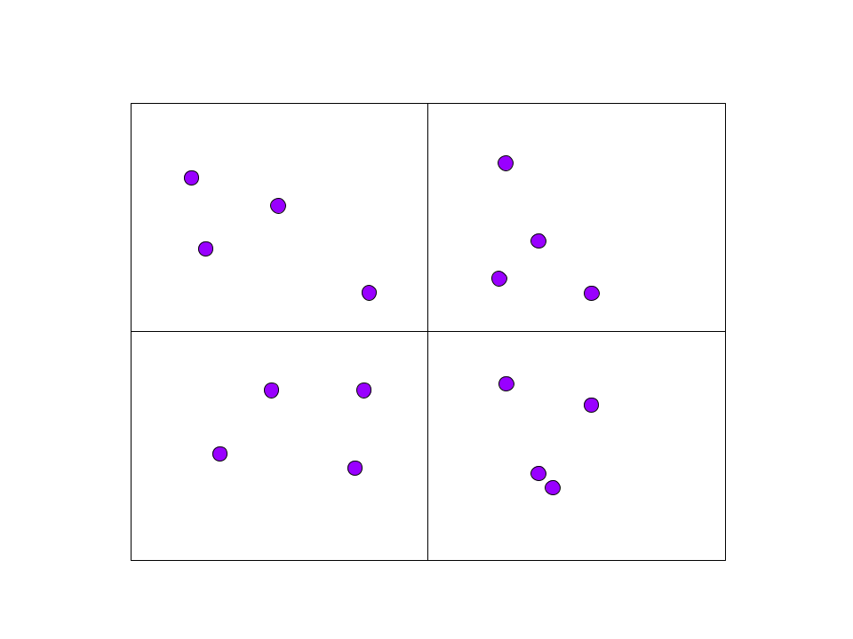
ANN Benchmarks: Recall

Slide 35
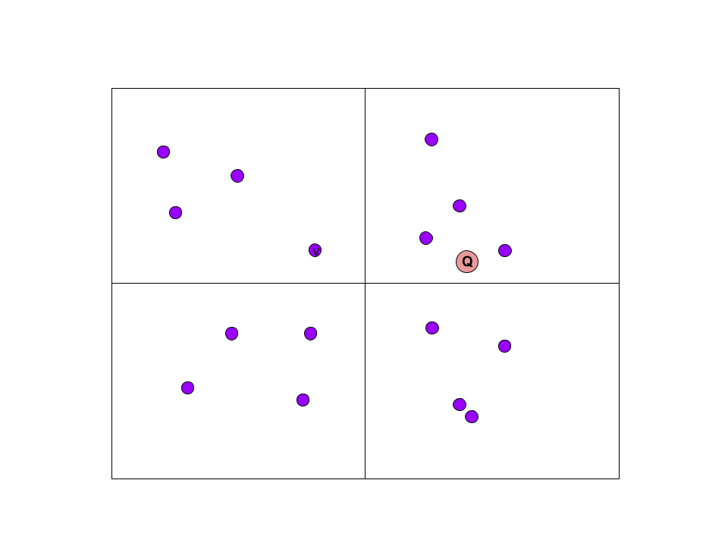
ANN Benchmarks: Recall

Slide 36
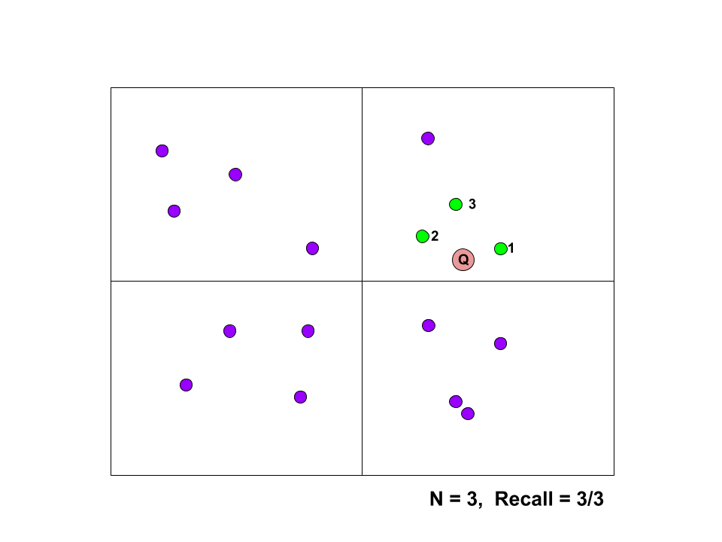
ANN Benchmarks: Recall

Slide 37

ANN Benchmarks: Recall
N = 3, Recall = 3/3

Slide 38
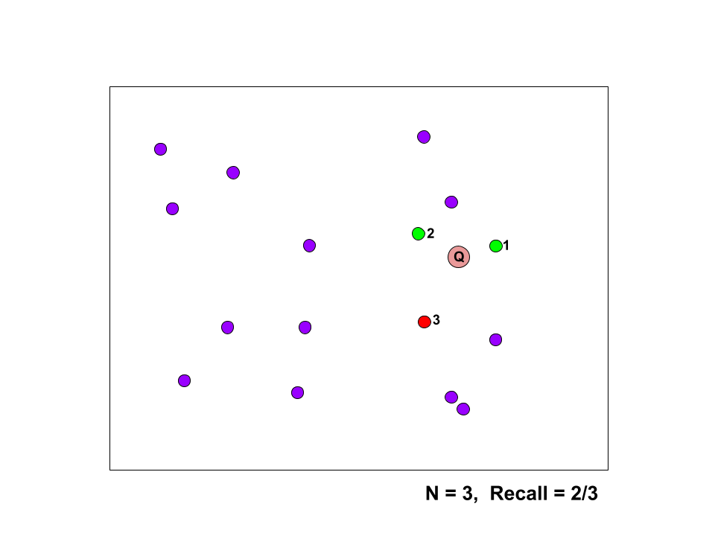
ANN Benchmarks: Recall
N = 3, Recall = 2/3

Slide 39
ANN Benchmarks: Recall vs Throughput
Recall
N = 10
10K q

Slide 40
ANN Benchmarks: Recall vs Throughput
Recall
N = 10
10K q
Throughput
Batch

Slide 41
ANN Benchmarks: Recall vs Throughput
Recall
N = 10
10K q
Throughput
Batch
Run Parameters
10 / dataset
X
X
X
X
X
X
X
X
X
X

Slide 42
ANN Benchmarks

Slide 43
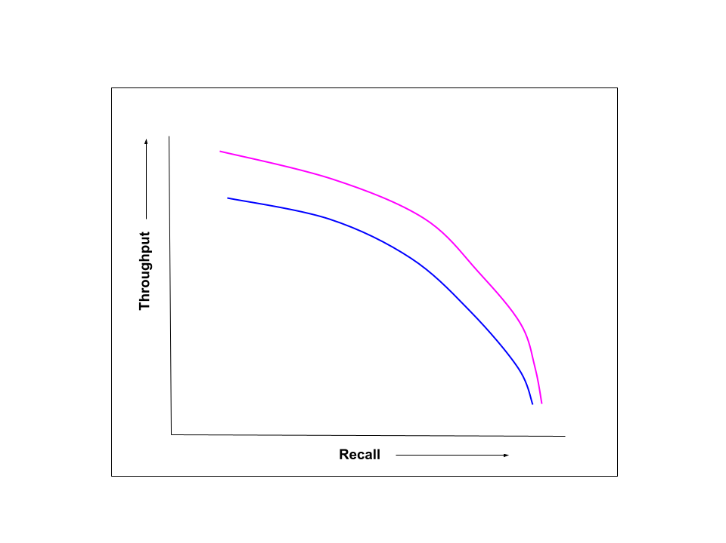
ANN Benchmarks

Slide 44
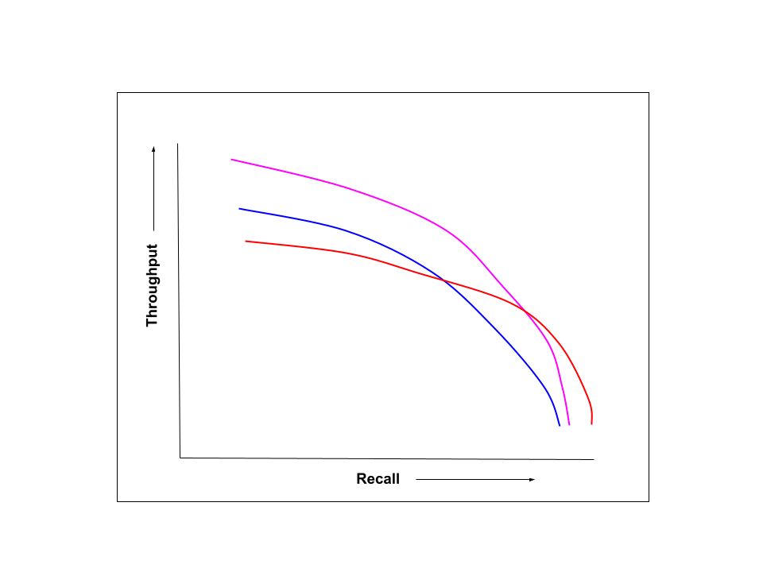
ANN Benchmarks

Slide 45
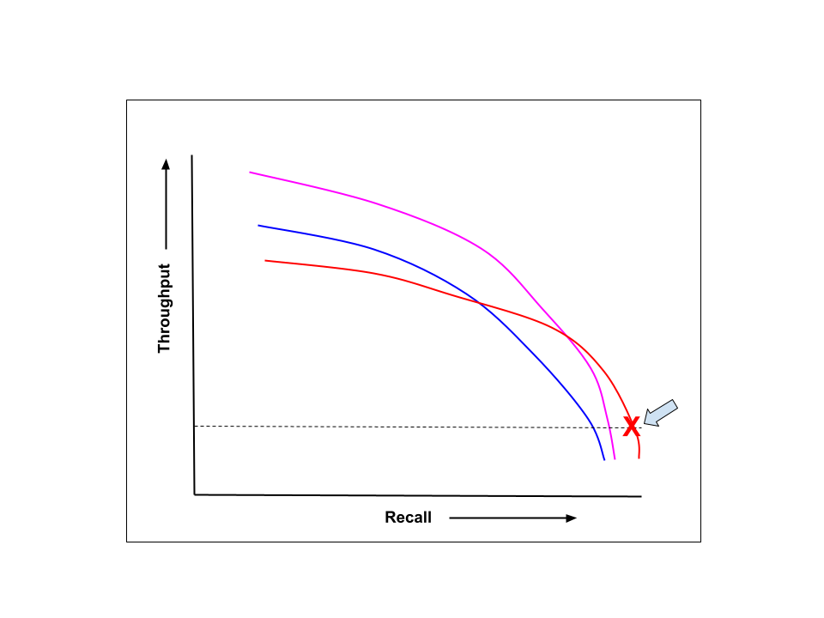
ANN Benchmarks and Ranking
operational threshold

Slide 46
Competition Recall Ranking
Track | Operational Threshold
#1 | 10,000 QPS
#2 | 1,500 QPS
#3 | 2,000 QPS

Slide 47
Competition Baseline Algorithms

Slide 48
Baseline Algorithms
Track | Baseline Algorithm
#1 | Faiss-IVFPQ
#2 | MS-DiskANN
#3 | Faiss-IVFPQ + 1 GPU
* Baseline algorithms provided by organizers
* Final ranking based on cumulative
improvements over baseline

Slide 49
Competition Results

Slide 50
Winners Summary
Track | Benchmark | Winners
#1 | Recall@10 | Kuaishou+Tsinghua U
#2 | Recall@10 | Zilliz+SUST
#3 | Recall@10 | Intel on Optane

Slide 51
Winner: Track #1 (Benchmark=Recall@10)
Winner: Kuaishou+Tsinghua U (15 participants)
Team | BigANN | Deep | MSSpaceV | MSTuring | Text2Image | SSNPP
K+T U | 0.711 | 0.723 | 0.7645 | 0.756 | - | -
* threshold = 10,000 QPS

Slide 52
Winner: Track #1 (Benchmark=Recall@10)
Winner: Kuaishou+Tsinghua U (15 participants)
Team | BigANN | Deep | MSSpaceV | MSTuring | Text2Image | SSNPP
K+T U | 0.711 | 0.723 | 0.7645 | 0.756 | - | -
Faiss- IVFPQ | 0.635 | 0.650 | 0.729 | 0.704 | 0.069 | 0.754
* threshold = 10,000 QPS

Slide 53
Winner: Track #2 (Benchmark=Recall@10)
Winner: Zilliz+SUST (5 Participants)
Algo | BigANN | Deep | MSSpaceV | MSTuring | Text2Image | SSNPP
Zilliz+SUST | – | – | 0.760 | – | 0.495 | 0.886
* threshold = 1,500 QPS

Slide 54
Winner: Track #2 (Benchmark=Recall@10)
Winner: Zilliz+SUST (5 Participants)
Algo | BigANN | Deep | MSSpaceV | MSTuring | Text2Image | SSNPP
Zilliz+SUST | – | – | 0.760 | – | 0.495 | 0.886
MS- DISKANN | 0.950 | 0.937 | 0.900 | 0.936 | 0.489 | 0.163
* threshold = 1,500 QPS

Slide 55
Winner: Track #3 (Benchmark=Recall@10)
Winner: Intel Optane (8 Participants)
Algo | BigANN | Deep | MSSpaceV | MSTuring | Text2Image | SSNPP
Intel on Optane | 0.9998 | 0.9998 | 0.9984 | 0.9957 | 0.9973 | -
* threshold = 2,000 QPS

Slide 56
Winner: Track #3 (Benchmark=Recall@10)
Winner: Intel Optane (8 Participants)
Algo | BigANN | Deep | MSSpaceV | MSTuring | Text2Image | SSNPP
Intel on Optane | 0.9998 | 0.9998 | 0.9984 | 0.9957 | 0.9734 | -
Faiss- IVFPQ on GPU | 0.9326 | 0.9428 | 0.9085 | 0.9132 | 0.8603 | 0.9786
* threshold = 2,000 QPS

Slide 57
Winners Summary (All Benchmarks)
Track | Benchmark | Winners
#1 | Recall@10 | Kuaishou+Tsinghua U
#2 | Recall@10 | Zilliz+SUST
#3 | Recall@10 | Intel on Optane
#3 | Throughput ( qps) | NVidia on 8 GPUs
#3 | Power ( KwH / q ) | Intel on Optane
#3 | Cost ( $ / 100K qps * 4yr ) | Intel on Optane

Slide 58
Highlights

Slide 59
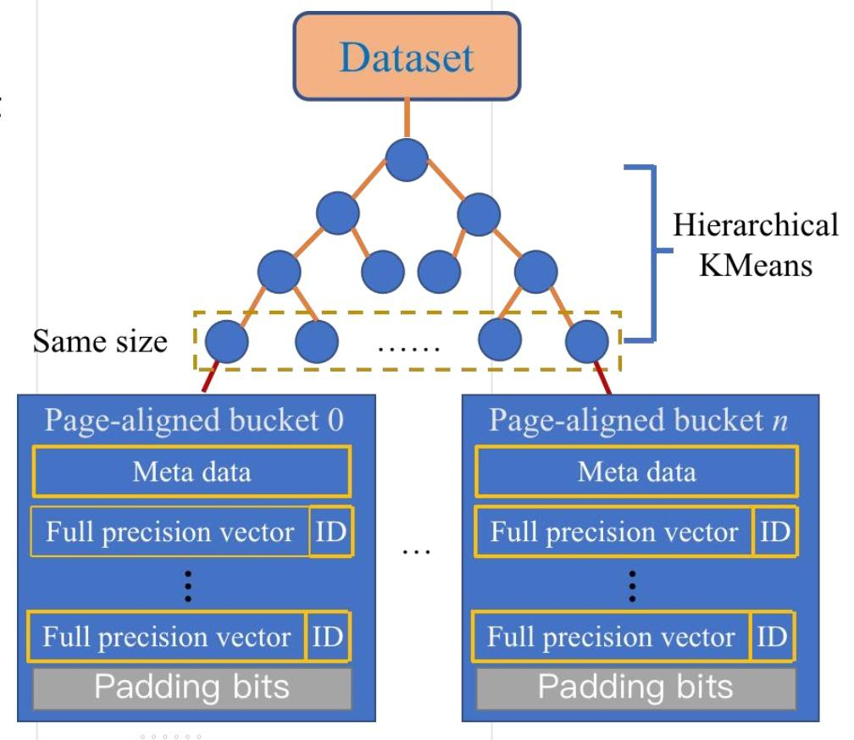
Track #2: Zilliz+SUST
Hybrid Graph Clustering Index
Memory Layout and Access Optimized For SSD
DiskANN Design
SSD

Slide 60
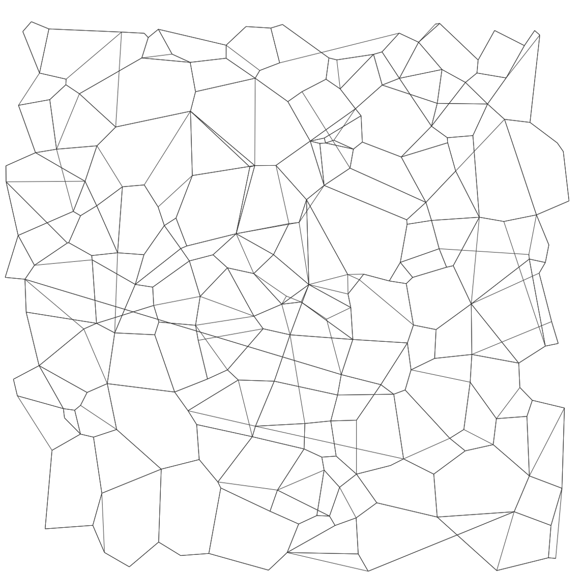
Track #2: MS-DiskANN Baseline
DiskANN Design
Compressed vectors
(50-60GB/billion vectors)
DRAM
Low-diameter graph
+full-precision vectors
SSD
graph construction similar to HNSW

Slide 61
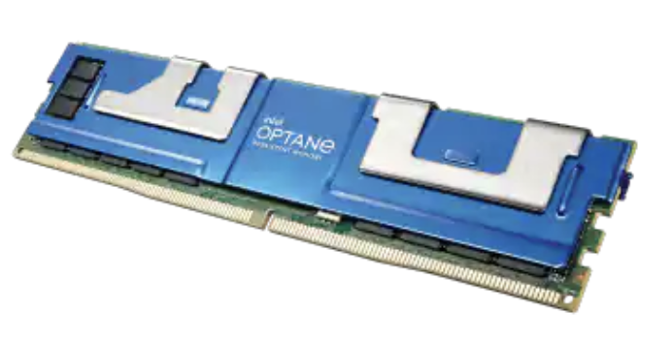
Track #3 Recall Winner: Intel on Optane
Intel Optane NVM DIMM (16)
Graph–based Algorithm

Slide 62
Track #3 Recall Winner: Intel on Optane
Intel Optane NVM DIMM (16)
Graph–based Algorithm
Top-performing algorithms on Recall@10 were neck-and-neck
 | Team | BigANN | Deep | MSSpaceV | MSTuring | Text2Image | SSNPP
1 | Intel | 0.9998 | 0.9998 | 0.9984 | 0.9957 | 0.9973 | -
2 | Nvidia | 0.9988 | 0.9954 | 0.9899 | 0.99443 | 0.9469 | -

Slide 63
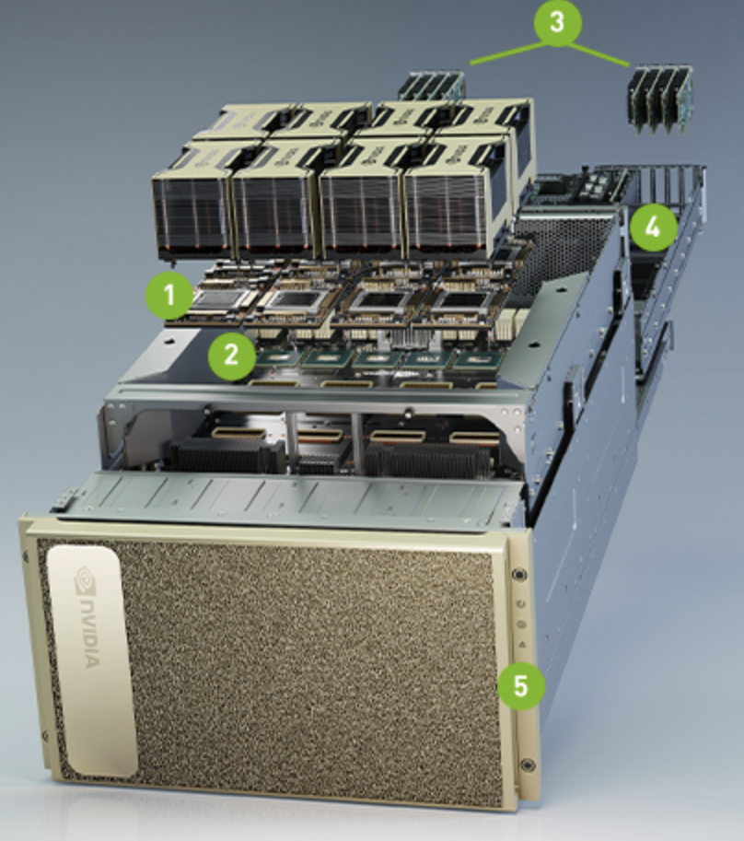
Track #3 Throughput Winner: NVidia on 8 GPUs
NVidia A100 w/8 GPUs
Compression Via Product Quantization
Clustered Inverted File Index
Ranking Benchmark = qps
Operational Thresh, recall@10 = 0.9

Slide 64
Track #3 Throughput Winner: NVidia on 8 GPUs
NVidia A100 w/8 GPUs
Compression Via Product Quantization
Clustered Inverted File Index
Ranking Benchmark = qps
Operational Thresh, recall@10 = 0.9
The Clear Winner!
 | Team | BigANN | Deep | MSSpaceV | MSTuring | Text2Image | SSNPP
1 | Nvidia | 747K | 802K | 840K | 584K | - | -
2 | Intel | 336K | 197K | 158K | 161K | 17K | -

Slide 65
Track #3 Power Winner: Intel Optane
Benchmark = KwH / q
Via IPMI standard

Slide 66
Track #3 Power Winner: Intel Optane
Benchmark = KwH / q
Via IPMI
The Clear Winner!
 | Team | BigANN | Deep | MSSpaceV | MSTuring | Text2Image | SSNPP
1 | Intel | 0.0022 | 0.0041 | 0.0049 | 0.0048 | 0.0446 | -
2 | Nvidia | 0.0119 | 0.0112 | 0.0090 | 0.0090 | 0.0480 | -
* (watt-sec) / q shown here

Slide 67
Track #3 Cost Winner: Intel Optane
Benchmark = $$ / ( 100K qps * 4 yrs )
System Cost includes everything MSRP
Horizontal Scaling of 1 System
$0.10 / KwH

Slide 68
Track #3 Cost Winner: Intel Optane
Benchmark = $$ / ( 100K qps * 4 yrs )
System Cost includes everything MSRP
Horizontal Scaling of 1 System
$0.10 / KwH
The Clear Winner!
 | Team | BigANN | Deep | MSSpaceV | MSTuring | Text2Image | SSNPP
1 | Intel | $15K | $16K | $16K | $16K | $104K | -
- | Nvidia | $304K | $304K | $153K | $153K | $917K | -

Slide 69
Future

Slide 70
Suggestions Box For Next Competition
Qual Too Many Datasets
Help With Index Build
Recall@100
Neighbors Order
More RAM T1/T2
Higher Dimensions
Bit-Vectors / Hamming
Experimental Hardware

Slide 71
2022 Competition
New Datasets
  BERT-like video emb
  > 768 dims
Benchmarks
  query-by-query
  qps all tracks
Filters
Insertions/Deletions
Out-of-Distribution Q

Slide 72
How To Participate

Slide 73



Getting Involved
big-ann–benchmarks.com
github.com/big-ann-benchmarks
medium.com/big-ann-benchmarks
big-ann-organizers@googlegroups.com
gwilliams@ieee.org

Slide 74

Q&A
Organizers
Harsha Simhadri, Microsoft
George Williams, Smile Identity
Martin Aumuller, ITU
Mathijs Douze, Meta
Artem Babenko, Phystech
Dmitry Baranchuk, Yandex
Qi Chen, Microsoft
Lucas Hosseini
Ravishankar Krishnaswamy, Microsoft
Gopal Srinivasa, Microsoft
Suhas Subramanya, CMU
Jingdong Wang, Baidu

Slide 75
Track #1 Winner: Kuaishou+Tsinghua University

