Slide 1
OpenSearch - Ecommerce Search & Discovery Platform
Powered by Querqy
Notes:
intro / linkedin profiles / new slide #todo ani

Slide 2



About us
Dr. Johannes Peter
Psychology and Computer Science | Querqy Committer | Team Servant | Data & Cloud Engineer | Product Manager (if there is no alternative)
https://www.linkedin.com/in/dr-johannes-peter-1b060975/
Shenoy Pratik
SDE @ Relevancy Engineering OpenSearch.org | USC Alumni | Ex-Computer Vision at SAP
https://www.linkedin.com/in/pshenoy36/
Anirudha Jadhav
Open-Source @AWS | Engineering Leader @ OpenSearch.org , Solr, Lucene Elasticsearch
https://www.linkedin.com/in/ianirudha/

Slide 3
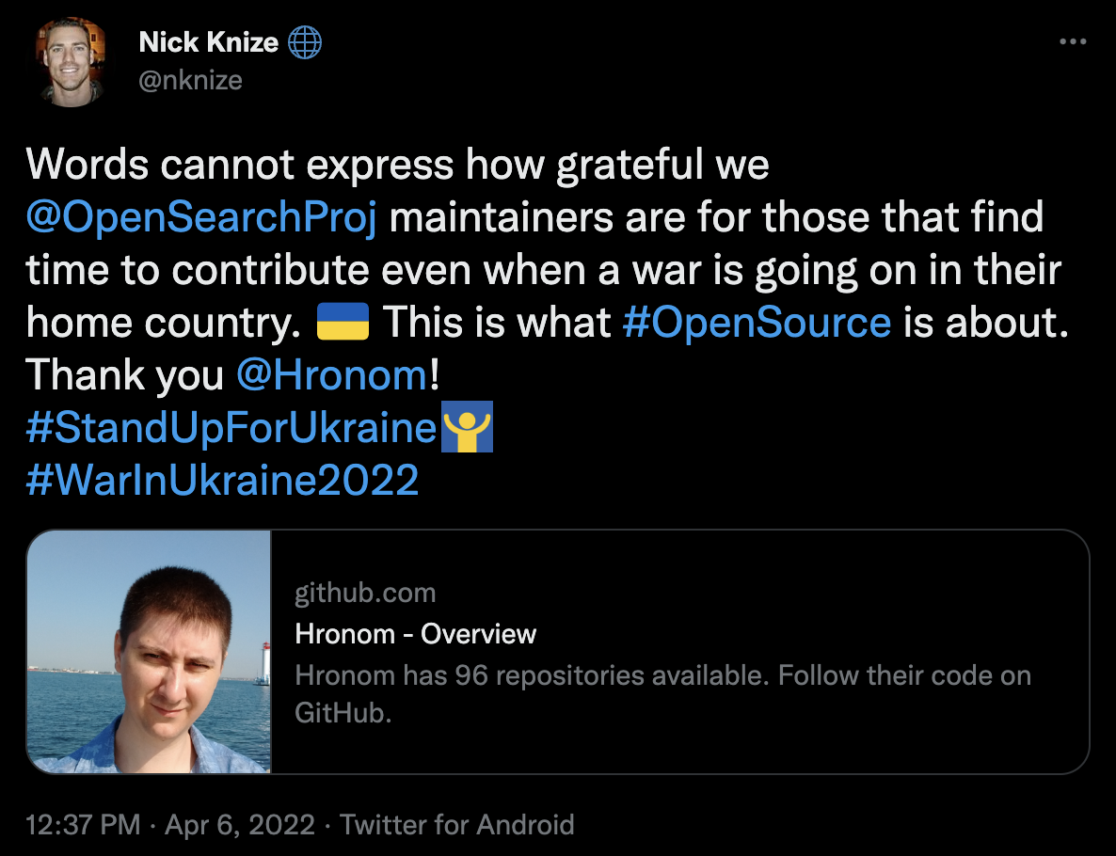
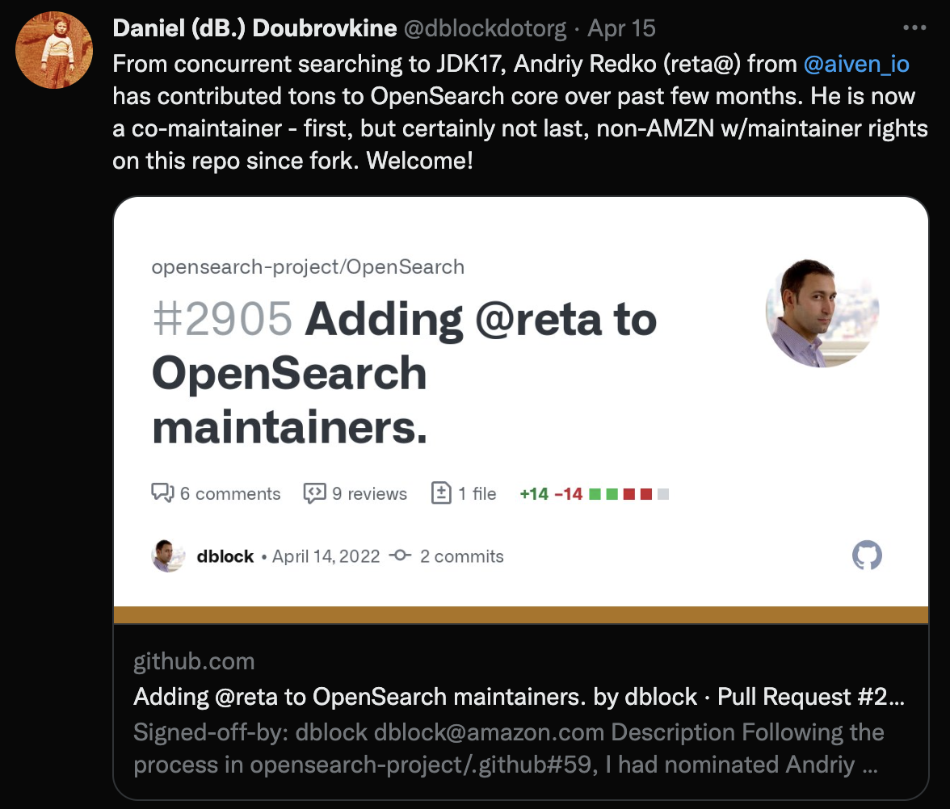

About OpenSearch(.org)
Notes:
what is open search
Know about the background
Released 1.0 around 1 year ago
Community -> Issues, design proposal
Biweekly community meeting opensearch.org/events or meetup.com
external maintainer and truly open project for everyone

Slide 4
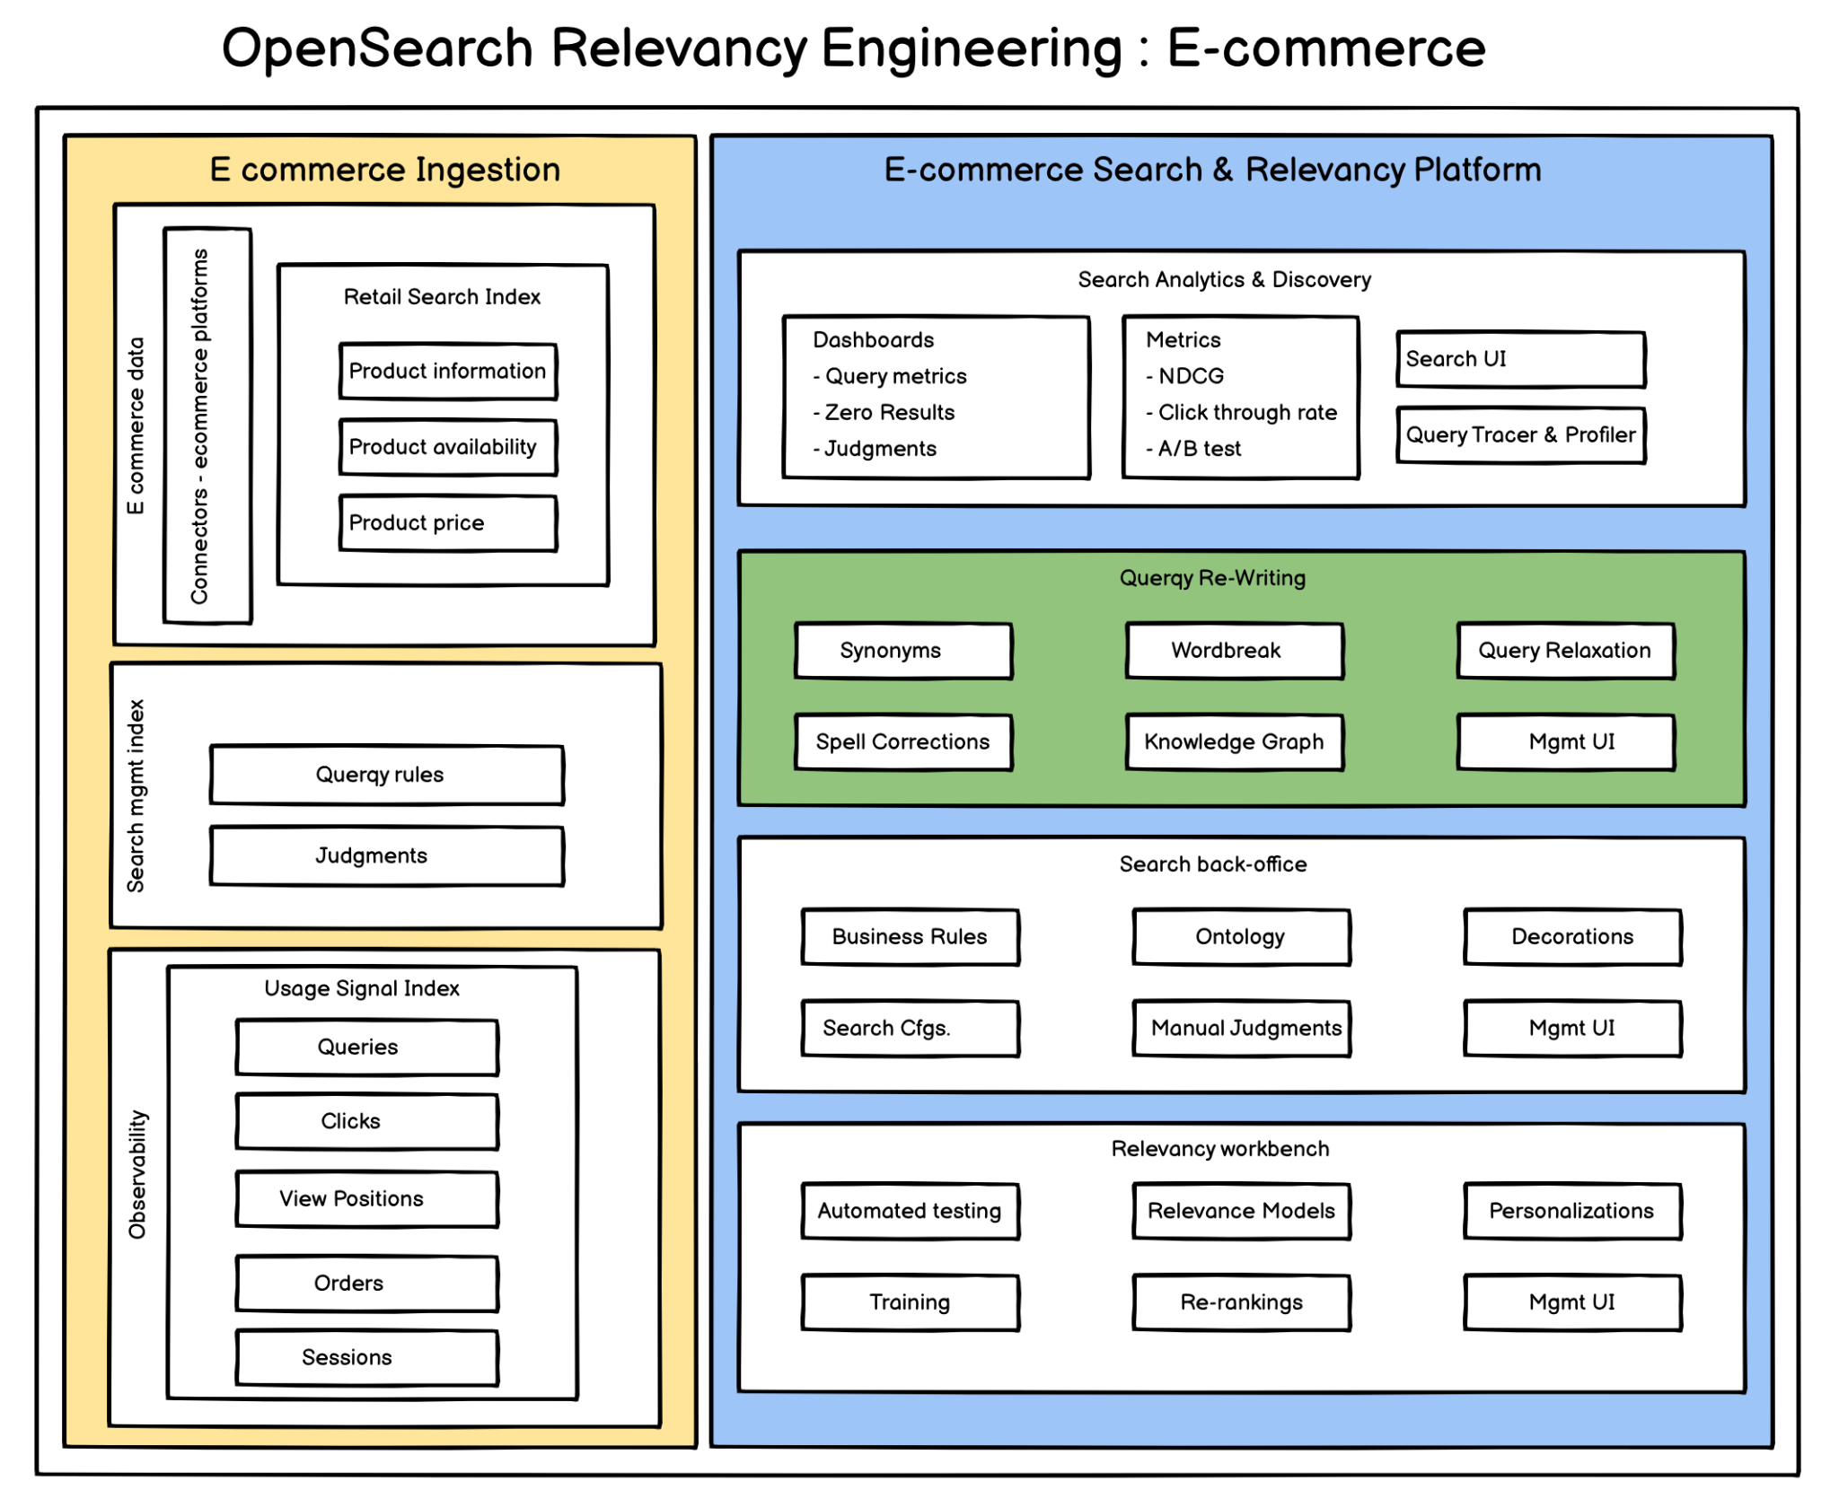
Notes:
user centric search vs content search

Slide 5
Search in the context of retail

Slide 6


“You want to implement a new search? This is a great idea. We will give you a long list of requirements. As soon as you have implemented all the features we will somehow compare the searches and decide whether we want to have it or not.”
Notes:
Most retailers already have some kind of webshop with some kind of search
Reasons for developing a new search are heterogeneous (cloud transf, potential for growth)
Common problems / challenges; how can they be shared
Developing a new search is not trivial

Slide 7
Sales responsibilities
Teams sliced by categories (category managers)
  Smartphones
  Notebooks
  …
Overall responsibility
  Discounts
  Promotions
  Findability
  …

Slide 8
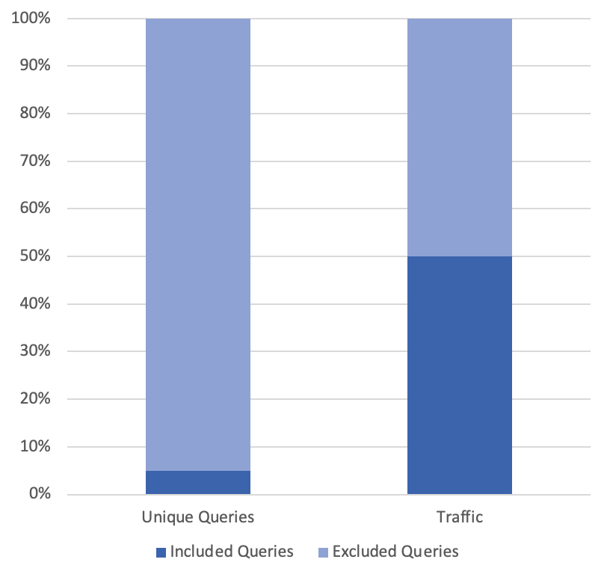
Much focus on short-head
Maintainable amount of queries
{

Slide 9


“I don't care about algorithms. I need the following products to be at the top for several queries at next Tuesday between 5 and 10 pm. Thank you.”

Slide 10

Retail is marketing-driven
Singles' day (139 bn in China in 2021)
Black Friday
Valentines Day
Thanksgiving
Christmas
…
Notes:
Alibaba and JD

Slide 11
“Your machine learning learns the wrong things. Please tell it to push our private labels!”

Slide 12
What is relevance in retail about?
Customer satisfaction / inspiration / experience
Margin
Promotions
Private labels
Manufacturer deals
Storage cost
Return cost
Sponsored products

Slide 13
“Well, you finally did it and released a new search ... ... this is awesome ... uhm ... we are all really excited about this ... ... and ... uhm ... what about AI?”

Slide 14
Why developing an own search?
This is the must-have
{

Slide 15
Why developing an own search?
{
This is the potential
This is the must-have
{

Slide 16
Get your short-head done!
Continuous improvement & maintenance
Enablement of Category Managers
Query rewriting
  Wordbreak
  Spell Correction
  Synonyms / Graphs
  Boosts
  Semantic filters
  …

Slide 17

Own your e-commerce search with Chorus
(Wrigley, 2022)
Querqy (library/plugin for search business rules)
SMUI (UI for rule maintenance)
Splainer (tracing / debugging of result scores)
Quepid (manual judgments)
Blacklight / ReactiveSearch (search UI)

Slide 18
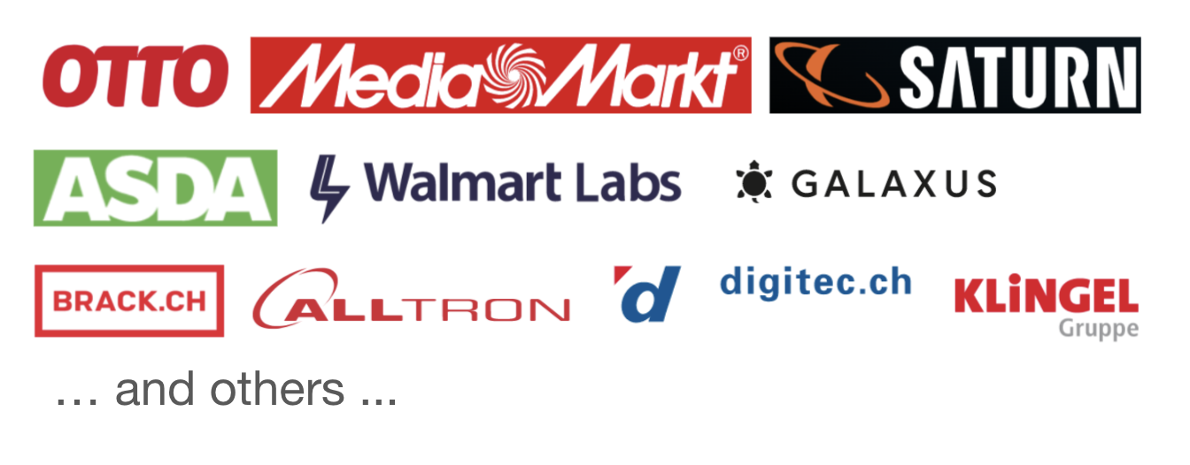
What is Querqy?
Querqy is a library and an open source query rewriting plugin for Solr, Elasticsearch and (soon) OpenSearch

Slide 19
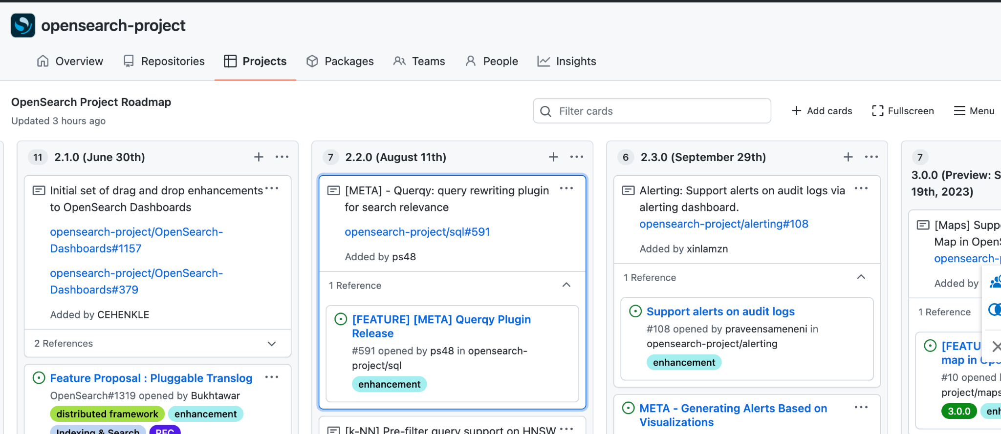
Querqy for OpenSearch
Source code: https://github.com/JohannesDaniel/querqy-opensearch
Roadmap: https://github.com/orgs/opensearch-project/projects/1
Notes:
https://github.com/orgs/opensearch-project/projects/1
link in SQL repo
current project link

Slide 20
Analytics with OpenSearch

Slide 21
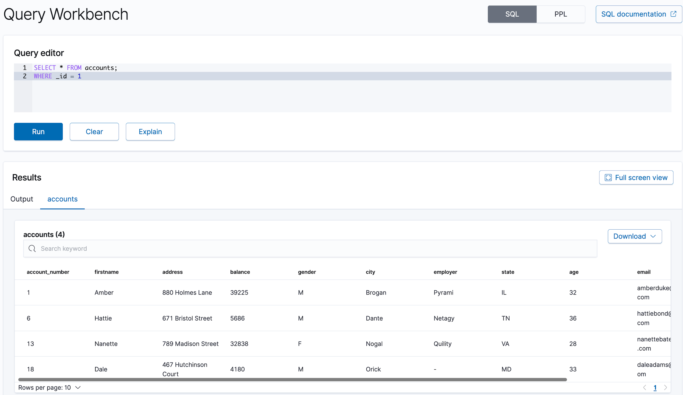
OpenSearch SQL
OpenSearch SQL lets you write queries in SQL rather than the OpenSearch query DSL
SQL supports
  Aggregations
  Full-text Search
  Functions
  JDBC
  ODBC

Slide 22
OpenSearch SQL for E-commerce
Sample session dataset:
  We created sample session data that captures queries, product clicks and checkout information
  The products are subset of category `printers` from Chorus Dataset
  Attributes stored: session_id, query, product_click, checkout details

Slide 23
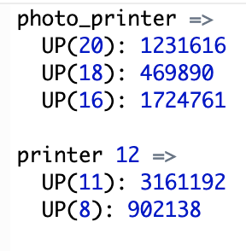
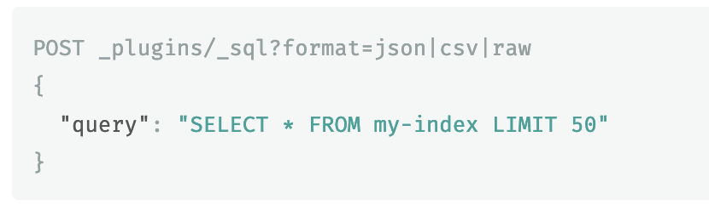
OpenSearch SQL for E-commerce
Using the output of OpenSearch SQL, we can update the querqy rules
Go a step further, to automate the querqy rules with SQL REST APIs

Slide 24
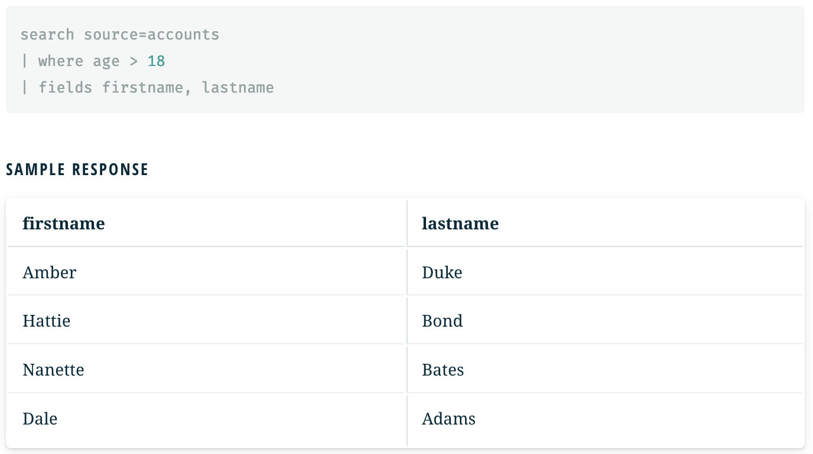
OpenSearch PPL
Piped Processing Language (PPL) is a query language that lets you use pipe (|) syntax to explore, discover, and query data stored in OpenSearch, especially for observability.

Slide 25
Observability into E-commerce Session Data
Use OpenSearch PPL to create graphs, charts and panels.
Create visualization and saved queries from clickstream logs, session information, service logs in Events Analytics.
Create operational panels to aggregate all the visualizations in a single pane.

Slide 26
Join us
100% open source work!
https://www.linkedin.com/in/ianirudha - lets talk!
  Greater Seattle Areas
  Vancouver CA
  Berlin, Germany
  Bangalore, India
  Shanghai
  Fully remote!

Slide 27
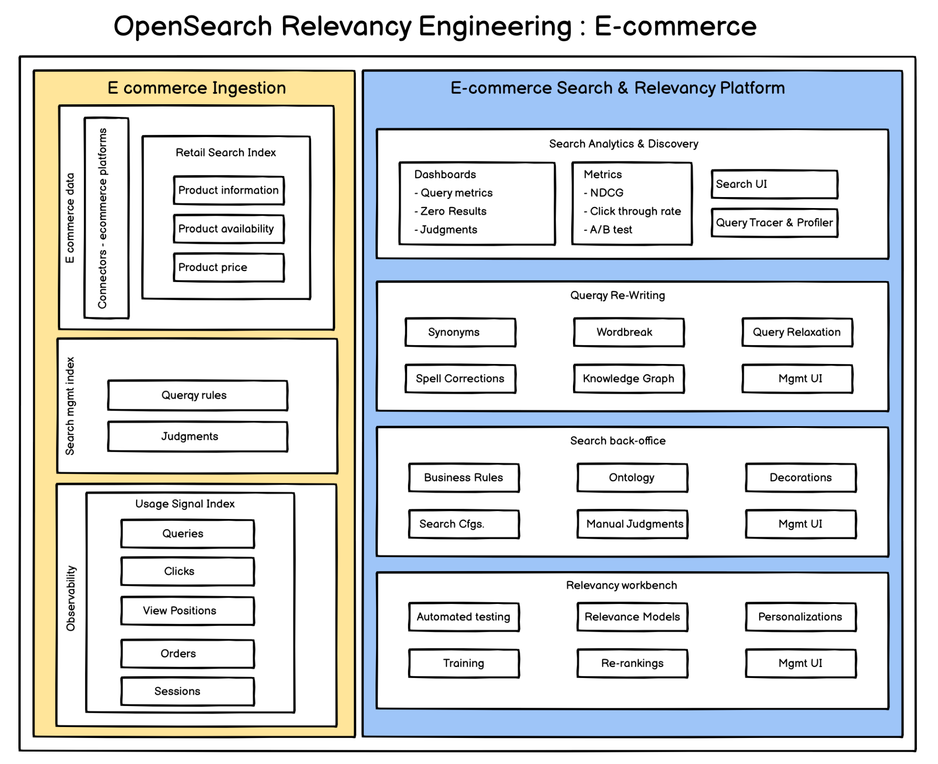
Future plans
&
Thank You!
Notes:
OpenSearch - Search and Relevancy Platform
How do customers use a Search Platform?
Index Data
Json data/docs using API Clients or crawlers.
Configure Search relevance
Searchable fields
Custom rankings attributes
Create Search UI/UX
Support for different search use-cases (E-commerce, Doc Search, Geo Search, etc.)
Full-text Search Querying with configurable params (no. of results returned, structure of result)
Iterate
Analytics
ClickStream
A/B testing
Personalization
Dynamic Re-Ranking
Search Platform Features
Customers expect the following features to be present out of the box to enable faster, relevant and accurate search.
Spell Corrections & Typo Tolerance
Synonyms
Support for Languages
Rule Configuration
Search Management UI
Re-ranking & Learning to rank
Grouping and deduplication
Geo-awareness
Search Testing
Search Scoring
Customer insights
Advanced language processing
Lemmatization, word breaks, stop words, optional words, prefixes.
Search Platform Components
Search Engine Backbone - OpenSearch
Indexing/Searching Connectors
API Clients - PHP, Ruby, Js, Python, Swift, Kotlin, Java, Go, Scala, .NET
Framework integrations: Direct integrations with ORM - Django, Rails, Symfony, Laravel
Extensions: Jekyll, Wordpress, Magento 2, Shopify, SFCC B2C, Netlify, Zendesk
Search UI
QuickSearch → A UI library to providing quick production grade UI, connected to Search APIs
Support for integrable widgets: sort, filter, product UI grids, rating, price, search bar
Available in variety of flavors: React, VueJs, IOS, Android.
OpenSource (Apache 2) Libraries: Blacklight, Reactive Search
Auto-Complete → A UI library to complete user inputs.
Improves user experiences, reduces typo/ language errors.
Makes the search platform pluggable to websites/Apps.
Themed Search libraries: Restricted to specific use-cases
Document Search - Captures document hierarchy, handles typos.
Needs an integrable crawler. To search and index webpages, catalogs
Geolocation Search - Uses lat/long coordinates, filters by geographical areas
Relevance Engine
Query Pre-Processing: Querqy
Search/Rules Management UI
Query Tuning UI
Learning to Rank/AI re-Ranking
Personalization
Analytics
Click Stream
Query Observability and Analytics
Testing/Scoring Engine
Quepid
Scaling
RRE
Security

