Slide 1


Search Relevance @ Box
Simplicity
Jay Franck, Machine Learning Engineer
2023

Slide 2
Box (NYSE:BOX) is the leading Content Cloud, a single platform that
empowers organizations to manage the entire content lifecycle, work
securely from anywhere, and integrate across best-of-breed apps.
Founded in 2005, Box simplifies work for leading global organizations, including AstraZeneca, JLL, and Nationwide. Box is headquartered in Redwood City, CA, with offices across the United States, Europe, and Asia. Visit box.com to learn more. And visit box.org to learn more about how Box empowers nonprofits to fulfill their missions.

Slide 3
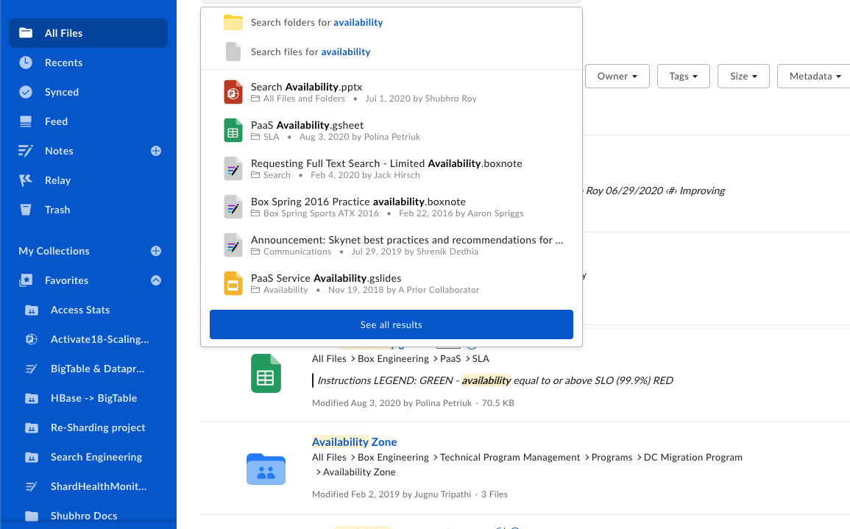








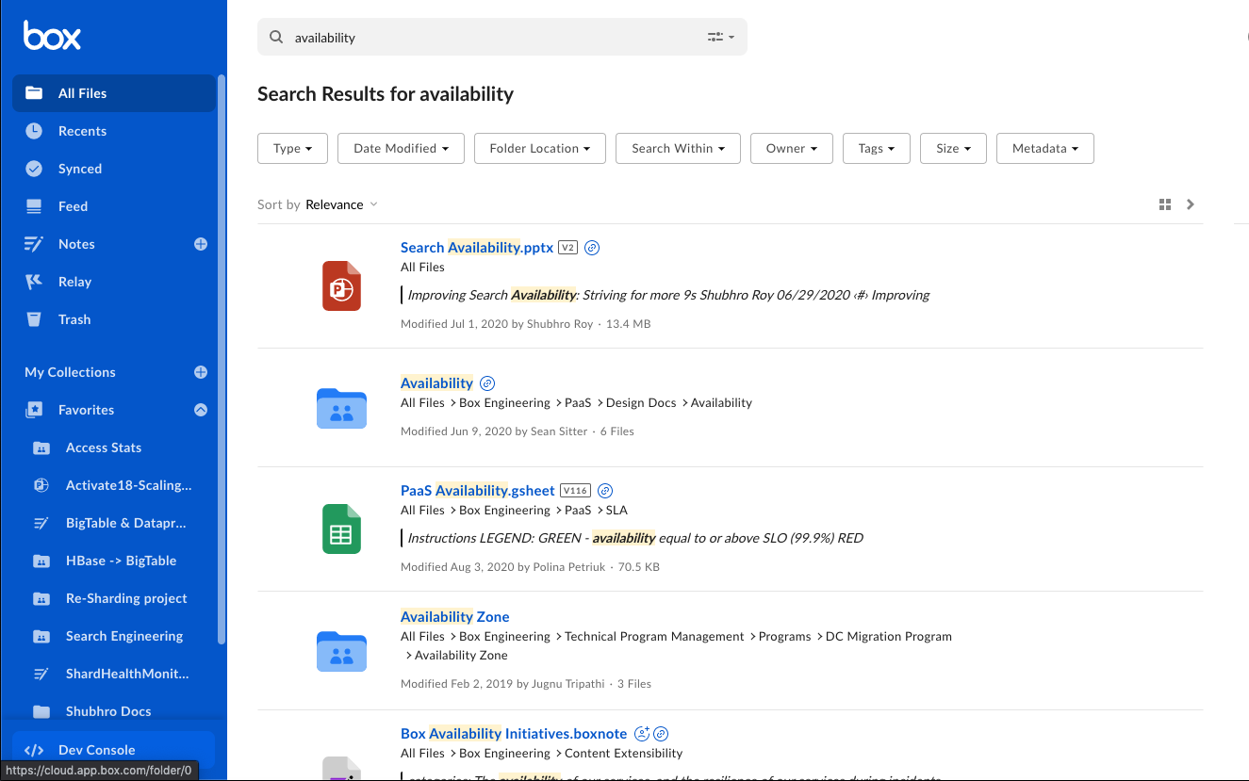

Box Search

Slide 4
Box hosts some of the world's most important content from many of the largest organizations
Safety and security are crucial
Efficiency and scalability are imperative
Availability is mission critical
Challenge
and
Opportunity

Slide 5
Search enables customers to find their valuable insights in an efficient manner.
200+ billion docs
10k+ updates / sec
Challenge
and
Opportunity
200+ TiB index size
100+ queries / sec

Slide 6
How do Customers use Box Search?
Specific content retrieval vs. Discovery
Keyword matching is common
No Q&A (e.g., "How does NDCG work?")
Lack of Natural Language queries

Slide 7
Relevance Philosophy
Make it Universally available
Think of long-term maintenance
Keep it as simple and safe as possible

Slide 8







Architecture
Search Service
AWS SageMaker Reranker
(TensorFlow Model)
Top K Most Recent Documents

Slide 9
What aspects of Search does the Relevance team touch?
Solr Query Field Boosting (qf)
Solr Timestamp-based boost (recip)
TensorFlow Ranking Model
Experimentation + A/B Testing
Relevance
Stack

Slide 10
For each eDisMax query, terms that match with a Solr field will have an associated score -> Which fields are most relevant?
Query: "Box"
Document 1: {Title: Cardboard Boxes, Description: Cardboard Construction}
Document 2: {Title: Box Company Earnings, Description: FY23 Box Company Earnings Report}
We could try to manually tune each of these. Is there a better approach?
q=box&qf=title^1.5 description^3
Boosting Query Field
(qf)
Scores

Slide 11
Suppose you had a set of extracted field scores and a label (Actual Ranking).
Per query, the scores used are relative and fairly uninteresting
How do you tune the global weights such that you can boost important fields?
qf: title^1.45,description^1.2,metadata^2.45
Genetic Algorithm
Title Score | Description Score | Metadata Score | Actual Ranking | Document Id
3.24 | 1.05 | 0.75 | 4 | 11342342
0.75 | 0.24 | 0.0 | 0 | 37810394
0.92 | 2.3 | 0.65 | 2 | 94615184
0.34 | 0.78 | 0.12 | 1 | 16387764

Slide 12
Our approach in Spark
Grab all labelled queries
[De-boost] Normalize features from 0->1 at the request level
Fit a simple linear model to the normed features to get a baseline ranking
Grab relative weights, scale to fitness
Build a bunch of amoebas (variants) with various perturbations and mutations
Rank fitness based on NDCG of each amoeba
Repeat 4,5,6 until convergence threshold is reached
Genetic Algorithm
Don't code this up by yourself! Use PyGAD or S-GA (Spark)

Slide 13
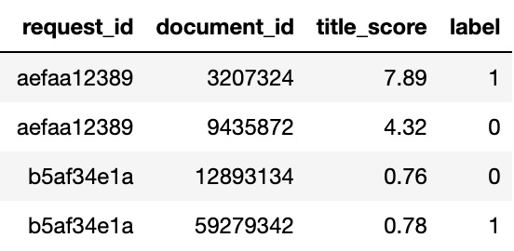
Grab all labelled queries
Genetic Algorithm
Over-simplified example...

Slide 14
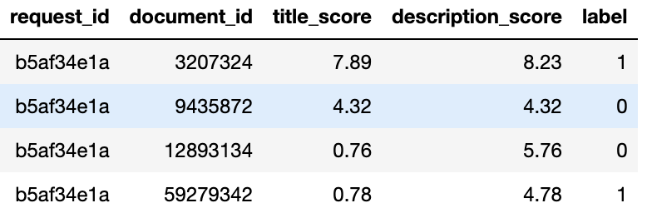
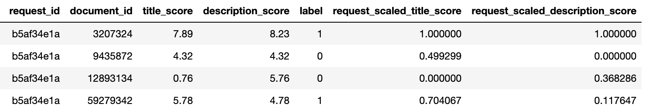
2. [De-boost] Normalize features from 0->1 at the request level
Especially important if you have multiple experiments!
Genetic Algorithm

Slide 15
3. Fit a simple linear model to the normed features to get a baseline ranking
4. Grab relative weights
title_field^1.45, description_field^1.05
This is our baseline model to be improved upon!
Genetic Algorithm

Slide 16
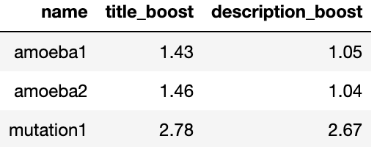
6. Build a bunch of amoebas (variants) with various perturbations and mutations
Genetic Algorithm

Slide 17
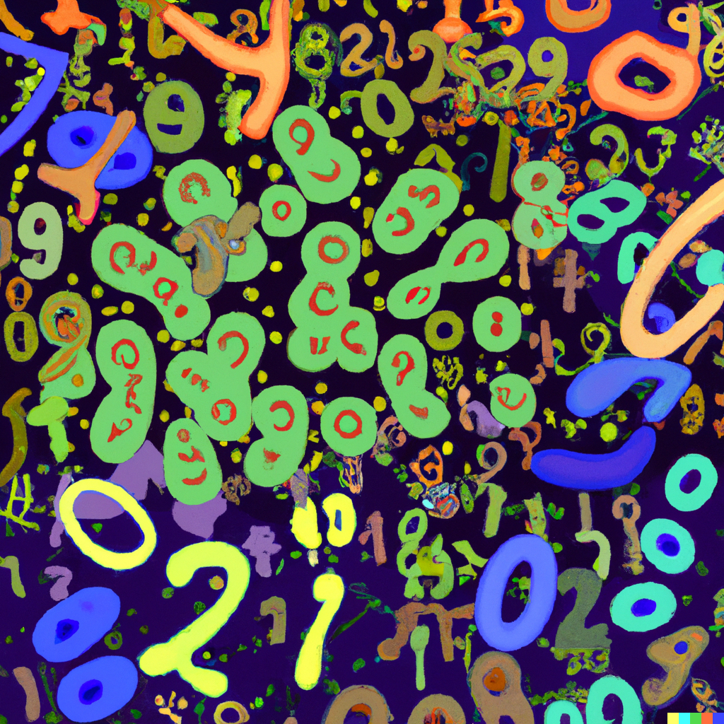
Genetic Algorithm

Slide 18
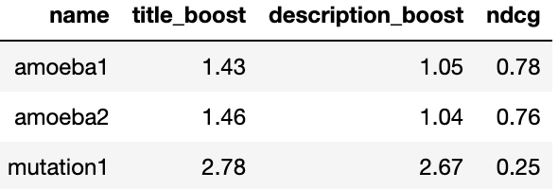
7. Test fitness (NDCG) of each variant, rescale parameters based on strength
Genetic Algorithm
NB: Can use this for pf fields as well!
​

Slide 19
If there are a large number of Documents being returned by Solr from a Lucene search, how do you improve the recall set for your reranker?
    Virality
    Popularity
    We will tackle Virality first.
Timestamp Boost Tuning

Slide 20
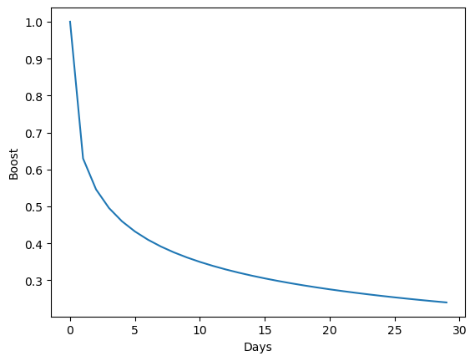
Using the Solr recip function, add a multiplicative boost function to the timestamp of the last update to the Solr document:
boost : recip(x, m, a, b) := f(x) = a/(xm+b)
x: The timestamp delta
m: inverse timescale
Timestamp Boost Tuning
Nolan Lawson's blog post
Timothy Potter's presentation at LuceneRevolution in 2011
This Stack Overflow answer

Slide 21
    We have actually introduced a further parameter, and that is to raise the time difference to a power < 1
    Full formula: ~recip(pow(ms(NOW,updated),0.5),1e-6,1,1)
    m = 1 e –6 (of order < a day)
    a,b = 1
    x = SQRT(Time in Milliseconds – Timestamp of Last Update)
Timestamp Boost Tuning
Remember that m is representative of the timescale of the virality of your user interactions with updated content. Box customers typically interact with fresh documents, while most online guides we saw had timelines of weeks/years!

Slide 22
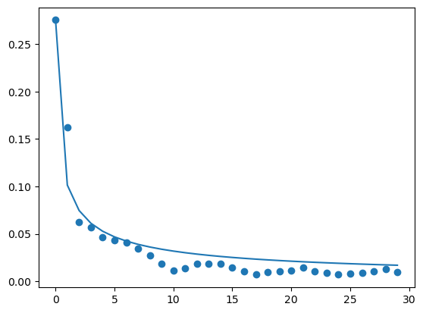
How do you actually tune these values? Our imperfect approach:
Fit the recip function to your document interaction data
A/B test the rest (Reranker interactions, etc.)
Timestamp Boost Tuning
Days since last update on a Document

Slide 23

Once you have a decent set of BM25 matches, how do you get the top results to the user?
Throw the Top K results to a Reranker
      K can be determined experimentally, via user studies, or set by business rules
      TensorFlow Ranking is a well-documented, maintained, scalable solution
TensorFlow Ranking

Slide 24

TensorFlow Ranking

Slide 25
Feature Set (Apart from Solr `score` output)
Updated/Created timestamps (Virality)
User interaction with the document and parent folders (Recents from Redis)
Individual Solr field scores
Number of other editors of the document (Popularity)
TensorFlow Ranking

Slide 26
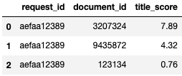
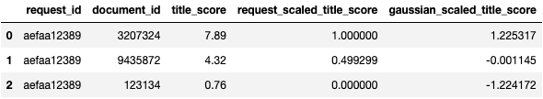
TensorFlow Ranking

Slide 27
Feature Set
Raw features +
Globally-scaled features +
Query-scaled features +
Binary Features
      We let the NN decide which are important
      WeightedSHAP - https://arxiv.org/abs/2209.13429
TensorFlow Ranking

Slide 28
Missing feature handling
.fillna(0.0) is not sufficient
Reciprocal functions, timestamp deltas need careful thought
How are you caring for categorical/binary items?
Some domain experience here is critical
TensorFlow Ranking

Slide 29
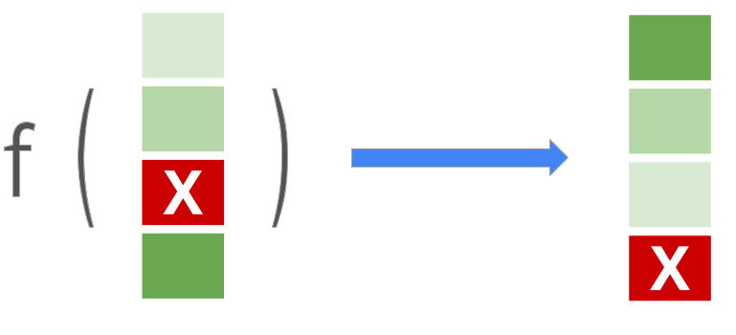
Double layer ~100 nodes is sufficient
Softmax loss
100k training examples is acceptable
Dropout ~50% is very helpful
We train a single model for all of our customers, regardless of language or industry.
TensorFlow Ranking

Slide 30

Experiments that failed, in brief...
Context Aware
Document Interaction Network (http://research.google/pubs/pub49364/)
Arbitrarily large ranking (latency + diminishing returns)
Categorical/Embedding features
Approx. NDCG loss (https://research.google/pubs/pub48168/)
TensorFlow Ranking

Slide 31

Other misfortunes:
Insufficient logging for feature extraction
Sending large JSON blobs
Natural Log vs Base 10
TensorFlow Ranking

Slide 32

AB Testing Framework

Slide 33
Each experiment can get:
Variable amount of traffic
Specific users/enterprises pinned to it
A combination of Endpoints + Solr configs
Built via a series of Jsonnet configuration files that are parsed with Search Service.
{
Traffic: 20
Reranker: JaysExtraFastModel.py
SolrBoost: recip(pow(ms(NOW,updated),0.5),1e-6,1,1)
}
AB Testing Framework

Slide 34
On a weekly basis, we evaluate experiment metrics:
Traffic
CTR
NDCG
Latency
via non-parametric stat tests (bootstrapping):
Provides mean values, confidence levels
Sanity-Check: Compare results to aggregated Welch's T-Test
AB Testing Framework

Slide 35
Search Relevance @ Box is
Built on Universal components that can boost all customers
Use Solr to boost recent documents
Simple/Scalable reranker model to boost popular items
Recap

Slide 36
QA

Slide 37
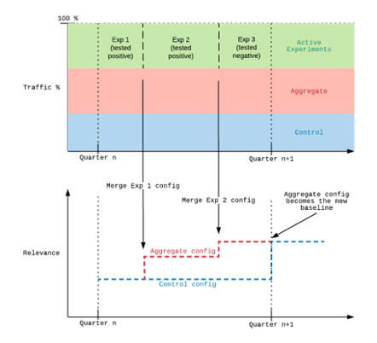
A/B Testing

