Slide 1


Creating Representative Query Sets For Offline Evaluation
ID #, Photographer Name

Slide 2




Introduction to Getty Images
Most content is supplied by independent contributors; we pay royalties when content is consumed
Customer Driven: Ensure that customers can find the content they’re after with as little friction as possible
We operate three sites:
Getty Images – Editorial and Creative content. Over 520M assets. For large businesses
iStock Photo – Creative content. Over 170M assets. For small to mid-sized businesses
Unsplash – Free creative content

Slide 3
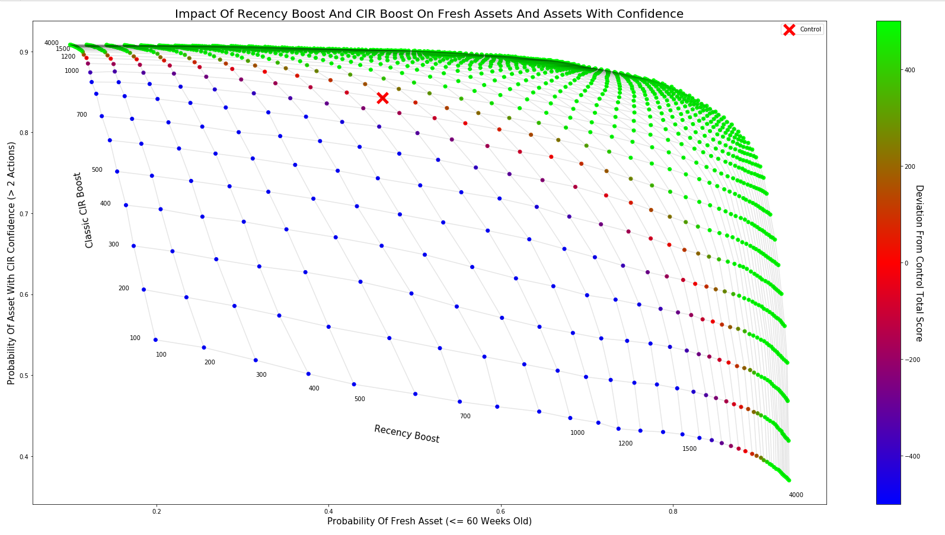
Sort Algorithm Optimization at Getty Images
All retrieval, and ranking control points define dimensions of an optimization landscape
We traverse this landscape using
Hypothesis-driven exploration
Machine Learning
Searching for configurations that best satisfy primary and guardrail metrics.

Slide 4

Experimentation Lifecycle
Ideation
Implement
Configuration
Offline Evaluation
A/B Testing
Deployment
ID #, Photographer Name

Slide 5
Motivation
Our pace of experimentation is rapidly increasing
We optimize for
Primary metrics: conversion, interaction
Guardrail metrics: recency, diversity etc.
We rely heavily on offline evaluation
To understand the impacts on guardrail metrics
To understand the risks to primary metrics
We need query sets to facilitate our offline evaluations.

Slide 6
Offline Evaluation
Our search is segmented by site, region, media type and sort type (and others)
Typically, we perform offline evaluations by
Constructing a new sort algorithm for a customer segment
Firing queries from a query set against control and the new sort
Capturing the results
Comparing aggregate statistics of the control and test sort algorithms

Slide 7

Query Sets
For offline testing to be indicative of what would happen should we push a sort algorithm to customers, the query set needs to be representative
Customer behaviour is seasonal, so a query set that is constructed from user queries before Christmas will not be representative in the summer
We are computationally bounded, so we would like query sets to be of a reasonable size
We would like it to be simple to refresh/create a new query set

Slide 8
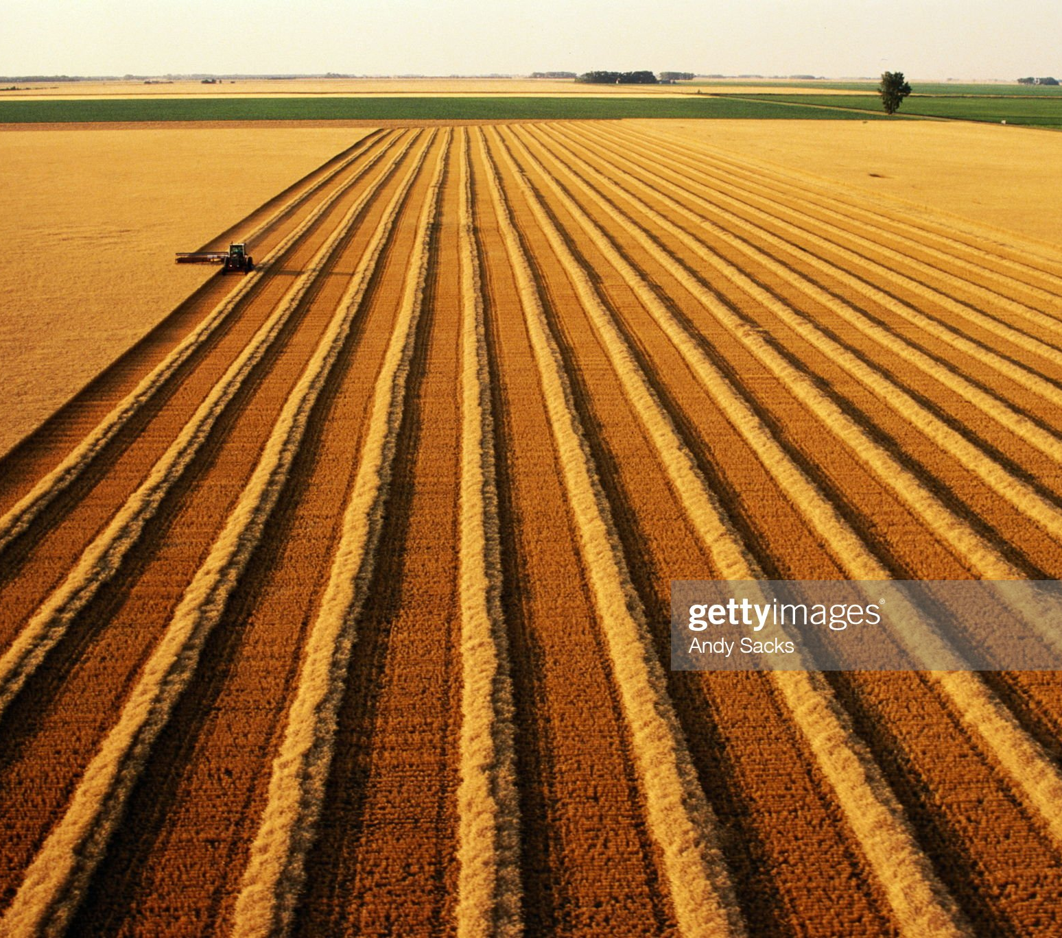
Harvesting Query Sets On-Demand
We’d like to harvest customer queries from our logs
We’d like to be able to create a new query set quickly and easily, without having to do a lot of analysis each time
Core question: “How big does a randomly sampled query set need to be in order to be representative?”
We reduce random sampling error through bootstrapping

Slide 9
What Does Representative Mean?
A query attribute is a categorical property of a search query
Numerical attributes are bucketed to make them categorical
We have several query attributes that we care about:
Number of concepts
Ambiguous terms
Number of results
Contains People
Query Frequency
Query Value, etc.
For a query set to be representative, the distributions of the buckets in the sample frame should be preserved in the query set

Slide 10
Approach
sample_size = 0
For attribute in attributes:
Find minimum_sample_size
If minimum_sample_size > sample_size:
sample_size = minimum_sample_size
Return sample_size

Slide 11
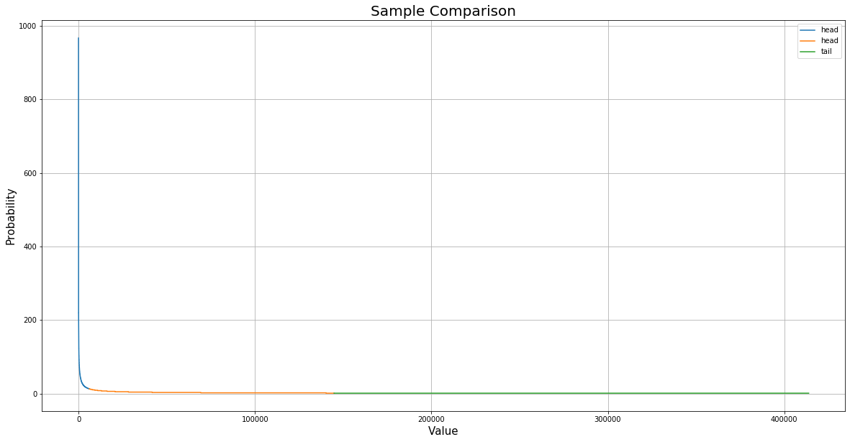


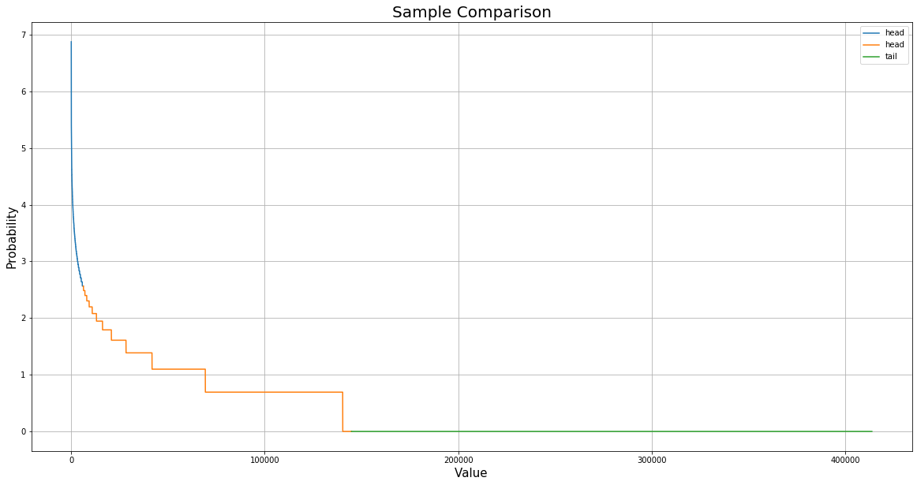
Example Attribute: Query Frequency
Bucketing:
Head: 1.5% most frequently occurring queries
Shoulder: 1.5% - 35% most frequently occurring queries
Tail: 65% least frequently occurring queries

Slide 12
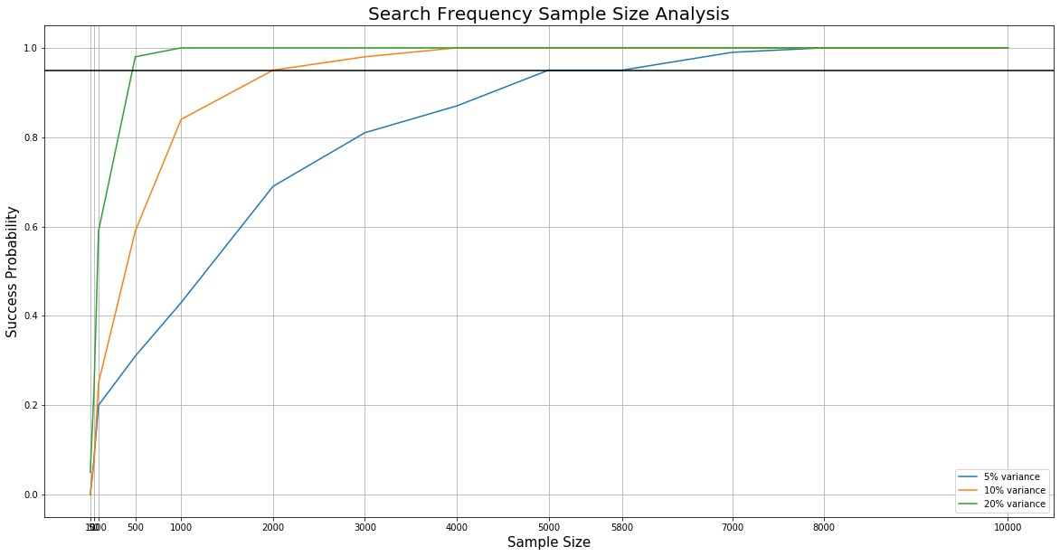
Example Attribute: Query Frequency
Intuition:
Choose a maximum allowable variance (e.g. 5%)
Choose a confidence interval (e.g. 95%)
Take repeated random samples from the sampling frame of progressively larger sizes until no bucket frequency changes more than the allowable variance from the sampling frame with the specified confidence.

Slide 13
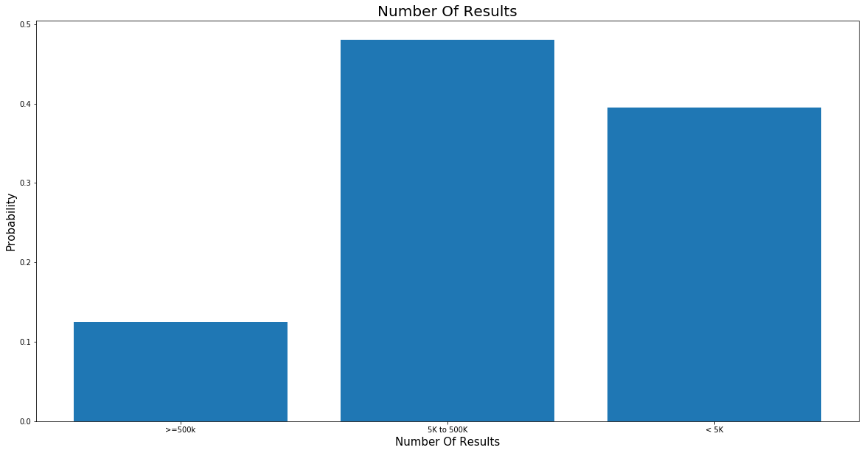
Summary Of Attributes
Some attributes have skewed distributions and require larger sample sizes to achieve a maximum 5% variance with a 95% confidence.

Slide 14

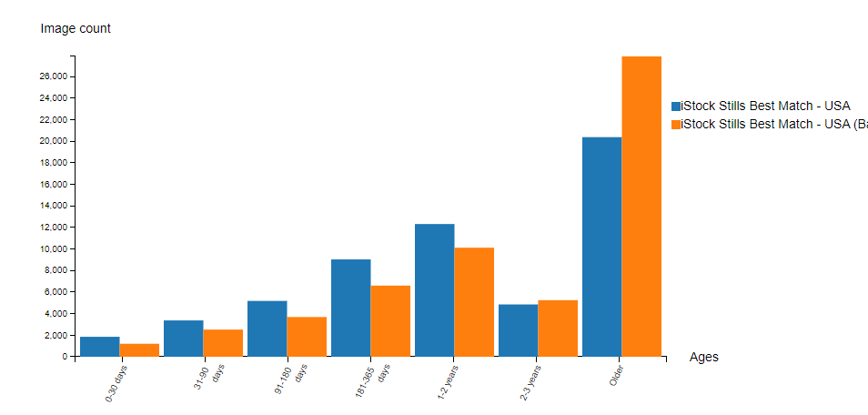
Findings
When repeated for all of our query attributes, we arrive at a minimum required sample size of 10 000 queries
So, if we need to refresh our query sets, we can be reasonably certain that harvesting a 10k random sample will be representative

Slide 15

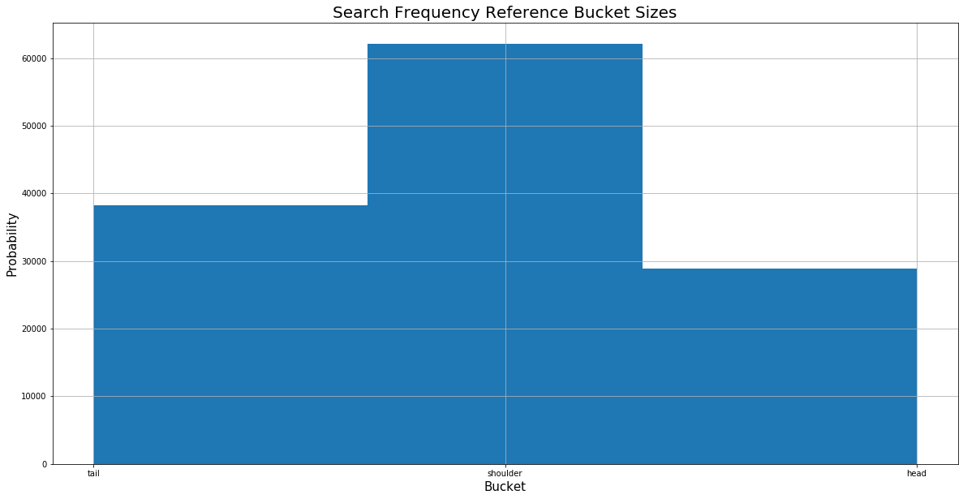
Findings
Engineer your attributes so that they have few buckets, of not very disparate sizes to keep your sample size as small as possible
In more computationally bounded scenarios we’ve made use of stratified sampling (inefficient prototypes where running 10K queries is prohibitive)

Slide 16

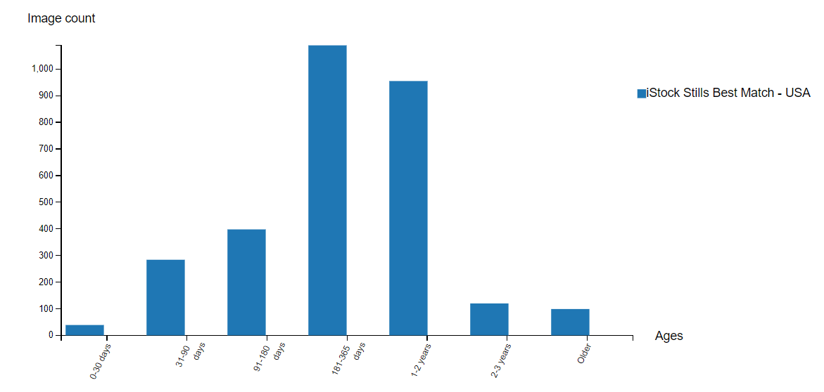
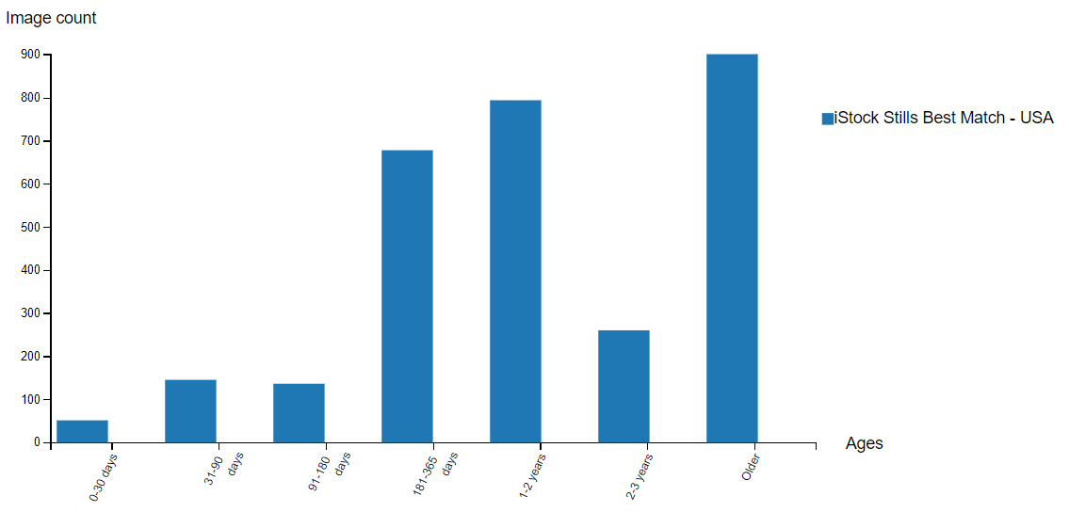
Slicing By Buckets
We can slice offline evaluations by attribute values to identify query segments that are most negatively (or positively) impacted by a change

Slide 17

Thank You

