Slide 1

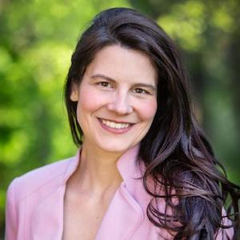
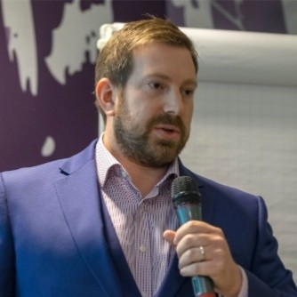
Vector Search
Information Services
Erica Lesyshyn
Max Irwin

Slide 2
Agenda
Search Ecosystem
Problem Statement
Previous Failures
Chosen Solution
Implementation
Next Steps
Source: Medscape EM Physician Compensation Report 2017

Slide 3



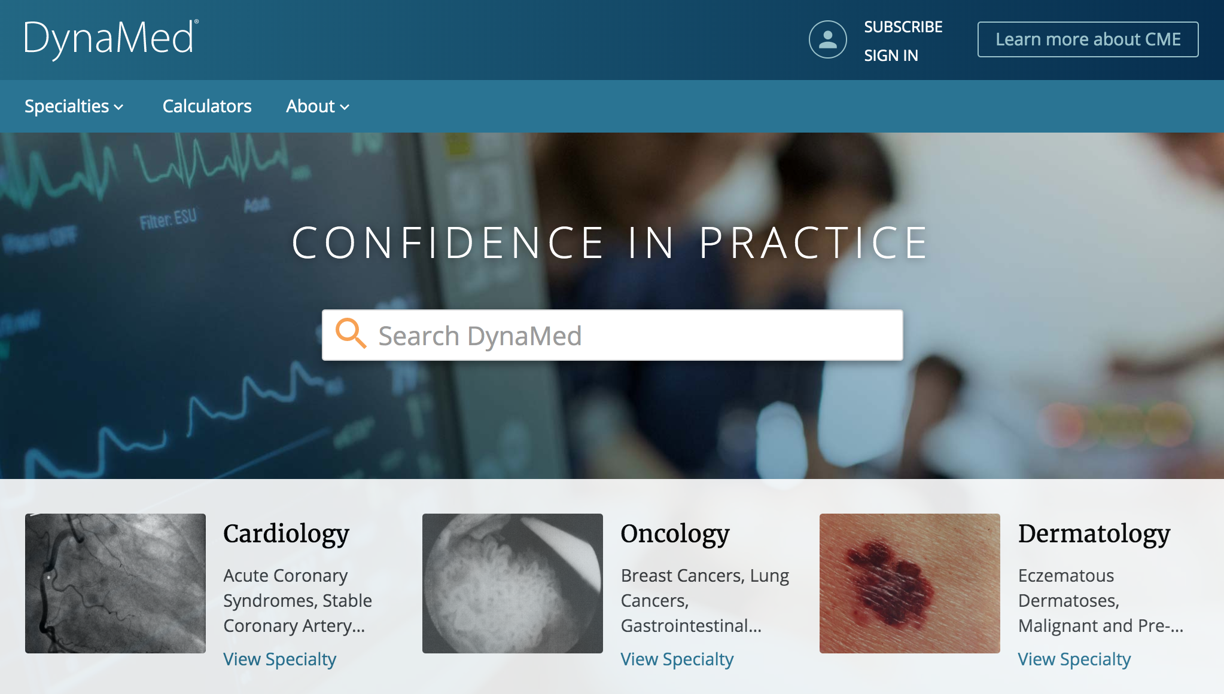
Clinical Decisions
INSERT SCREENSHOT HERE
DynaMed
DynaMedex
DynaMed Decisions
Dynamic Health
Source: Medscape EM Physician Compensation Report 2017

Slide 4
Search Ecosystem
CONTENT TRANSFORMATION
ENRICHMENT
INDEXING
MEDICAL SEARCH PLATFORM
QUERY INTELLIGENCE
SEARCH PREP
SEARCH RUNTIME
Knowledge
GRAGH
USER FEEDBACK
EXPERT FEEDBACK
CLICK THRU RATES
CONVERSION RATES
A/B TESTING
JUDGEMENT LISTS
GRAPH CURATION
SURVEYS & EXPERIMENTS

Slide 5
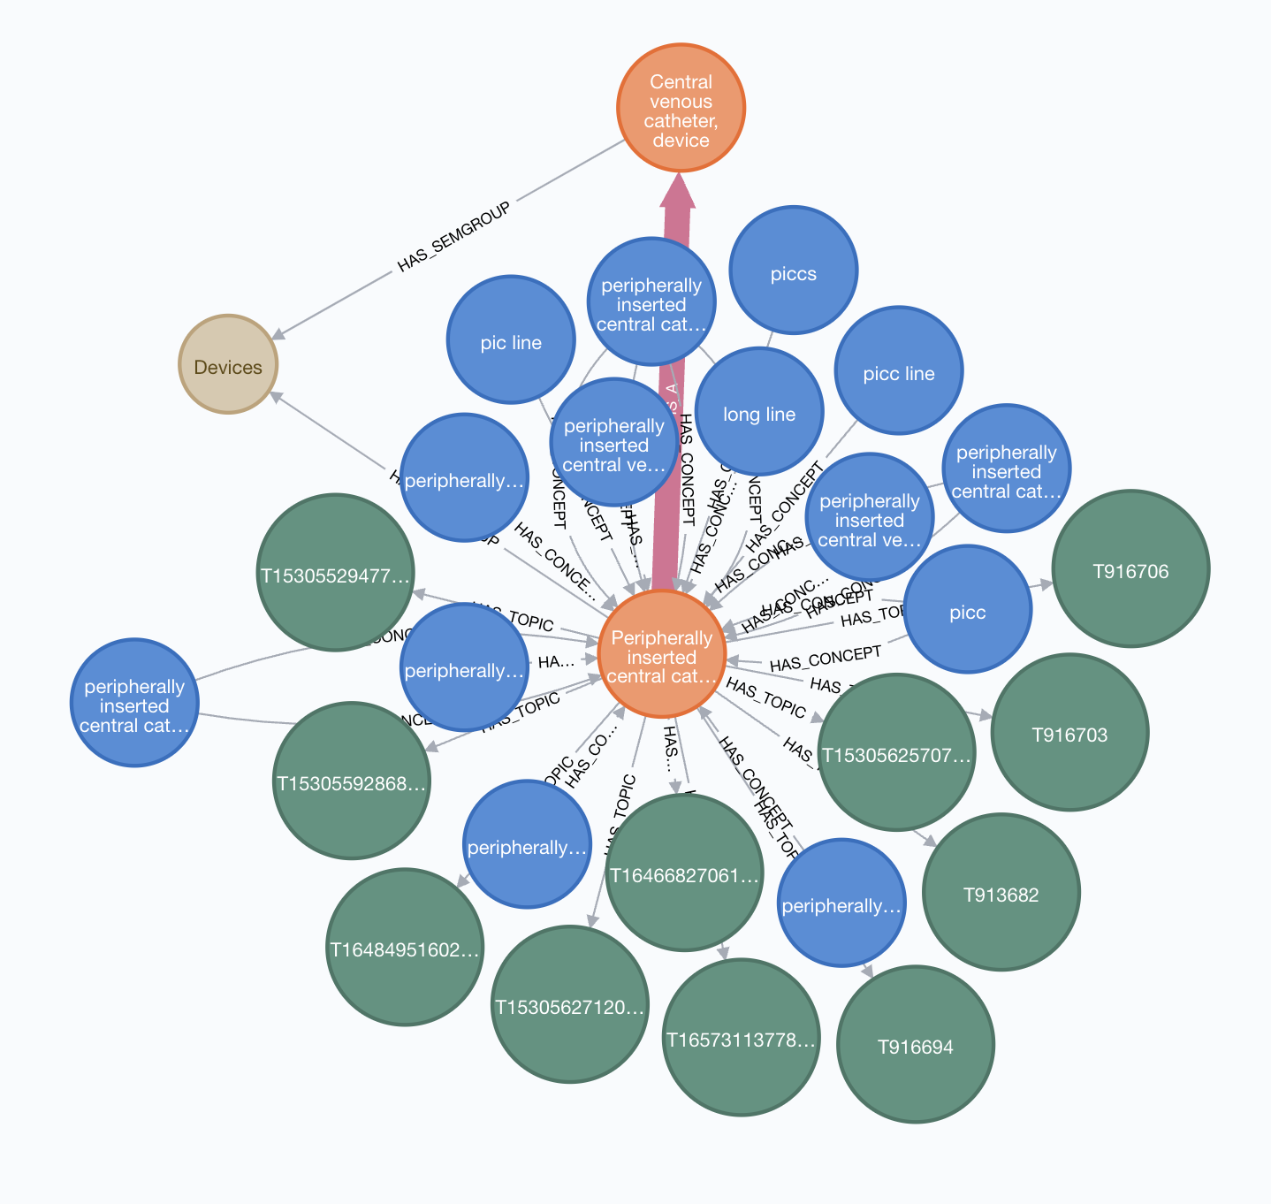
Medical Knowledge Graphs
Content centric*
umls centric
Concepts: 68,000
Concepts: 355,000
TERMS: 430,000
TERMS: 1,400,000
* Using NLP to harvest UMLS entities from the content

Slide 6
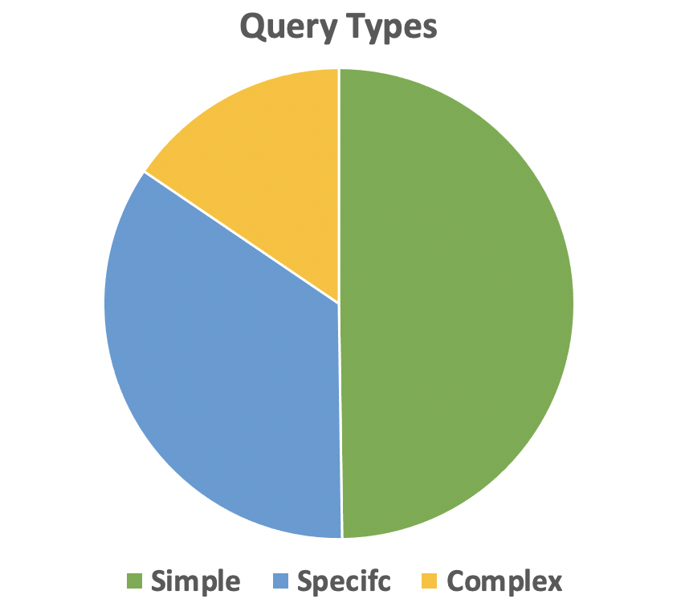

How are users searching in DynaMed?
LAMA monotherapy
for COPD management
COPD
COPD
management

Slide 7
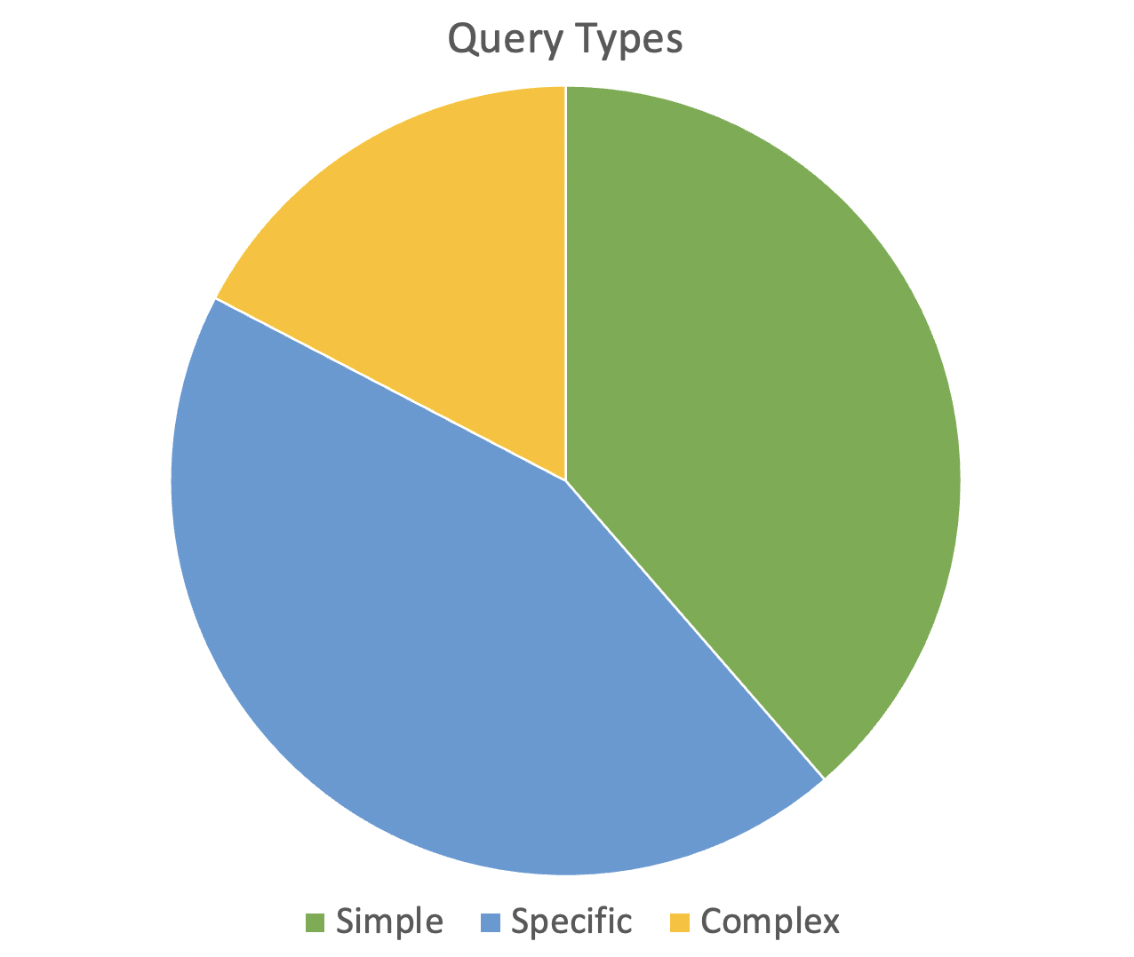
How are users searching in Dynamic Health?
safe breastmilk handling and storage practices
PICC
nasogastric placement

Slide 8

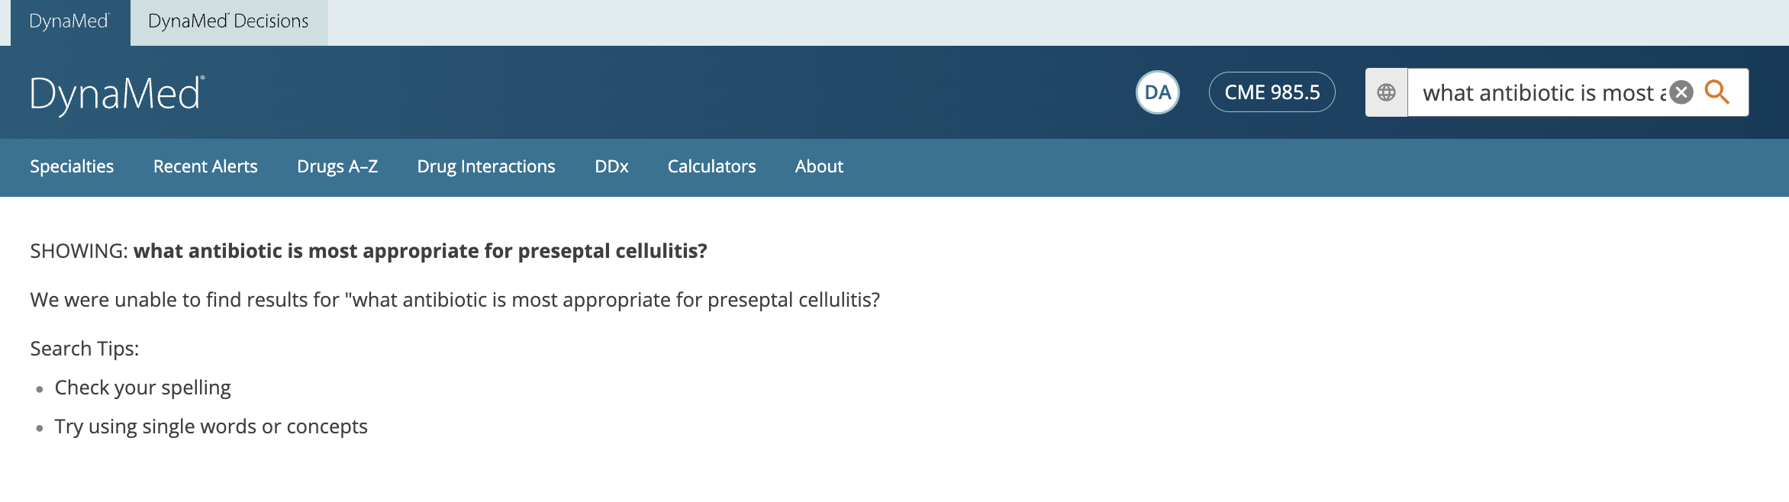
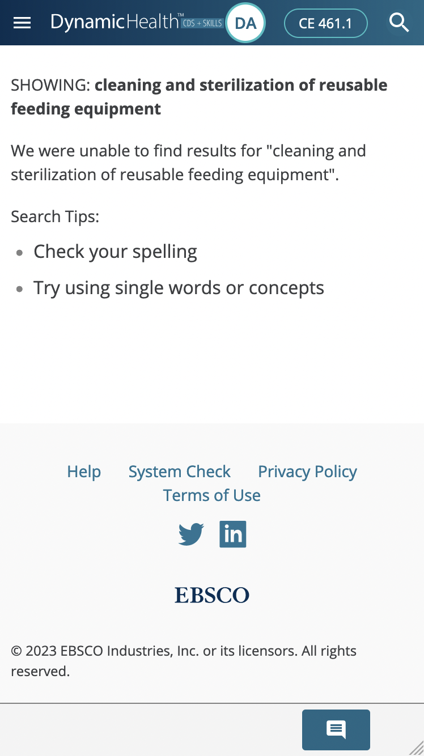
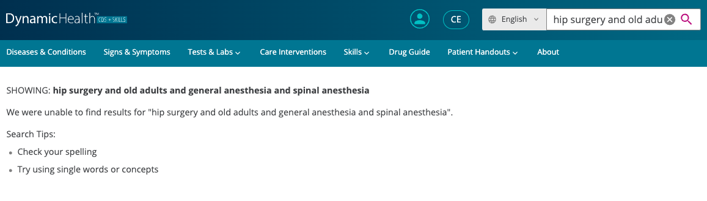
Complex Queries

Slide 9
Previous Attempts
ELASTIC SEARCH
TUNING
VECTOR
SEARCH
POC #1
VECTOR
SEARCH
POC #2
11/2019
01/2021
07/2021
10/2020
10/2021
04/2022
ELASTIC SEARCH
TUNING
CRITICAL SEGMENTS POC
MODEL
Selection & tuning
ELASTICSEARCH
TUNING
VECTOR SEARCH
POC

Slide 10
Elastic Search Tuning
recall
precision

Slide 11
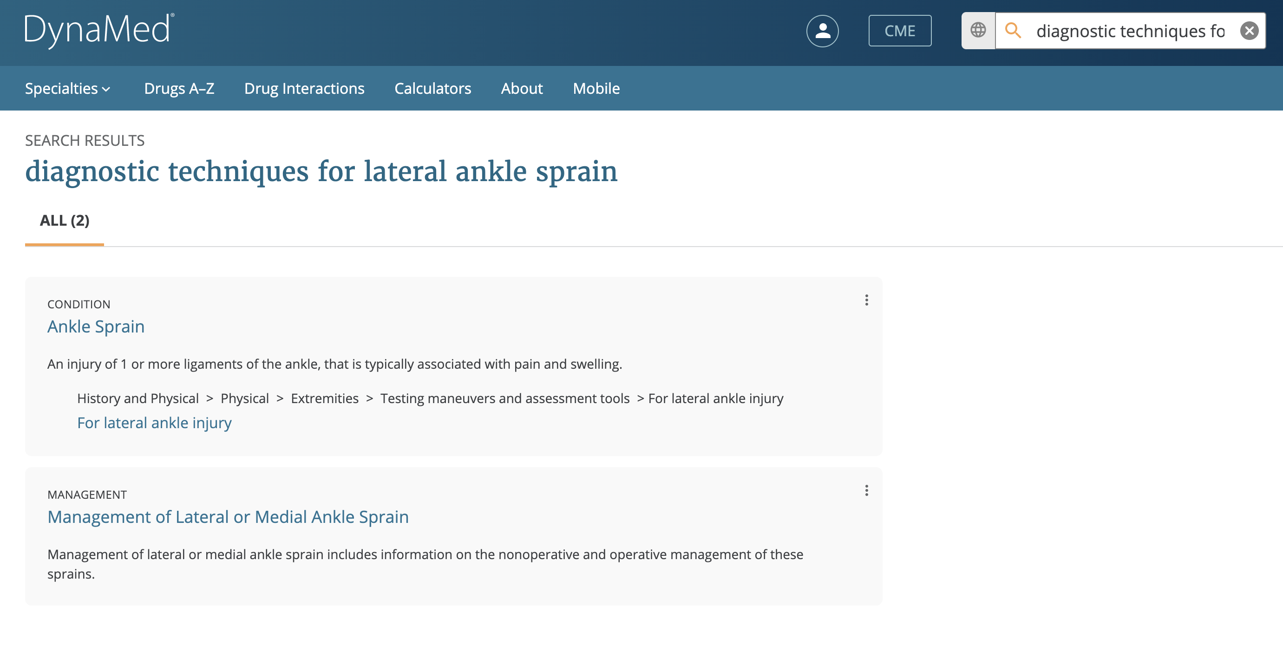
diagnostic and techniques and lateral and ankle sprain

Slide 12
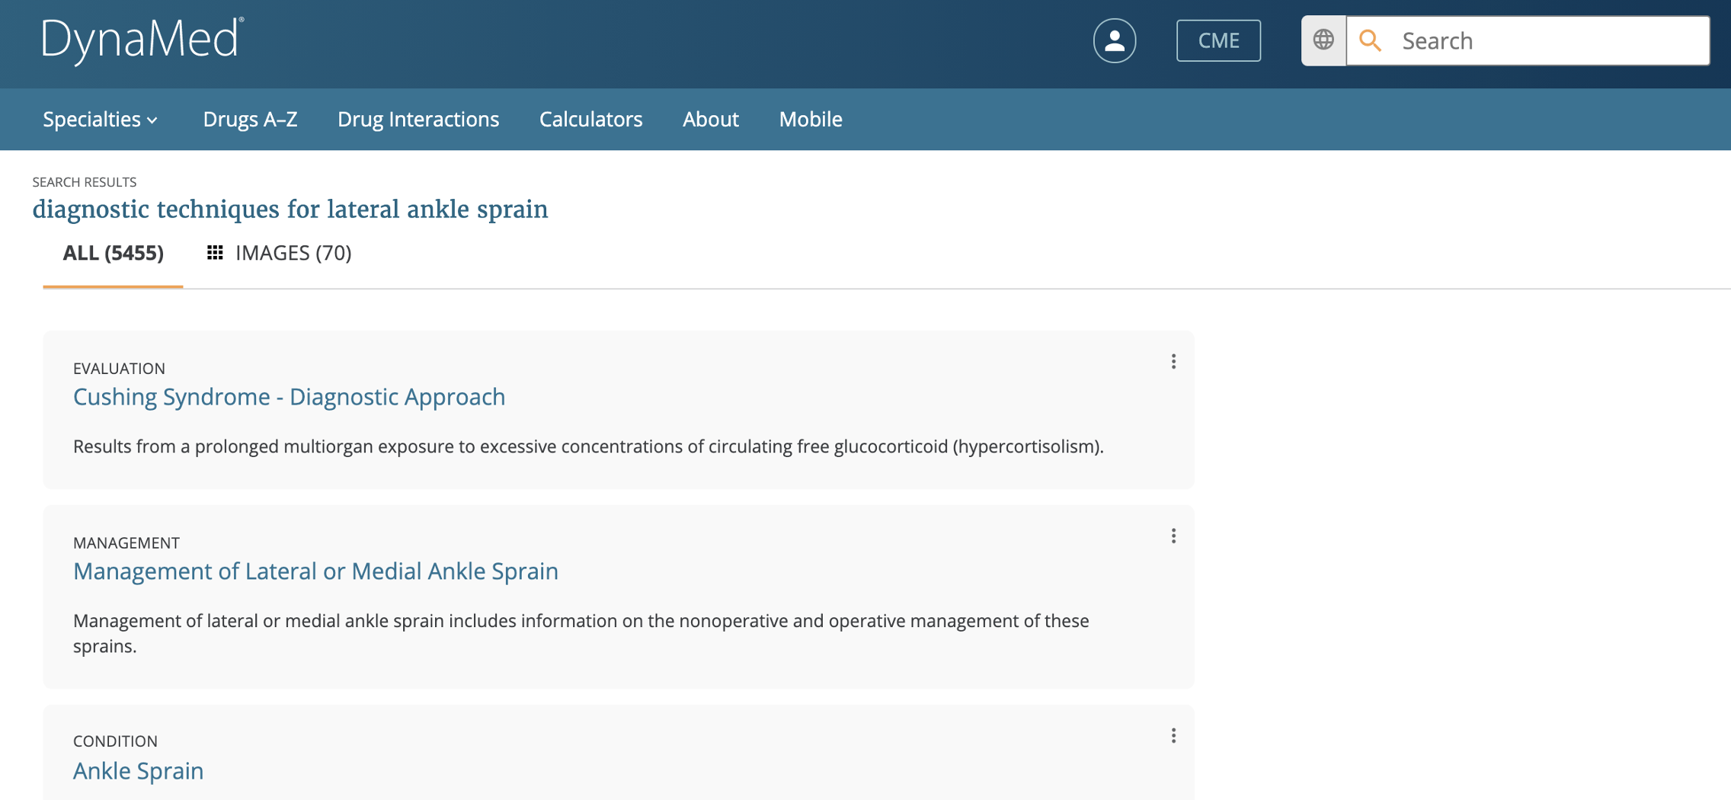
diagnostic OR techniques OR lateral OR ankle sprain
Minimum should match

Slide 13

Previous Attempts
ELASTIC SEARCH
TUNING
VECTOR
SEARCH
POC #1
VECTOR
SEARCH
POC #2
11/2019
01/2021
07/2021
10/2020
10/2021
04/2022
ELASTIC SEARCH
TUNING
CRITICAL SEGMENTS POC
MODEL
Selection & tuning
ELASTICSEARCH
TUNING
VECTOR SEARCH
POC

Slide 14
Critical Segments
diagnostic techniques for lateral ankle sprain
diagnostic techniques lateral ankle sprain
Ranking Criteria
matching Criteria

Slide 15
Previous Attempts
ELASTIC SEARCH
TUNING
VECTOR
SEARCH
POC #1
VECTOR
SEARCH
POC #2
11/2019
01/2021
07/2021
10/2020
10/2021
04/2022
ELASTIC SEARCH
TUNING
CRITICAL SEGMENTS POC
MODEL
Selection & tuning
ELASTICSEARCH
TUNING
VECTOR SEARCH
POC

Slide 16
Ingesting
Searching
DOCUMENT
User query
model
Index the vector and document metadata
DOC VECTOR
Query VECTOR
Search the index for the nearest vectors
INDEX

Slide 17
Classification
simple
Bm25
User query
specific
complex
vector

Slide 18
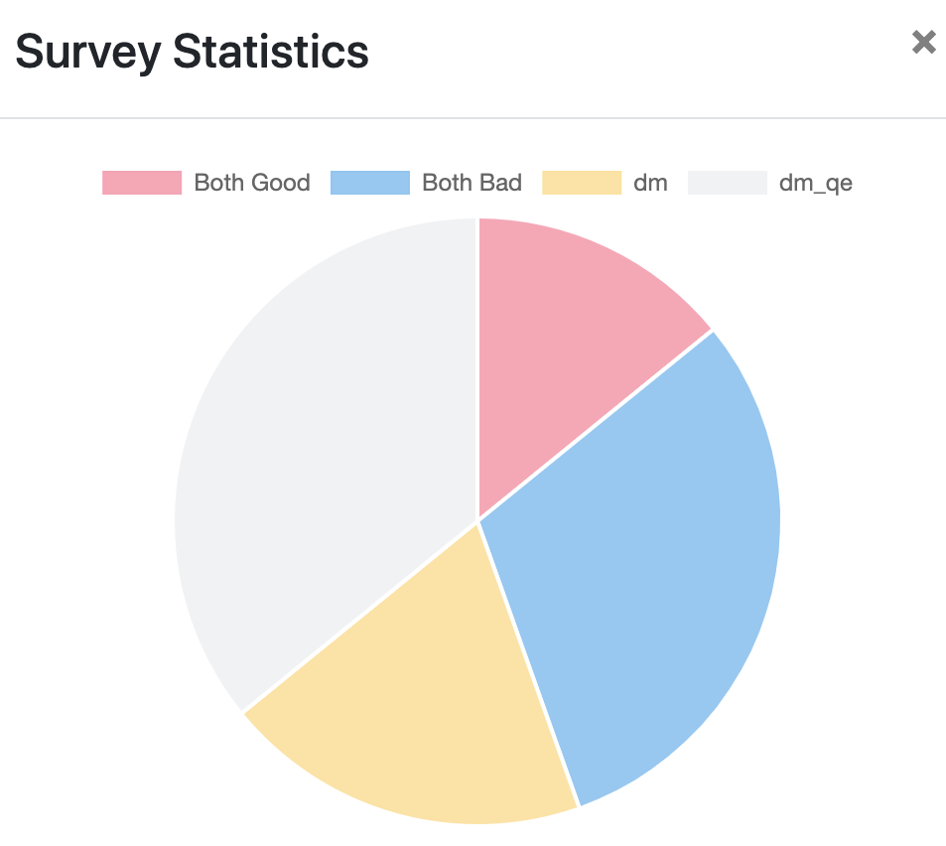
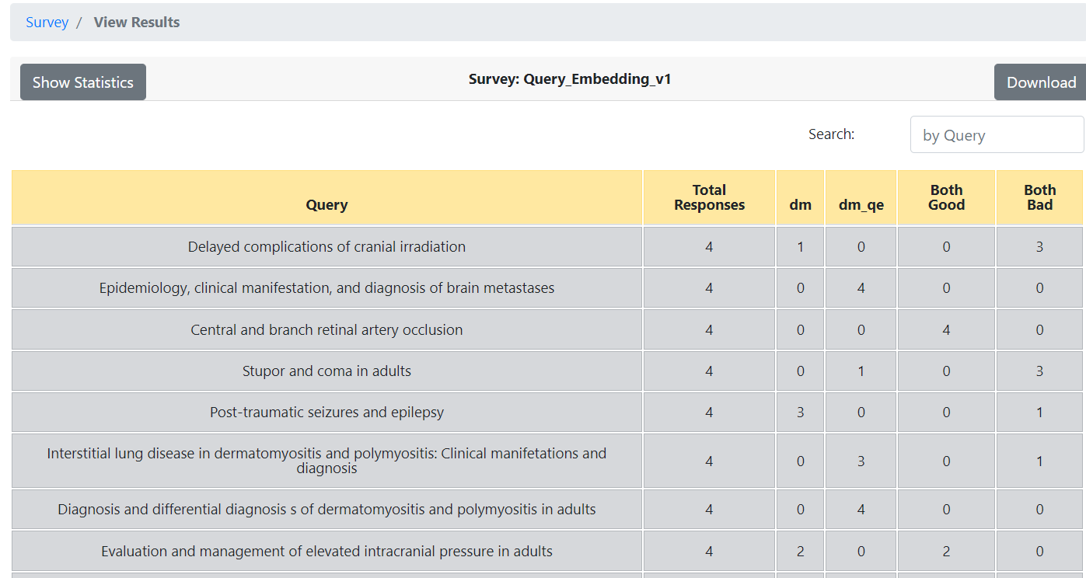
Vector Search POC #1 Results

Slide 19

Previous Attempts
ELASTIC SEARCH
TUNING
VECTOR
SEARCH
POC #1
VECTOR
SEARCH
POC #2
11/2019
01/2021
07/2021
10/2020
10/2021
04/2022
ELASTIC SEARCH
TUNING
CRITICAL SEGMENTS POC
MODEL
Selection & tuning
ELASTICSEARCH
TUNING
VECTOR SEARCH
POC

Slide 20
Model Selection & Tuning
ATTEMPT | OUTCOME
Find a pretrained model to help us: SnomedBERT BioBERT PubMedBERT | Word embeddings, not sentence embeddings
Use these models with a sentence transformer class | These models were not fine-tuned for sentence similarity, made the output worse
Add our vocabulary to the pretrained models (using exBERT architecture) | Couldn’t get this to work, made the output worse

Slide 21
Previous Attempts
ELASTIC SEARCH
TUNING
VECTOR
SEARCH
POC #1
VECTOR
SEARCH
POC #2
11/2019
01/2021
07/2021
10/2020
10/2021
04/2022
ELASTIC SEARCH
TUNING
CRITICAL SEGMENTS POC
MODEL
Selection & tuning
ELASTICSEARCH
TUNING
VECTOR SEARCH
POC

Slide 22
Vector Search
Model Selection & Tuning
Document Splitting
Technology Selection

Slide 23
Technology Selection
Elasticsearch 7.8
AWS Open Search
Qdrant
  Pros
    Familiar technology
  Cons
    Not available in AWS Managed Services
    Two different clusters to manage
    Quality & performance unknown
    Does not support approximate nearest neighbor
  Pros
    Available in AWS Managed Services
  Cons
    AWS fork of Elasticsearch repo
    Recent divergence
    Two different clusters to manage
    Quality & performance unknown
  Pros
    Supports pre-filtering for approximate nearest neighbor
    Quality & performance known
  Cons
    Two different clusters to manage
    Recently founded
    No monitoring dashboards

Slide 24
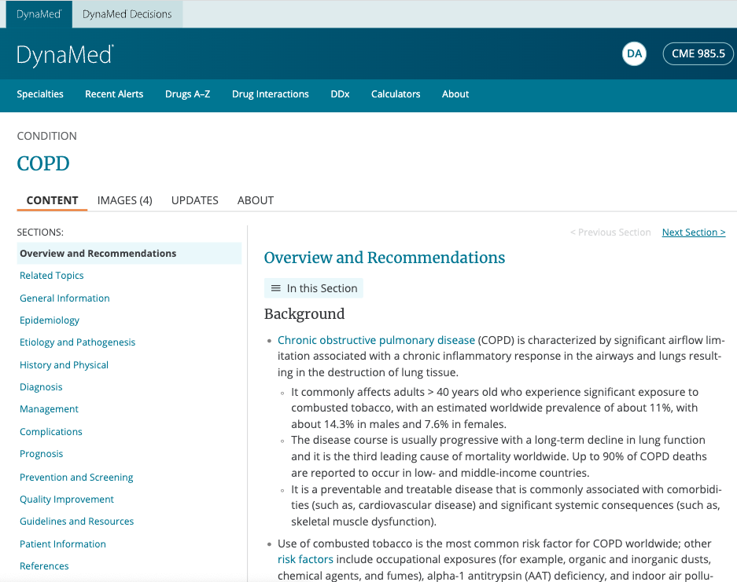
Document Splitting

Slide 25
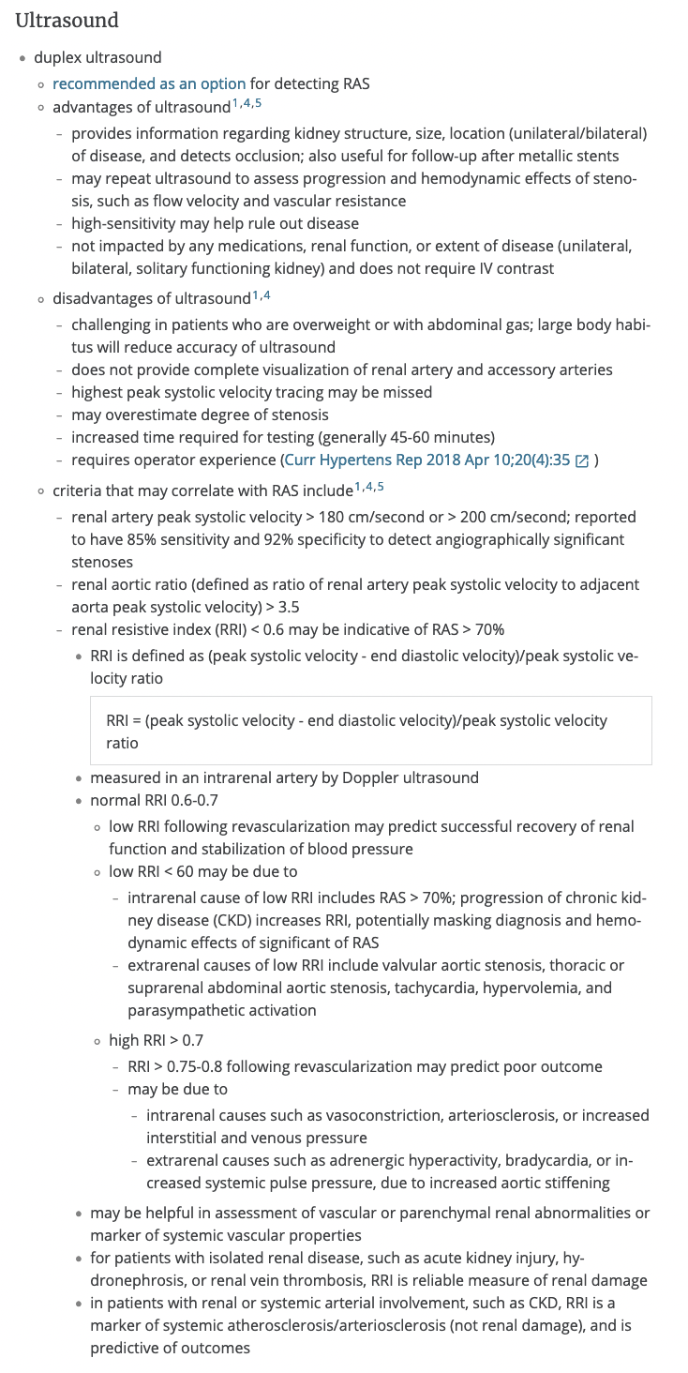
Document Splitting
DynaMed
  4,500 long documents, split into 240,000 sections.
  Sections further split due to model input max length.
  Total: 400,000 vectors
Dynamic Health
  4,800 short documents, split into 50,000 sections
  Sections further split due to model input max length.
  Total: 64,000 vectors
Section splitting is basic and sometimes happens mid-word. Fixing this will improve quality.

Slide 26
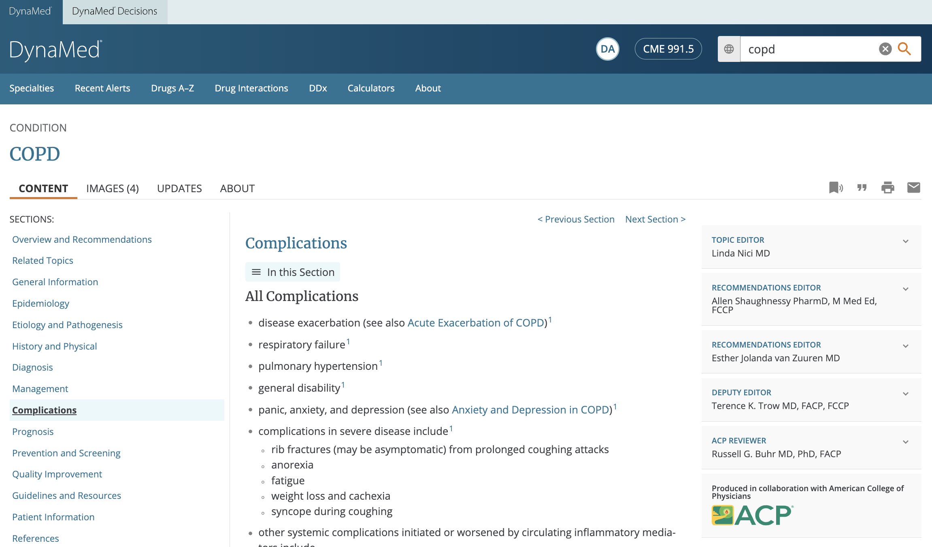
Fragmented Text
Researching Large Language Models (LLM) to summarize text before vectorizing it.

Slide 27
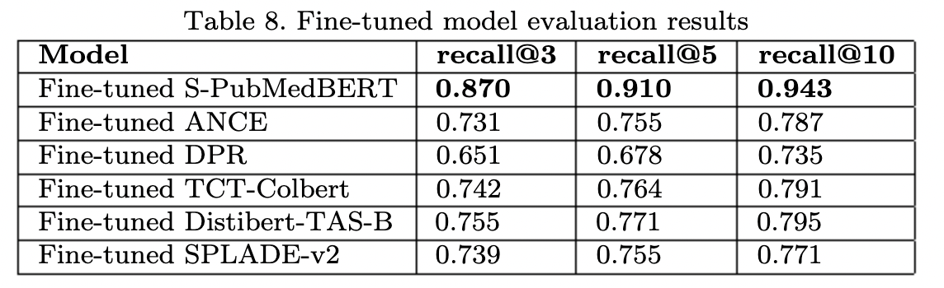

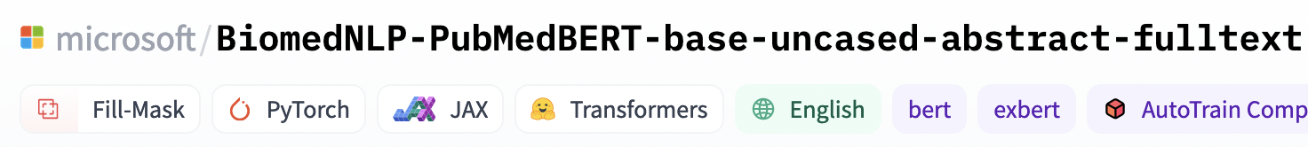

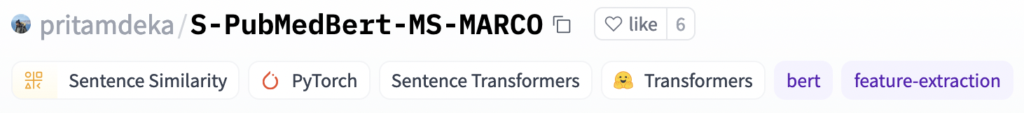
Using an in-domain model is critical to success
PubMedBERT Pre-trained on PubMed central (full text)
Fine-tuned with MS-MARCO as a Sentence Transformer
Next Steps: fine-tuning this model beyond MS-MARCO
Domain-specific pre-trained BERT model
1
PubMedBERT
Large in-domain corpus
Domain-Specific Language Model Pretraining for Biomedical Natural Language Processing
Domain-specific S-BERT Bi-Encoder model
2
PubMedBERT
S-PubMedBERT
Base model + Similarity data
https://www.researchgate.net/publication/364961522_Improved_Methods_to_Aid_Unsupervised_Evidence-Based_Fact_Checking_for_Online_Heath_News

Slide 28
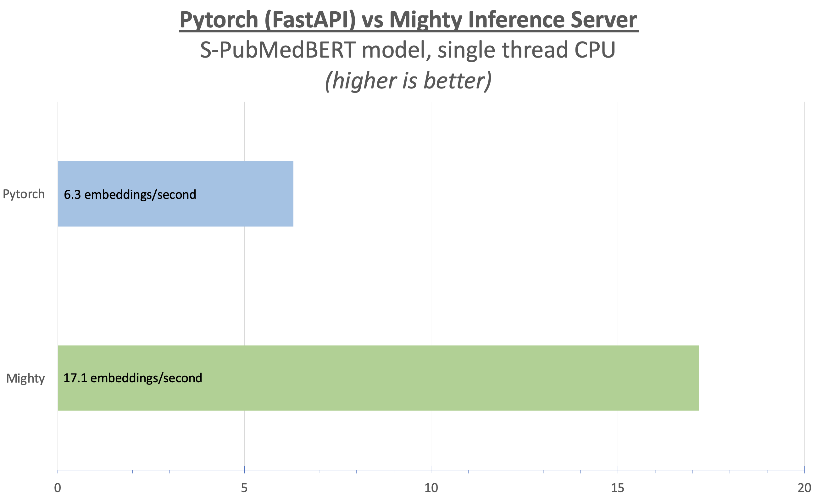

Mighty Inference Server for fast and concurrent inference
AWS c6i.4xlarge
  16 threads & concurrent requests
  Ingestion AND Queries
Custom reverse proxy
  Handle all requests concurrently
  Queues with minimal overhead
Very fast
  Content vector: 200 to 500ms
  Query vector: 30 to 50ms
High Throughput
  All 460,000 embeddings in < 6 hours
  Up to 500 queries per second
Embeddings per second for sample dataset of 1500 documents

Slide 29
Vector Search
Model Selection & Tuning
Document Splitting
Technology Selection

Slide 30
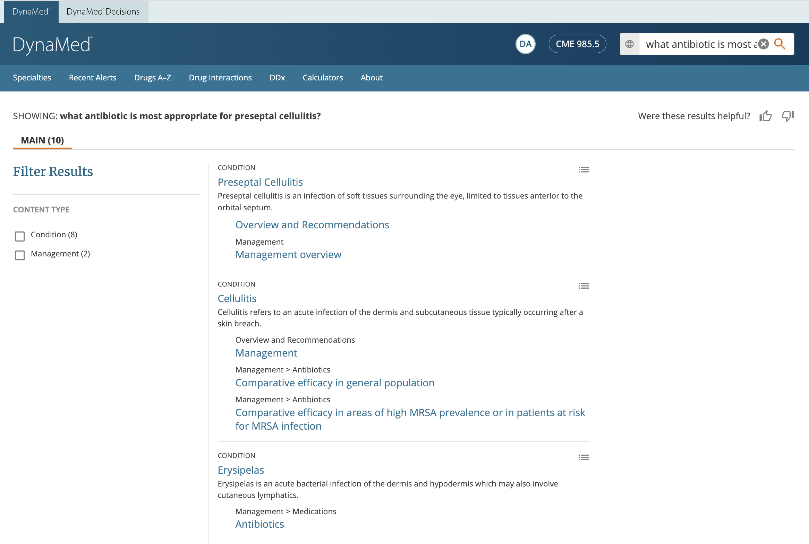
“what antibiotic is most appropriate for preseptal cellulitis?”
semantic search
Vector search

Slide 31
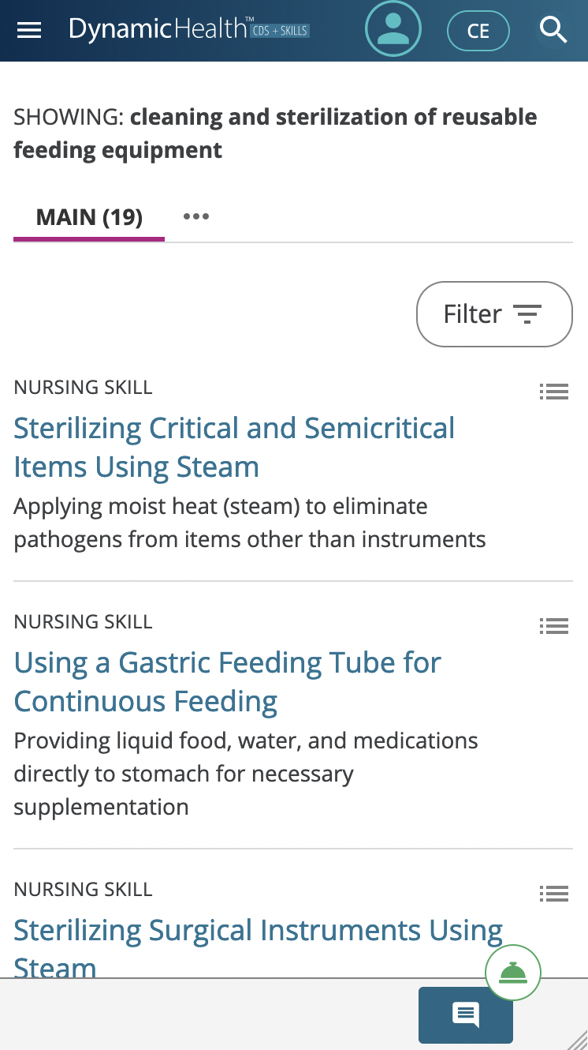
semantic search
“cleaning and sterilization of reusable feeding equipment”
Vector search

Slide 32
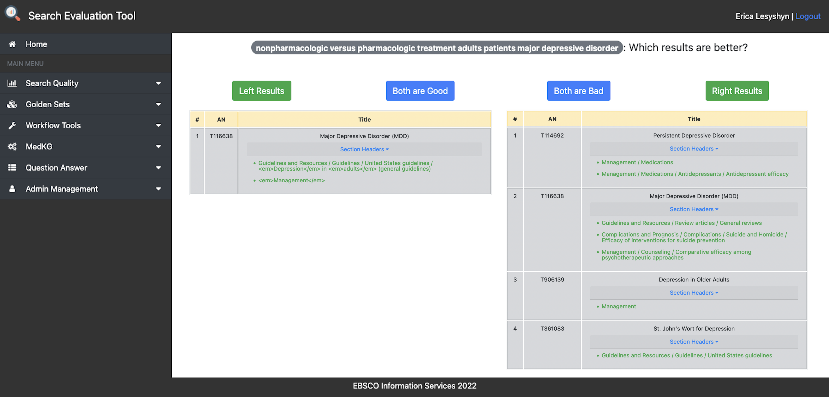
Subject Matter Expert Feedback
3 experts, each rating the same 55 queries
Side-by-side result sets (random and blind)
Pick one or the other, or say both are good or both are bad

Slide 33
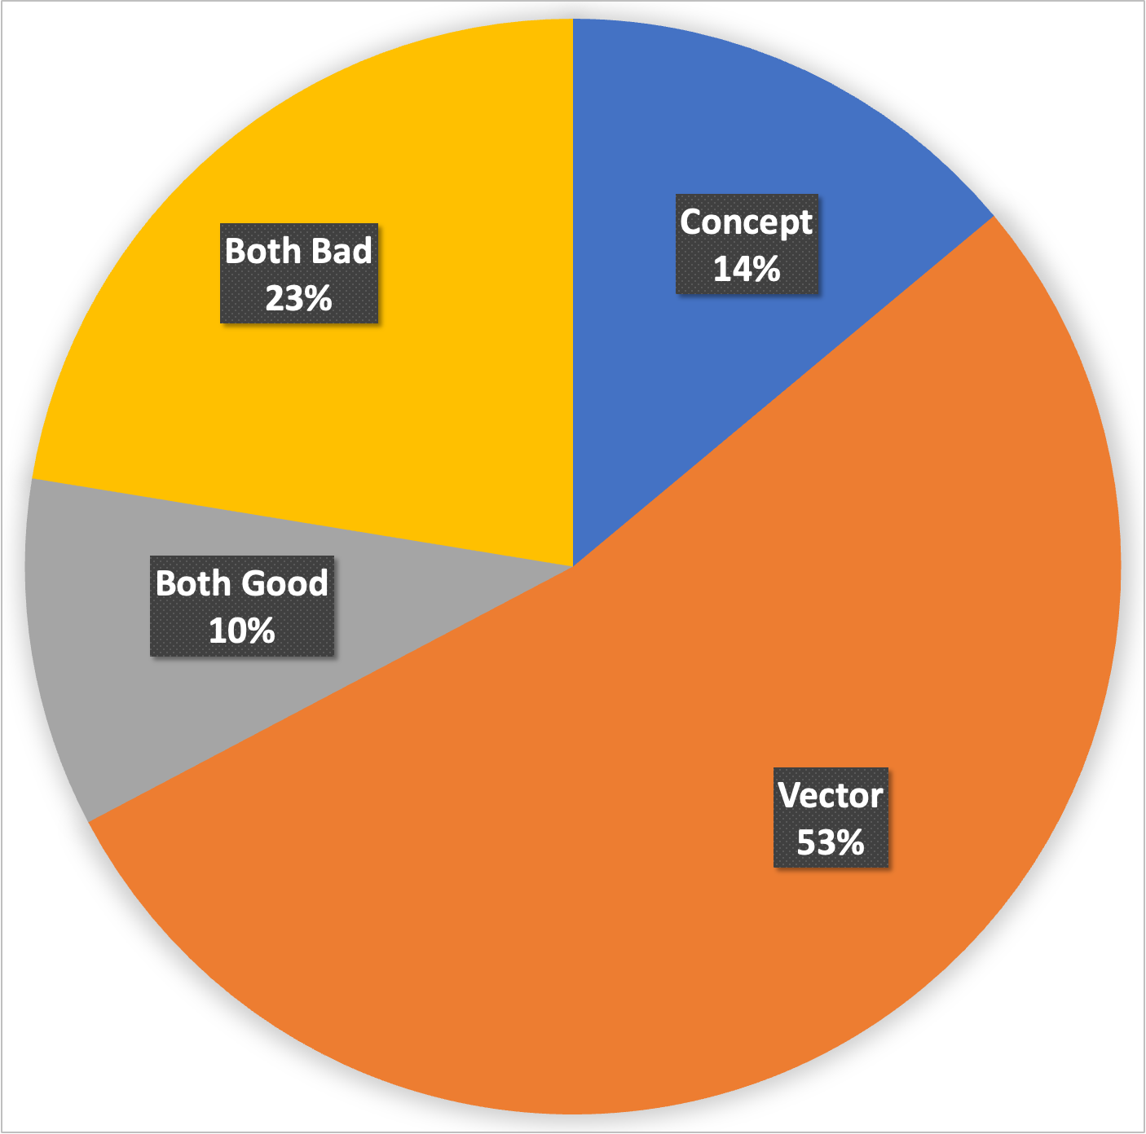
Subject Matter Expert Feedback
Rater Majority Consensus: 89%
Results
  53% preferred vector search
  14% preferred concept search
  10% said both were good
  23% said both were bad

Slide 34



Daily Content Refresh
1
2
3
Rebuild Graph
Refresh Caches
Reingest Content
Med KG
Content
Ingestion
Pipeline
QUERY
INTELLIGENCE
S3

Slide 35




Content Ingestion Pipeline
ETL process
listener
converters
enrichers
Mighty
indexers
Qdrant
notifiers

Slide 36

Content Ingestion Pipeline
Mighty
Qdrant

Slide 37
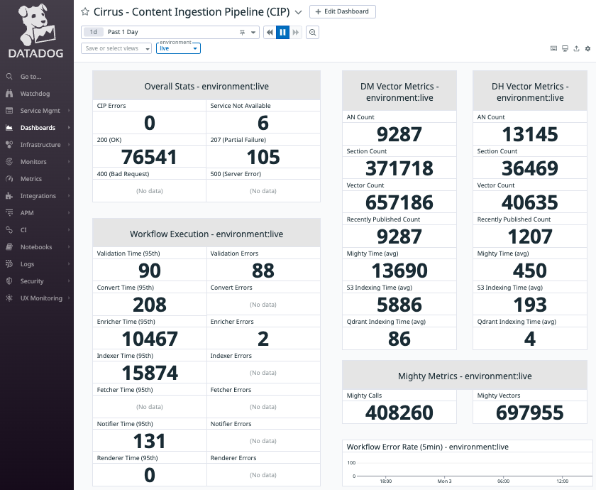
Content Ingestion Pipeline

Slide 38
Search Runtime
1
2
MEDICAL SEARCH
PLATFORM
QUERY INTELLIGENCE
Mighty
Query segmentation
User intent?
expand
Runtime search
strategies
filter
recommend
3
Qdrant

Slide 39
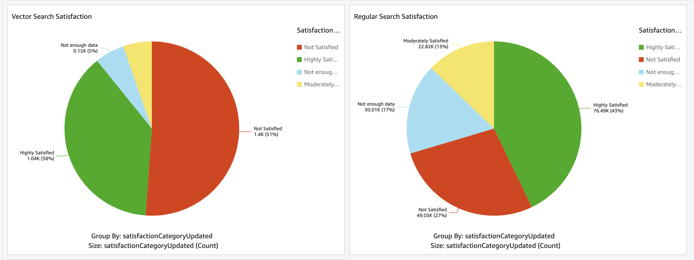
Key Performance Indicators

Slide 40
Lessons Learned
You Don’t Know What You Don’t Know
Fail Fast
VS

Slide 41
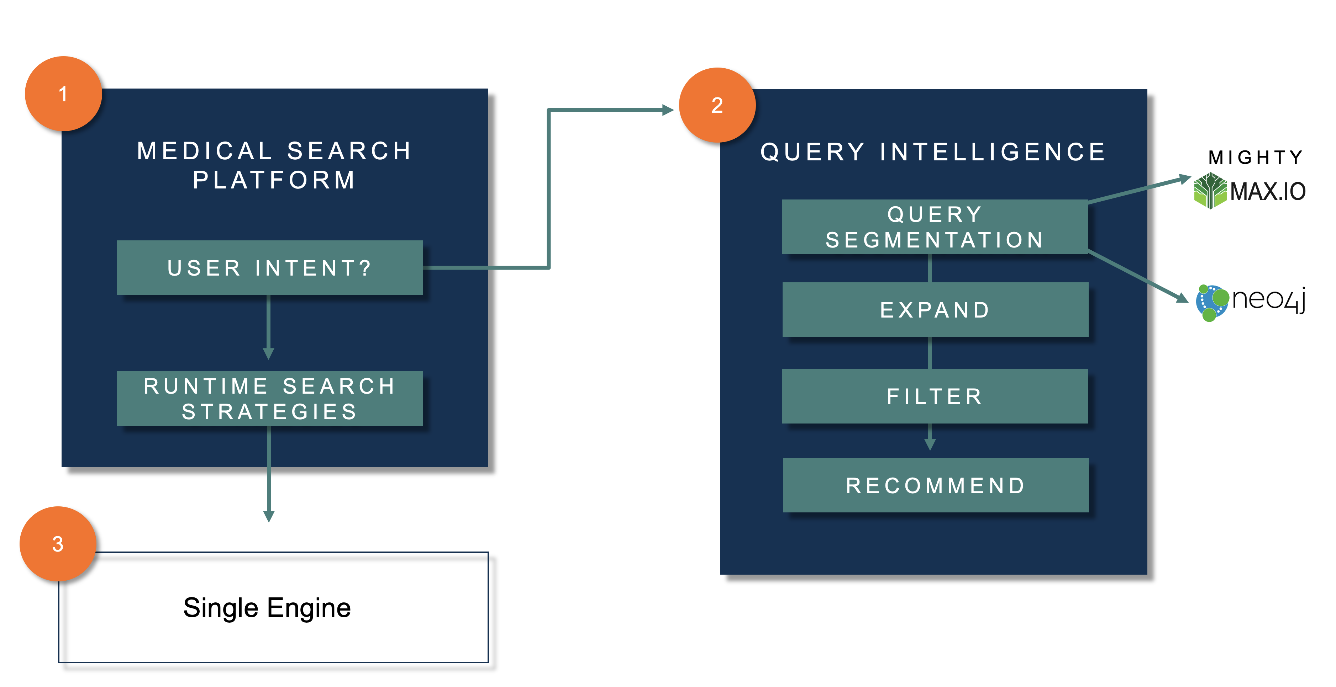
Lessons Learned
BM25 + Vector Search

Slide 42
Next Steps
Iterate to improve quality
Measure
1
Click log analysis
Improve models
2
Single Search Engine
3
Similarity data mining
Tune with newer content
Investigate combined BM25+ANN capable engine
Tune with similarity data

