Slide 1

Exploiting Citation Graphs in Large Corpora to Improve Relevance on Broad Queries
Haystack 2023
Marc Morissette
Director of Technology

Slide 2

Who are we?
Lexum is a software company that designs and operates online legal information delivery products. We specialize in the management and the publishing of legal information over the internet.
CanLII, the Canadian Legal Information Institute, is a non-profit organization founded in 2001 by the Federation of Law Societies of Canada on behalf of its 14-member law societies. Its mandate is to provide efficient and open online access to judicial decisions and legislative documents.

Slide 3



CanLII – Content
Legislation
Statutes & Regulations
85,000 (legislations)
1,450,000 (sections)
Case Law
Court & Tribunal Decisions
3,100,000
Legal Commentary
Books, Law Review Articles, Practice Manuals
100,000

Slide 4


CanLII – Users
Lawyers
Legal Researchers
"joint submission" and "crown" /p "repudiate”
“Nuisance” and protest and “180(1)”
causation /10 death and remov! /5 ventilator
(“Misrepresentation” /p (“did not read” or “failed to read”)) and “specific performance”
The Public
All walks of life
Joint custody distance
Terminated for alleged marijuana impairment
Trump tower

Slide 5
Broad Queries
pension benefits divorce
insurance dispute resolution
disability discrimination
fair dealing research
bankrupt discharge
strike vote validity
request for access to records
hearsay admissibility
costs awards factors
privacy invasion
residential eviction enforcement
sale agreement cancellation
constructive dismissal
recognizance to keep the peace
freedom of expression
charter 2b
aboriginal land titles
custody assessment
pipeda s 7

Slide 6
Broad Queries
pension benefits divorce
insurance dispute resolution
disability discrimination
fair dealing research
bankrupt discharge
strike vote validity
request for access to records
hearsay admissibility
costs awards factors
privacy invasion
residential eviction enforcement
sale agreement cancellation
constructive dismissal
recognizance to keep the peace
freedom of expression
charter 2b
aboriginal land titles
custody assessment
pipeda s 7

Slide 7
How Do You Handle Broad Queries?
Legislation
Statutes & Regulations
85,000 (legislations)
1,450,000 (sections)
Case Law
Court & Tribunal Decisions
3,100,000
Legal Commentary
Books, Law Review Articles, Practice Manuals
100,000

Slide 8
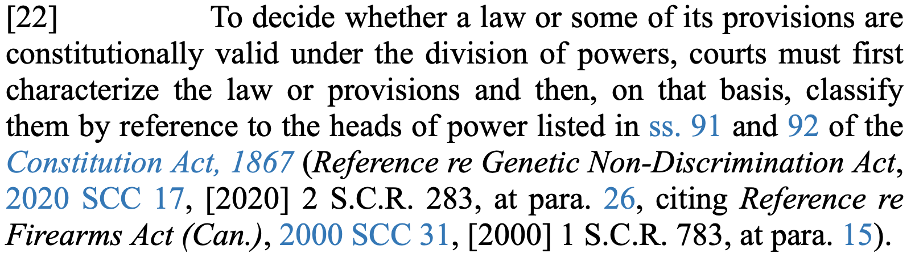
Idea: Identify “Authoritative” Documents Via Citations

Slide 9
Idea: Identify “Authoritative” Documents
Legislation
Statutes & Regulations
1,450,000 sections
cited 51,000,000 times (avg 35 per section)
Case Law
Court & Tribunal Decisions
3,100,000 decisions
cited 14,600,000 times
(avg 4.7 per decision)
Legal Commentary
Books, Law Review Articles, Practice Manuals
100,000 documents

Slide 10

Intuition: Sort By Citations
BM25 score
sort: citedCount

Slide 11

Sort By Popularity: Does it Work?
Navigational searches: yes
On short highly representative fields (keywords): maybe
For everything else…

Slide 12
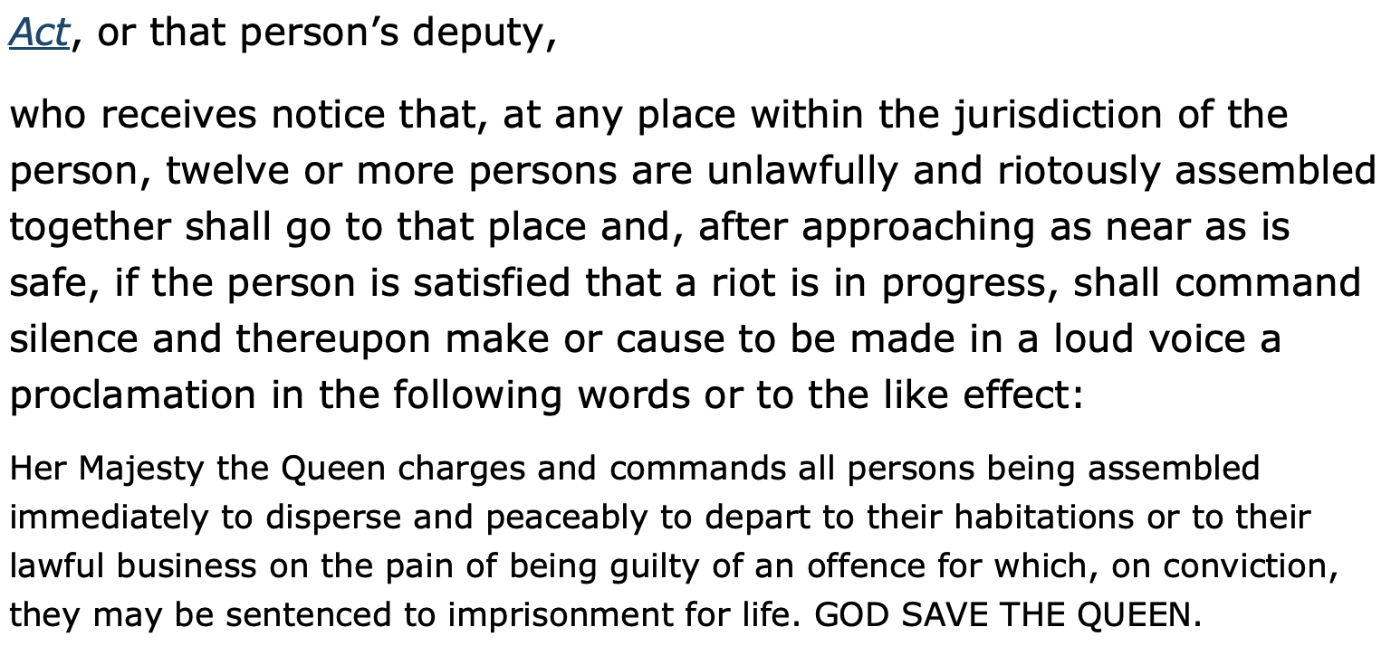
Legislation (riots)

Slide 13
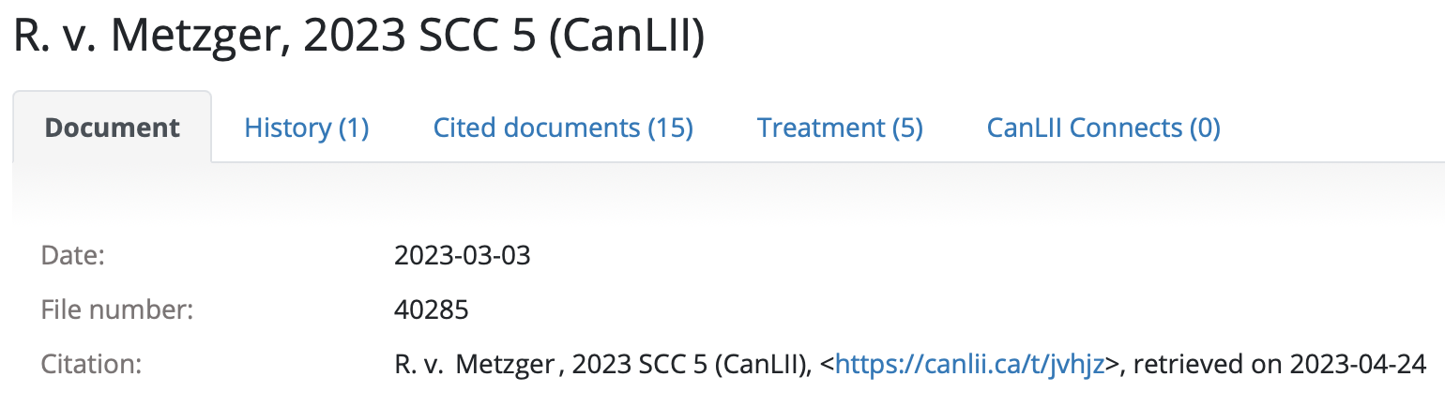
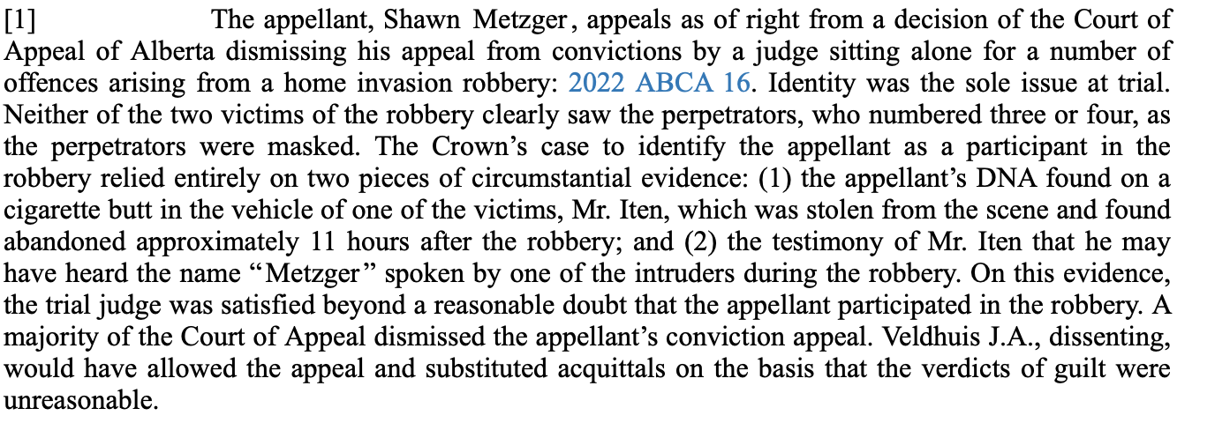
Case Law

Slide 14
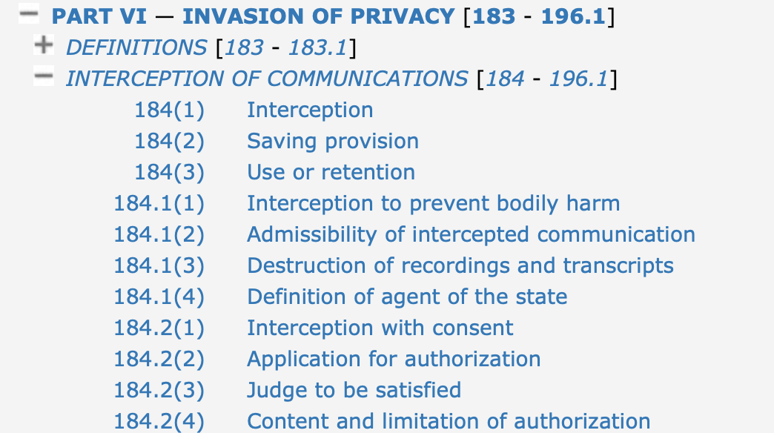
Is There a Better Way?

Slide 15


Citation Graph
“electronic surveillance”
Criminal Code s. 184-196.1
“electronic surveillance”
“electronic surveillance”
eavesdropping

Slide 16
Thinking of An Algorithm
“electronic surveillance”
Authoritative?
“electronic surveillance”
Authoritative?
“electronic surveillance”

Slide 17
Algorithm
A = Set of nodes (docs) that contain the search terms
L(A,*) = All edges departing from A (citations)
B = All nodes pointed to by L(A,*) (cited documents)
L(*,B) = All edges pointing to B (for stat. analysis)
For each b in B, calculate some probabilities
Highly relevant results!

Slide 18
The Math
For every eligible document b in B, we want to know whether b is authoritative
We have two competing hypotheses that we will test
  H₀ = b is not authoritative
  H₁ = b is authoritative
thus,
  H₀ = incoming links should contain few documents in A
  H₁ = incoming links should contain lots of documents in A

Slide 19
The Math
Both hypotheses follow a multinomial distribution where each incoming citation is a trial
A Bernouilli distribution f(t|, p_{h}) where
  t = |L(*, b)|
  p₀ = |A|/|E| where E is the set of documents eligible to cite b
  p₁ = R*G where R and G are constants and
    R is the query’s expected recall metric
    G is the ratio of edges L(*, b) that are relevant

Slide 20
The Math
The next step is to test the hypothesis using either
  A one-sided statistical test on H₁
  The Neyman-Pearson Lemma on H₀ and H₁
Perform the statistical test using the desired confidence interval, say 95%, and we’re done!

Slide 21

WRONG!

Slide 22
WRONG!
6,000 documents mention electronic surveillance
  Together, they cite 12,000 documents = |B|
We expect, maybe 1 to 20 authoritative docs (true positive)
Base Rate Fallacy
95% confidence means 5% error rate * 11,990 = 600 false positives
You want at least 99.99%+ confidence in such circumstances

Slide 23
Integrating into Solr (or OpenSearch)
Search
A = The set of nodes that contain the search terms
L(A,*) = All edges departing from A (citations)
B = All nodes pointed to by L(A,*) (cited documents)
L(*,B) = All edges pointing to B (for stat. analysis)
For each b in B, calculate some probabilities
DocValues
ord values
Invariant
Facet

Slide 24
Integrating into Solr (or OpenSearch)
Implementation mostly resides in a “simple” AggValueSource plugin
  A facet aggregation
Easy approximation: Semantic Knowledge Graph
  Originally developed for query expansion
  Facet function: relatedness in Solr and significant_terms in OpenSearch
  Math is different but a good approximation with minCount > 10

Slide 25
Merging With Regular Results
Authoritative results are transparently merged in with traditional search results
  Union mode: added to results if missing – legislations
  Intersection mode: reranking only – case law
Implemented using a Solr SearchComponent
  Probabilities are converted to a parameterized score

Slide 26
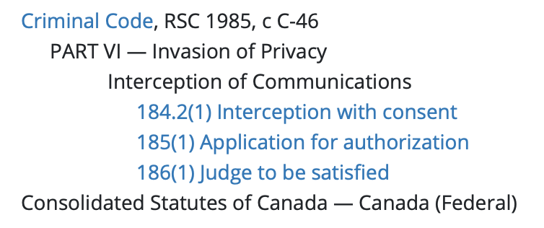

Demo Queries – Electronic surveillance
Successful Queries
electronic surveillance
electronic interception
wiretap
audio interception
Unsuccessful Queries
eavesdropping
Result

Slide 27
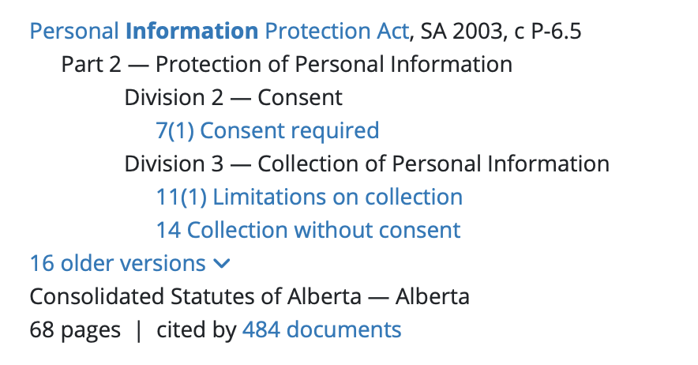
Demo Queries – Personal Information
Successful Queries
personally identifiable information
pipeda s7
consent to record information
consent to collect information
Results vary
Result

Slide 28
Evaluations
No user engagement data yet
Subject matter expert evaluated effect of Citation Graph on 132 queries:
  27% of results improved
  12% of results worsened
  60% unchanged
We have improved integration since then

Slide 29
Lessons Learned
Simple algorithms (BM25) are intuitive to users
  It gives them a measure of control
If you rate result engagement from 0 to 10, returning a document where none of the queried words appear rates as a solid -10.
This term could not be found in the current document. However, your query appears disproportionally often in documents citing this document, which is considered by the search engine a strong indication of relevance.

Slide 30
Lessons Learned
Correctly adjust E: the set of documents eligible to cite b
  Time bias
  Large jurisdiction bias

Slide 31
Lessons Learned
Math: apply some smoothing edge cases
  Disable on small A and small B
Maximize precision at the expense of recall
  Avoid systematic errors
  Req: 2002 SCC 1 vs
  doc text: 2002 SCC 45, [2002] 1 RCS 12

Slide 32
Thank you!
Marc Morissette
morissette@lexum.com

