Slide 1
Talking to Non-Searchers about Search Relevance
@dtaivpp

Slide 2

David Tippett
Senior Developer Advocate
Open-Source OpenSearch @ AWS
contact.tippybits.com
@dtaivpp
Notes:
Work on open-source OpenSearch at AWS
Been a developer advocate for a little over a year
Previously worked as Data Engineer, Network Automation Engineer, and DevOps engineer
Before this job I worked at companies who relied on open-source software
Who is using open-source project at their work?
How many of you have contributed to open source work?

Slide 3
Our non-searchers
CTO
Like shiny objects
Want improved sales and lowered cost
@dtaivpp
Notes:
Enter Stavros: It’s been over a year since I hired you and search still sucks. What did I hire you for David: What do you mean? I am here to present about how to make search better. If you think you can do better then why don’t you come up here and talk.

Slide 4

Stavros Macrakis
Senior Technical Product Manager
OpenSearch @ AWS
linkedin.com/in/macrakis
@dtaivpp

Slide 5
Our non-searchers
CTO
Like shiny objects
Want improved sales and lowered cost
@dtaivpp
Notes:
Heard about LLM’s and Vector DB’s at a conference
LLM’s and Vector databases are cool but they are just a few tools of search
Need to focus on laying a good foundation first
Search logging
Can you run A/B tests with searches?
Do you have judgements for testing your search templates against
Understanding your users searches (what fields are important to relevance)
Also, you have to spend money to make money. Relevance tuning isn’t free

Slide 6
Our non-searchers
Know what they are looking for but can’t figure out how to get there
Need transparency to understand their search
End-Users
@dtaivpp
Notes:
David: So I was going through our search logs from the other day and noticed that one user went through 20 pages of results for hotels in somewhere called the Berkshires.. Did you end up interviewing her?
Stavros to talk about Berkshires lady
We need to be enabling users with:
Auto-complete
Auto-suggest
Query interpretation and transparency

Slide 7
Our non-searchers
Want to improve the right sales
Need it to be maintainable
Clients
@dtaivpp
Notes:
Clients need the tools and understanding on how to use them
We could just pin results for queries but it’s not maintainable
There could be collisions with pinned results and ambiguously boosted terms
Do they know what is bad about their search?
What are their expectations?

Slide 8
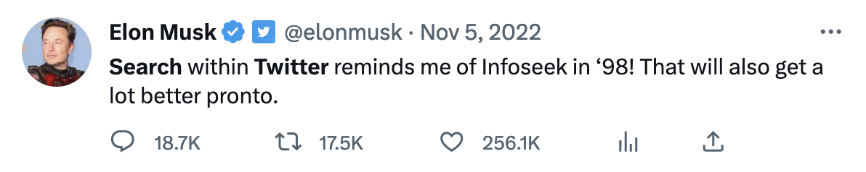
November 18th:
Twitter “hires” ML Engineer George Hotz to
fix twitter search
December 20th:
George quits as he realizes that he can’t fix
twitters search
@dtaivpp

Slide 9
Our non-searchers
The right people on their team
Numbers to share with upper management
Engineering Manager
@dtaivpp
Notes:
To do statistics you need a statistician – we need the same mentality with search and search relevance.
In particular you may need several roles on your team:
Data Engineer (How to get your data from source to search)
Handles ingestion, synonyms, update cycles for ingestion tooling
Ingestion of search logs
Search Relevance engineer
Well... I am probably not the person to tell you all what search relevance engineers do
Front end engineers to help capture search logs like clickstreams
DevOps engineers to deploy and build pipelines for your search systems
CEO consulting vs search consulting

Slide 10
Who are non-searchers
CEO
Clients
End-Users
Engineering Manager
@dtaivpp
Notes:
Boss:
CTO:
Clients:
End-Users:
Often know what they are looking for but don’t know how to get there
They need education as well on how they can build better queries
According to a Statistica as of April 2020 40% of searches only contain two works
They understand what bad search is but they don’t know how to make search better
Jump into Stavros’ example of building a bad search

Slide 11
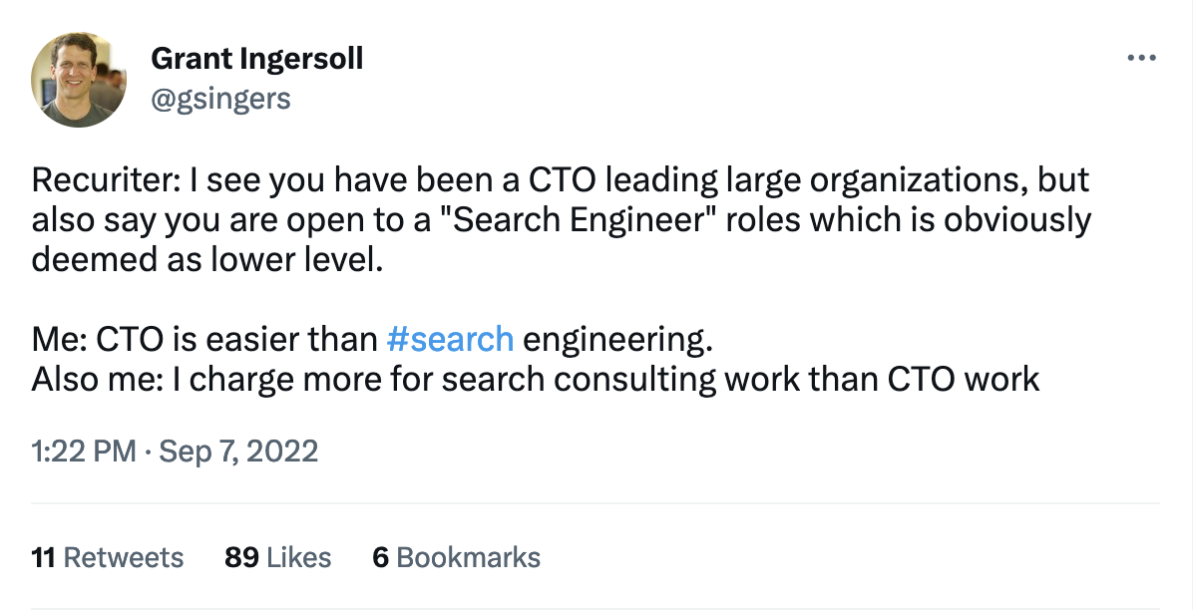
@dtaivpp

Slide 12

forum.opensearch.org
@dtaivpp
Notes:
Open source project how can we make search better for you

