Slide 1

A Cheap Trick for Question Answering
United States, 2023
for the Vector Search / GPU challenged
April 26, 2023
Sujit Pal, Elsevier Health Markets
ORCID: https://orcid.org/0000-0002-6225-110X

Slide 2
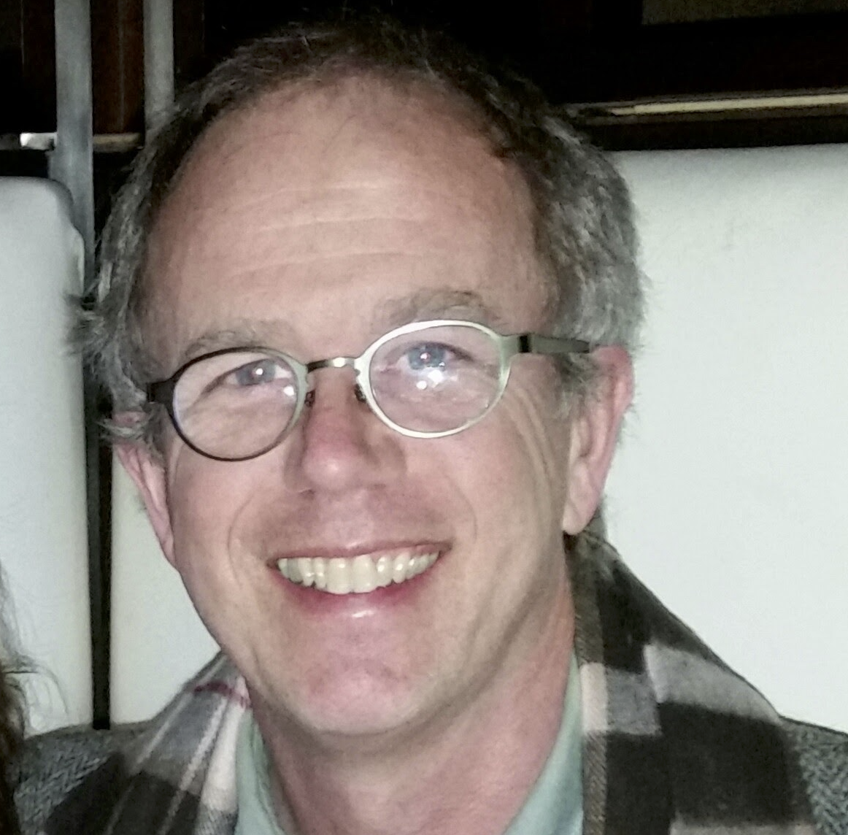
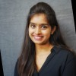

About Me / Us
Technology Research Director at Elsevier Health Markets
Previously Lucene / Solr search engineer, now Data Scientist
Interests: Search, NLP and AI / ML
Will Dowling
Sharvari Jadhav
Sujit Pal
Joint work with Sharvari Jadhav, Data Scientist at Elsevier
Being taken forward by Will Dowling, Sr. Data Scientist at Elsevier

Slide 3
Agenda
History
Introduction
Methods
Demo
Results
Conclusions

Slide 4
History
back to table of contents

Slide 5
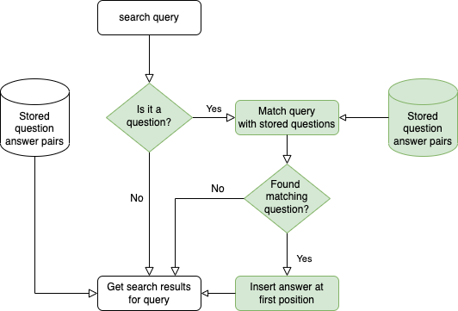
Manual FAQ Creation (2015-2017)
  Question Answer pairs created manually for “important” topics
  If query “looks like” question AND “matches” stored questions, show Question Answer pair as top result
  similar strategy to support for calculators, topic pages, other callouts
  problem: does not scale for large numbers of questions and answers

Slide 6
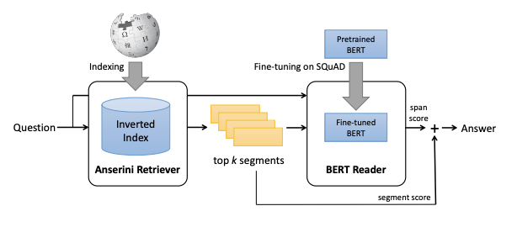
Automated Open Domain QA (2019-2020)
Motivated by SQUAD benchmarks showing super-human performance on reading comprehension tasks
Adapted retriever-reader architecture (BERTSerini)
Our experiments: 23M paras from 5000 medical books
Improved reading comprehension. results via fine-tuning
Answer quality not good enough
  0.45 @1; 0.6 @5
Put on hold until SOTA improves
 | BERT Base | SPAN BERT | SciBERT | SciBERT+CK
SQUAD 1.1 | 92 | 95 | 87.4 | 86.7
MedSQUAD | n/a | 71.3 | 84.9 | 90.2
Eval Scores (F1): Neural Component alone
 | K=1 | K=3 | K=5
CK_312 | 45 | 55 | 60
Eval Scores (F1): End to end
Image Credit: End to end Open-Domain Question Answering with BERTSerini (Wang et al, 2019)

Slide 7
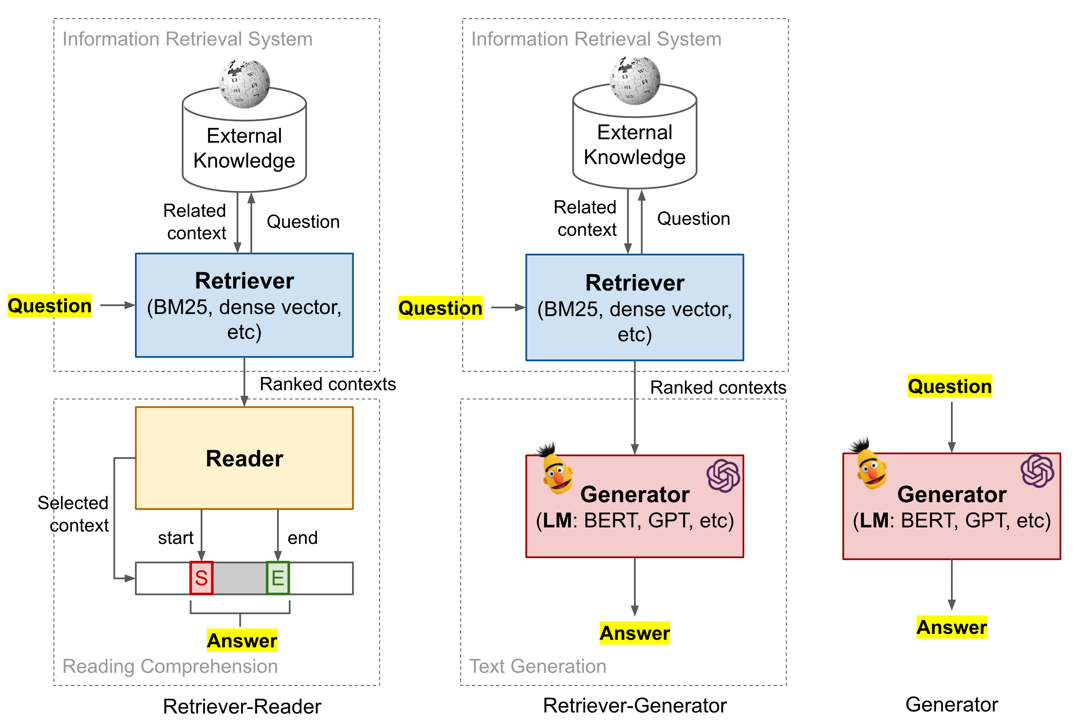
Improvements in Question Answering
Pipeline remains largely similar
Retriever-reader variously morphed:
  Retriever → trained model (Dense Retriever)
  Additional re-ranker model between Reader and Retriever
  Reader → Generator
  Jointly train Reader and Retriever
  Generator only systems (ChatGPT)
Accompanied by improvements in vector search and serving infrastructure
Models need tuning with labeled data
Image Credit: How to build an Open-Domain Question Answering System (Weng, 2020)

Slide 8
Introduction
back to table of contents

Slide 9
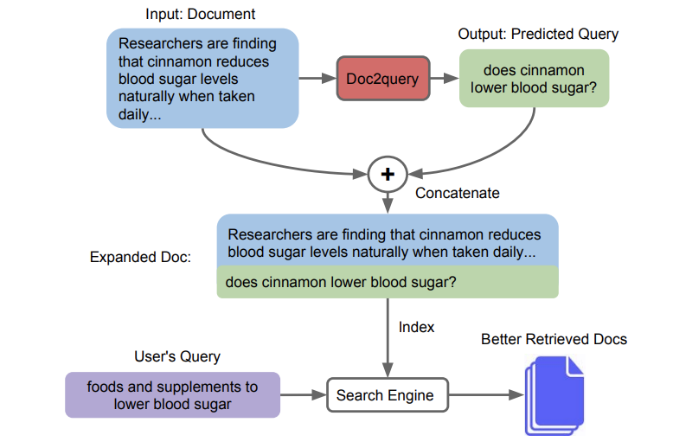

FAQ style but predict queries
doc2query (and docT5query) proposes augmenting passages with generated questions to improve retrieval effectiveness
Better results than BM25 but not as good as tuned reader-retriever
Low latency achieved by pushing expensive neural inference to indexing time.
practical way to achieve question answering with existing search infra?
Method | Eval MRR @10 | Latency (ms)
BM25 | 18.6 | 55
doc2query | 21.8 | 61
docT5query | 27.2 | 64
BM25 + BERT | 36.8 | 3500
Image Credit: Document Expansion by Query Prediction (Nogueira et al, 2019)

Slide 10
docT5query flow contrasted with retriever-reader flow
For a query q’ and a set of passage question pairs (p, q)
Retriever + Reader | Doc2query or docT5query
 | Questions q generated from each passage p
 | Write out (p, q) to index
Query q’ sent to retriever | Query q’ sent to retriever
Retriever matches q’ with passages p and returns top-N candidate passages p’ | Retriever matches q’ with generated questions q and returns associated passage p’ for top-N matches
Reader extracts answer a’ from passages p’ | Reader extracts answer a’ from passage p’

Slide 11
Other benefits of docT5query style
Ability to re-use existing search infrastructure
Low latency → minimal to no changes to query SLA
No need to build query-document labeled pairs for retriever / re-ranker models
Less chance of irrelevant answers since matching question with question
Limited risk of irrelevant (generated) questions, since they will most likely not be asked

Slide 12
Methods
back to table of contents

Slide 13
Dataset and Model
Dataset
  80k paragraphs from around 3500 Patient Guidelines
  Between 5-10 generated questions from each paragraph
Models (Question Generation)
  Base model: T5 base model fine-tuned with SQUAD and MS-MARCO
    valhalla/t5-base-e2e-qg fine-tuned on SQUAD (100k passage-question pairs)
    castorini/doc2query-t5-base-msmarco fine-tuned on MS-MARCO (107k passage-question pairs
  Fine tuned with MedQUAD (13k QA pairs) and Patient Guidelines (10k QA pairs)
Additional Models
  Model (Question Embedding) – sentence-transformers/all-MiniLM-L6-v2
  Model (Answer Extraction) – deepset/roberta-base-squad2

Slide 14
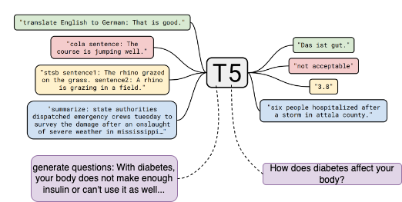
Overview of approach (Fine tuning)
  Fine-tuned 6 different models
  Base models (models 1 and 2) fine-tuned OOB on SQUAD and MS-MARCO
  Model 3 is T5-base fine tuned with MedQUAD dataset
  Model 4 is T5-base fine tuned with MS-MARCO filtered for medical questions
  Model 5 is T5-base fine tuned with Patient Guidelines train split
  Model 6 is Model 1 fine tuned with Patient Guidelines train split
  Evaluated using BLEU-4, NIST, ROUGE-L
Image Credit: Exploring the limits of Transfer Learning with a Unified Text-to-text Transformer (Raffel et al, 2020)

Slide 15
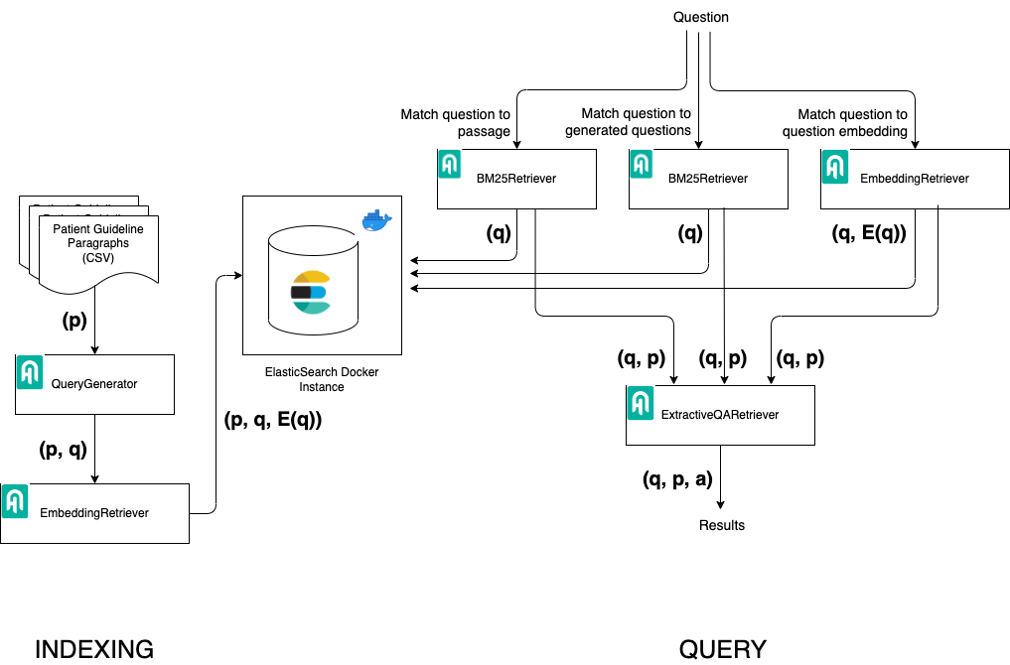
Overview of Approach (Search)
Three search flows (using Haystack from deepset)
  Compare question to passage using BM25 (baseline)
  Compare question to generated questions using BM25
  Compare question embedding to generated question embeddings using ANN
Compute MRR @1 and @10 manually for 20 randomly generated questions from corpus
  MRR @1 for our application (only top answer will get shown)
  MRR @10 for sanity checking with published numbers
DISCLAIMER: Manual evaluation done by yours truly, so chances of bias!

Slide 16

Demo
https://www.youtube.com/watch?v=3lnJkdQ8nhQ
back to table of contents

Slide 17
Results
back to table of contents

Slide 18
Evaluation of Question Generation Models
Model alias | Base model | Dataset | Processing dataset | Evaluation
 |  |  |  | BLEU-4 | NIST | ROUGE-L
Model 1 | t5-base | SQUAD dataset (100k (passage, question, answer) triples) | NA | 0.0206 | 0.1841 | 0.2002
Model 2 | t5-base | MS-MARCO dataset (100k (passage, long query) pairs from Bing) | NA | 0.0165 | 0.1042 | 0.2019
Model 3 | t5-base | MedQuAD dataset (13k (question, answer) pairs) |  | 0.0040 | 0.0306 | 0.2133
Model 4 | t5-base | MS-MARCO dataset (100k (passage, long query) pairs from Bing) | Filter questions and passages using knowledge miner to include medical content only | 0.0140 | 0.0756 | 0.1998
Model 5 | t5-base | Patient Guidelines(16k (passage, question) pairs) | No finetuning. Filter using knowledge miner | 0.0138 | 0.1229 | 0.1889
Model 6 | Model 1 | Patient Guidelines(16k (passage, question) pairs) | Finetuned. Filter using knowledge miner | 0.0141 | 0.1226 | 0.1874

Slide 19
Evaluation of Question Answering Pipelines
 | Passage BM25 |  | Question BM25 |  | Question Vector
Model | MRR @1 | MRR @10 | MRR @1 | MRR @10 | MRR @1 | MRR @10
Model 1 | 0.65 | 0.713 | 0.85 | 0.867 | 0.9 | 0.925
Model 2 | 0.45 | 0.55 | 0.7 | 0.75 | 0.7 | 0.75
Model 3 | 0.3 | 0.386 | 0.6 | 0.6 | 0.6 | 0.625
Model 4 | 0.15 | 0.231 | 0.5 | 0.558 | 0.5 | 0.533
Model 5 | 0.55 | 0.6125 | 0.75 | 0.75 | 0.75 | 0.75
Model 6 | 0.75 | 0.775 | 0.9 | 0.9 | 0.9 | 0.9
Note: Even though Model 6 showed best MRRs, we went with Model 1 for the demo because of overfitting concerns.

Slide 20
Conclusions
back to table of contents

Slide 21
Findings
Fine Tuning
MedQUAD not a good dataset to fine-tune with, passages too short
Errors in question generation – over / under-specified questions, nonsense questions, can be addressed by automatic or manual validation
Search
The docT5query approach provides better results for QA with less effort
Can reuse search infrastructure
Scope for improvement in larger dataset selection, dataset preprocessing and cleaning, automatic and manual validation of generated questions, etc.

Slide 22

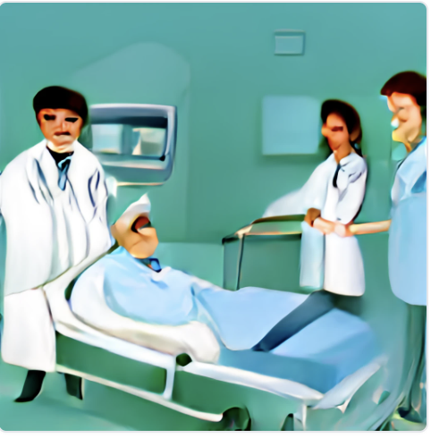

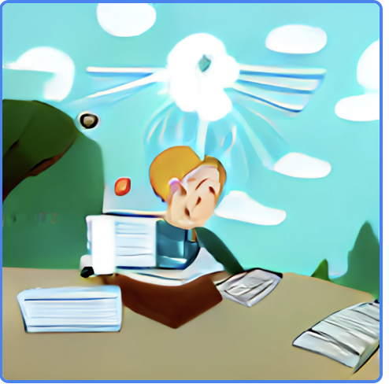
Applications
Question Answering – matching questions generated from documents to query to return answer passages
Matching patients with Clinical Trials – matching keywords in patient history with questions generated from Clinical Trial descriptions
Document Intent – measuring document utility by questions it can answer
Student Remediation – matching incorrectly answered questions to the chapters / sections student must revise
Image Credit: DALL-E Mini by craiyon.com

Slide 23




Thank you!
sujit.pal@elsevier.com
@sujitpal
@palsujit
@palsujit@hachyderm.io

